Slide 1
COMPUTER NETWORKS
Prof J. Noorul Ameen M.E, EMCAA, MISTE, IAENG.,
Assistant Professor/CSE
E.G.S Pillay Engineering College, Nagapattinam
9150132532
noornilo@gmail.com
Profameencse.weebly.com

Slide 2
Course Outcomes
At the end of this course students can able to
CO1. Explain about computer networks with its types and protocols
CO2. Explain about various routing protocols
CO3. Describe the controlling mechanisms available for flow, error and congestion control
CO4. Demonstrate various concepts in internet protocols, network services and management

Slide 3
UNIT 5-APPLICATION LAYER
Traditional applications
Electronic Mail (SMTP, POP3, IMAP, MIME)
HTTP
Web Services
DNS
SNMP

Slide 4
ELECTRONIC MAIL - EMAIL
EMAIL: It is an inexpensive application and it is fast and easy to distribute.
It includes attachments, hyperlinks, photos….
Major components of EMAIL:
(i)User Agents
(ii)Mail Servers and
(iii)Simple Mail Transfer Protocol(SMTP)
(i)User Agents:
Mail reader
Used for composing, editing and reading mail messages.

Slide 5
(ii)Mail Servers: It has mail box which contains incoming messages for user.
It contains message queue for outgoing mail messages.
It uses SMTP protocol between mail servers to send EMAIL messages.
Client: Sending mail server.
Server: Receiving mail server.
(iii)Simple Mail Transfer Protocol(SMTP): SMTP uses TCP to reliably transfer Email messages from client to server on port no 25.
SMTP directly transfer Email messages from sending mail server to receiving mail server.

Slide 6
Three phases of transfer:
(i)Handshaking
(ii)Transfer of messages
(iii)Terminating the connection
Scenario: Nilo sends message to Noor:
1. Nilo invokes her user agent for sending Email, provides Noor’s Email address, composes a message and instructs the user agent to send the message.
2. Nilo’s user agent sends message to her mail server.
Nilo’s
Noor’s
Nilo’s User agent
Noor’s User agent

Slide 7
3. The client side of SMTP, running on Nilo’s mail server sees the message in the message queue.
It opens a TCP connection to an SMTP server, running on Noor’s mail server.
4. After some initial SMTP handshaking, the SMTP client sends Nilo’s message into the TCP connection.
5. At Noor’s mail server, the server side SMTP receives the message.
Noor’s mail server then places the message in Noor’s mail box.
6. Noor invokes his user agent to read the message at his convenience.

Slide 8
Email Message Format:
header lines, e.g.,
To:
From:
Subject:
different from SMTP commands!
body
the “message”, ASCII characters only
header
body

Slide 9
Mail Access Protocols:
SMTP is used to deliver and store email messages to receivers mail server.
If receiver wants to retrieve email message from receivers mail server, then mail access protocols are needed.
Types of mail access protocols:
(i)POP3 and
(ii)IMAP
Nilo’s
Noor’s
Nilo’s User agent
Noor’s User agent

Slide 10
(i)POP3: POP3 begins when user agent opens a TCP connection to mail server on port 110.
Phases of POP3:
(a)Authorization: User agent sends user name and password to authenticate.
(b)Transaction: User agent can retrieve message, mark messages and delete messages.
(c)Update: It occurs after user agent has issued quit command to end POP3 session.
Once Noor has downloaded his message to local machine he can create folders and move downloaded messages.

Slide 11
(ii)IMAP:
It has more features than POP3.
It maintains a folder hierarchy on the remote server and it can be accessed from any computer.
IMAP associates each message with a folder.
When a message first arrives at the server, it is associated with the recipient’s INBOX FOLDER.

Slide 12
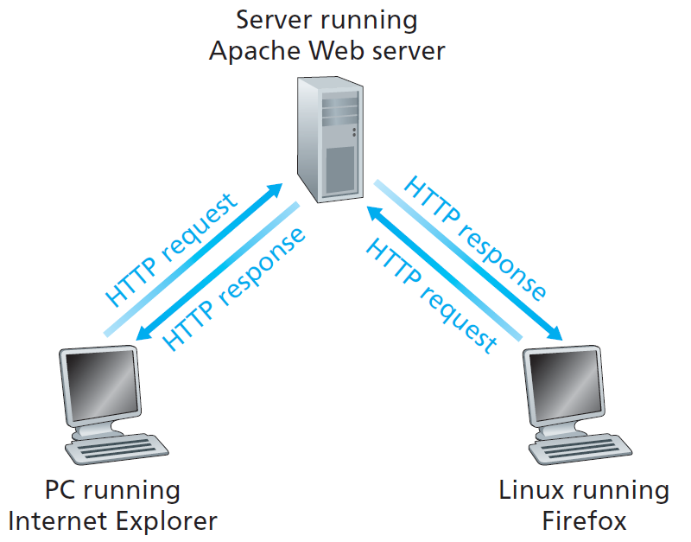
HTTP: HYPER TEXT TRANSFER PROTOCOL
HTTP: It is the world wide web’s application layer protocol.
Overview of HTTP: When a user request a web page, the browser send’s HTTP REQUEST message for the objects(ex: files) in the page to the server.
The server receives the request and responds with HTTP RESPONSE message that contains the objects.

Slide 13
HTTP - Stateless Protocol: Server sends requested files to clients without storing any state information about the client.
If particular client asks same object twice in a period of a few seconds, the server does not respond by saying that it is just served the object and the server resends the object.
Types of HTTP Connections:
(i)Non Persistent HTTP and
(ii) Persistent HTTP

Slide 14
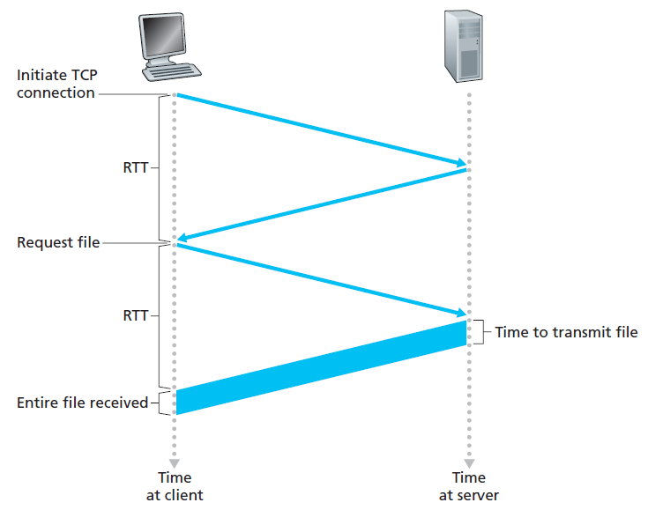
(i)Non Persistent HTTP: Only one object is sent over a single TCP connection.
After the
response message
received from the
server to client,
the connection is
closed.
Accept Connection
Response Message
Server Closes the Connection

Slide 15
(ii)Persistent HTTP: Multiple objects can be sent over a single TCP connection between client & server.
Server leaves the connection open after sending response.
Subsequent HTTP messages between same client/server are sent over the connection.
Types of Persistent connection:
(a)Persistent without Pipeline: Client issues request only when previous response has been received.
(b)Persistent with Pipeline: Client sends multiple HTTP request on a single TCP connection without waiting for corresponding responses.

Slide 16
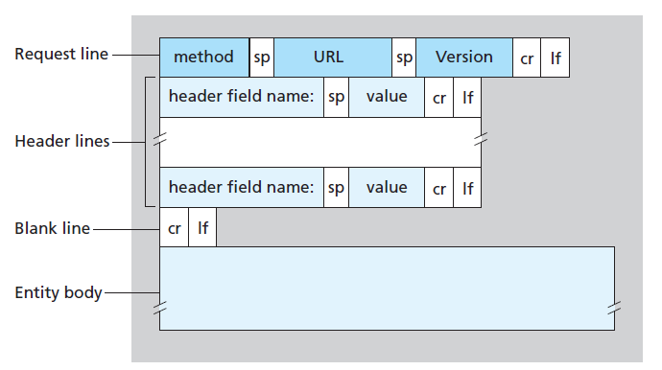
HTTP Message Formats:
HTTP Request Message:

Slide 17
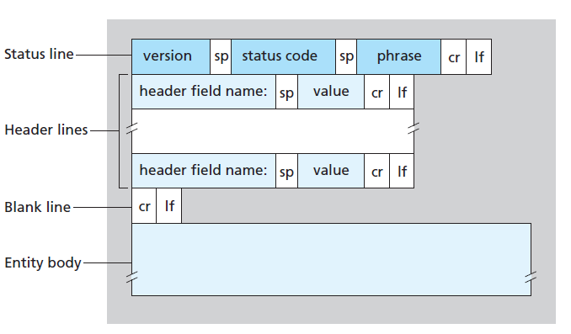
HTTP Response Message:

Slide 18
HTTP Status Codes: It indicates whether a specific HTTP request or HTTP response is completed successfully or not.
Status Codes:
200: Ok – Request succeeded and information is returned in the response.
301: Moved Permanently
400: Bad Request
404: Not Found
505: HTTP version not supported – The requested HTTP protocol version is not supported by the server.

Slide 19
Cookies: It allow websites to keep track of users.
Components of Cookie:
1. Cookie header line in HTTP response message.
2. Cookie header line in HTTP request message.
3. Cookie file kept on user’s host & managed by users browser.
4. Back – end database at website.
Web Caching: Web cache is also called as proxy server.
It is a network entity that satisfies HTTP request on behalf of an origin web server.
The web cache has its own disk storage and keeps copies of recently requested objects in this storage.

Slide 20
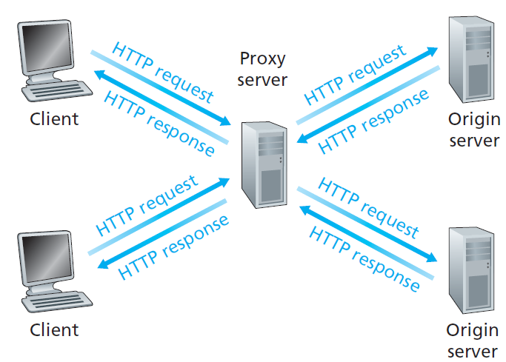
Clients requesting objects through a web cache

Slide 21
STEPS IN WEB CACHING:
1. Browser establishes a TCP connection to the web cache(Proxy Server) and sends an HTTP request for objects.
2. The web cache checks the presence of object stored locally.
3. If it has, it forwards the object within an HTTP response message to the client’s browser.
4. If the web cache does not have the object, the web cache opens a connection to the origin server and sends HTTP request for objects.
5. When the web cache receives the object, it stores a copy in its local storage and forwards a copy to the client’s browser.

Slide 22
WEB SERVICES
Web services are web applications that interacts with other web applications for the purpose of exchanging data.
Web services can convert existing application in to web applications.
Web services describes a standardized way of integrating web based application using XML, SOAP, WSDL & UDDI over Internet.
XML: It is short for Extensible Markup Language, used to tag the data.
It allows designers to create their own automated tags.

Slide 23
SOAP: Short for Simple object access protocol, a XML based messaging protocol used to prepare the information in the web service request and response messages before sending them over a network.
WSDL: Short for Web Services Description Language, used to describe the available web services and its capability.
UDDI: Short for Universal Description, Discovery and Integration, used for listing available services.

Slide 24
SNMP – SIMPLE NETWORK MANAGEMENT PROTOCOL
SNMP provides facilities for managing and monitoring network resources on the Internet.
Components of SNMP:
1. SNMP Managing Entity
2. SNMP Managed Device
3. SNMP Managed Objects
4. SNMP Agents
5. Management Information Base
6. SNMP Messages(PDU)

Slide 25
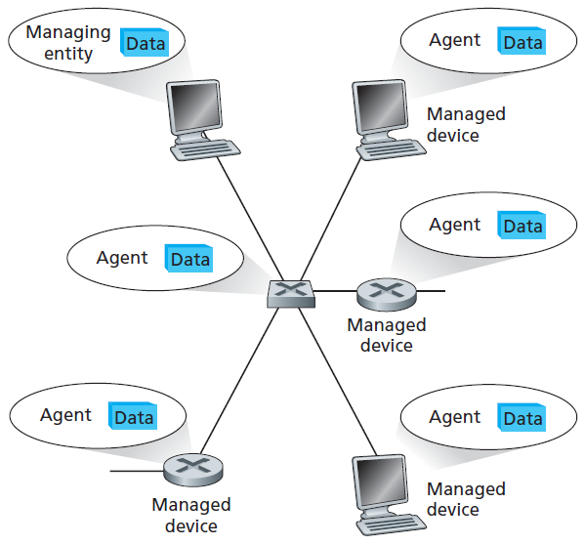
Principle components of SNMP Network Management Architecture

Slide 26
1.SNMP Managing Entity(SNMP MANAGER): It is an application, typically with a human being running in a centralized network management station.
It controls the collection, processing, analysis and display of network management information.
2.SNMP Managed Device: It is a piece of network equipment that resides on a managed network.
A managed device might be host, router, bridge, hub, printer or modem…
Within a managed device, there may be several managed objects.

Slide 27
3. SNMP Managed Objects: These are actual pieces of hardware within the managed device.
EX: Network Interface Card(NIC) and the set of Configuration parameters.
These managed objects have pieces of information called management information that are collected into a management information base(MIB).
Each managed object is assigned with an object identifier(OID).
The OID can be represented as a sequence of integers separated by decimal points.
When a SNMP manager requests an object, the SNMP Agent sends the OID.

Slide 28
4. SNMP Agents: It is a software that runs on managed device.
5. Management Information Base: In Internet, management information is represented as a collection of virtual information store known as management information base.
It may be no of IP datagrams discarded at a router due to errors or errors in NIC card.
It may be information such as version of software running on server.
It may be status information about functioning of particular device.
Related MIB objects are gathered in to MIB modules.

Slide 29
Selected Managed Objects in the MIB – 2 UDP Module

Slide 30
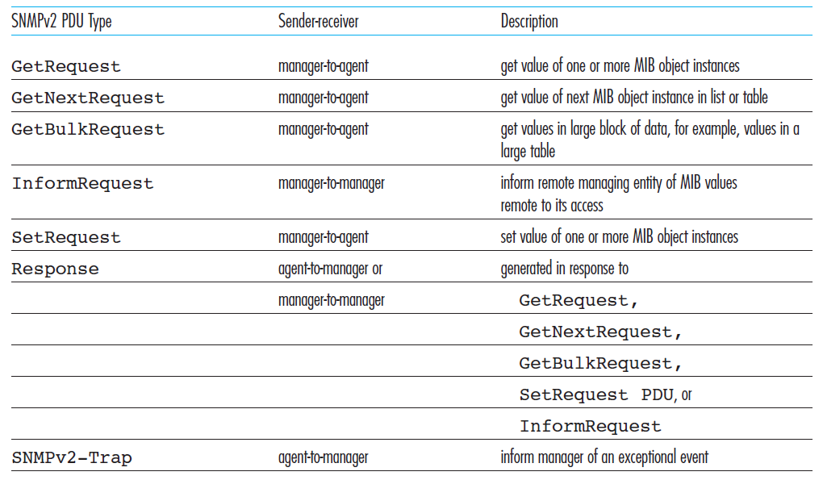
6. SNMP Messages(PDU): SNMP defines 7 types of messages known as protocol data unit(PDU).

Slide 31
DNS – DOMAIN NAME SERVICE
DNS is an internet service that translates domain names in to IP addresses.
There are 2 ways to identify a host:
(a)By a domain(host) name
(b)By an IP address
Domain(host) names are alphabetic(mnemonics) and easy to remember.
But the internet is really based on IP addresses and not easy to remember.
If a domain name is used, a DNS service must translate it in to the corresponding IP address.
This is the main task of DNS.

Slide 32
Scenario: In order to send HTTP request message to web server www.someschool.edu, the user’s host must obtain the IP address of www.someschool.edu.
This can be done as
1.The user host runs the client side DNS application.
2.The browser extracts the host name www.someschool.edu from the URL.
3.The DNS client sends a query containing the host name to a DNS server.
4.The DNS client eventually receives a reply, which includes IP address for the host name.
Once the browser receives the IP address from the DNS server, It can initiate TCP connection to HTTP server process located at that IP address.

Slide 33
Other Services Provided by DNS:
(a)Host aliasing:
Ex: www.relay1.west-coast.enterprise.com
Canonical Host Name
www.enterprise.com
Alias name
(b)Mail server aliasing:
Ex: relay1.west-coast.hotmail.com
Canonical host name
bob@hotmail.com
Alias name

Slide 34
(c)Load Distribution: DNS is used to perform load distribution among replicated web servers.
Busy sites such as amazon.com are replicated over multiple servers, with each server running on different end system and having different IP address.
This set of IP addresses is associated with one canonical name and it is contained in DNS database.

Slide 35
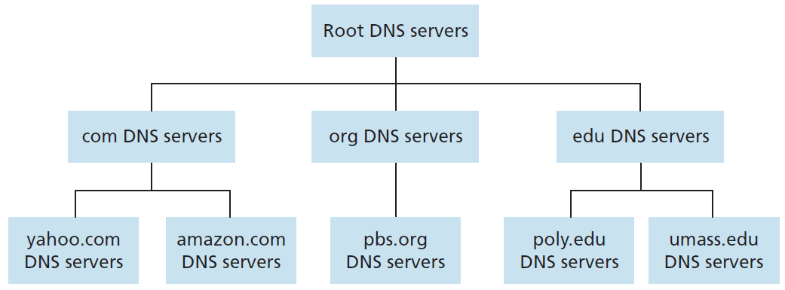
A Distributed Hierarchical Database:

Slide 36
Three classes of DNS Servers:
(a)Root DNS Servers: In Internet there are 13 root DNS servers labeled from A to M, most of which are located in north America.
(b)Top Level Domain(TLD) Servers: These servers are responsible for top level domains such as .com, org, net, edu and gov… and all of the country top level domains such as .uk, fr, ca, jp and in…
(c)Authoritative DNS Servers: Every organization with publicly addressable hosts on the Internet, must provide publicly accessible DNS records that maps the names of those host to IP addresses.

Slide 37
In addition to the above three types of DNS Servers there is another important type of DNS server, called Local DNS server.
LOCAL DNS SERVER: Each ISP has a Local DNS Server also called as default name server.
When a host connects to an ISP, it provides the host with IP address.

Slide 38
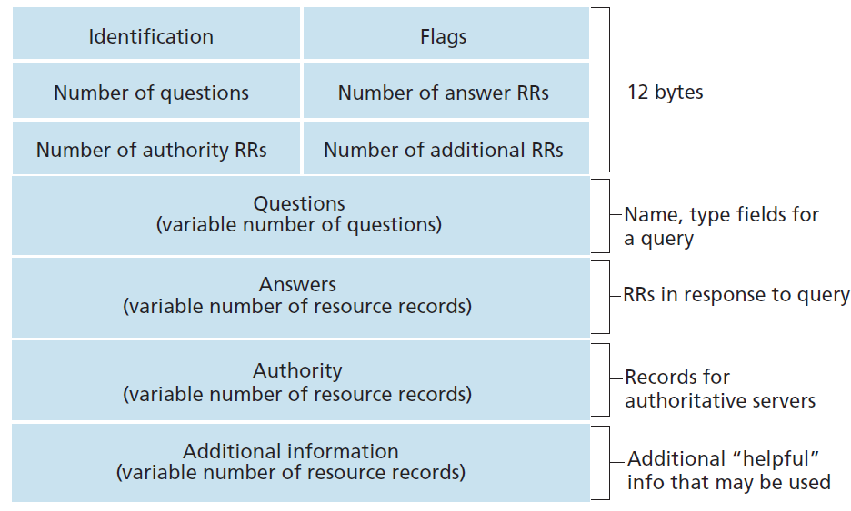
DNS Message Format:

Slide 39
DNS Records and Messages: DNS servers stores resource records that provides host name to IP address mappings.
Resource Record: It has four components namely “Name, value, Type and TTL”.
If Type=A, then name is a host name and value is the IP address for the host name.
If Type=NS, then name is a host name and value is the host name of an authoritative server.
If Type=CNAME, then value is a canonical host name for the alias host name.
If Type=MX, then value is the canonical name of the mail server, that has an alias host name.

Slide 40
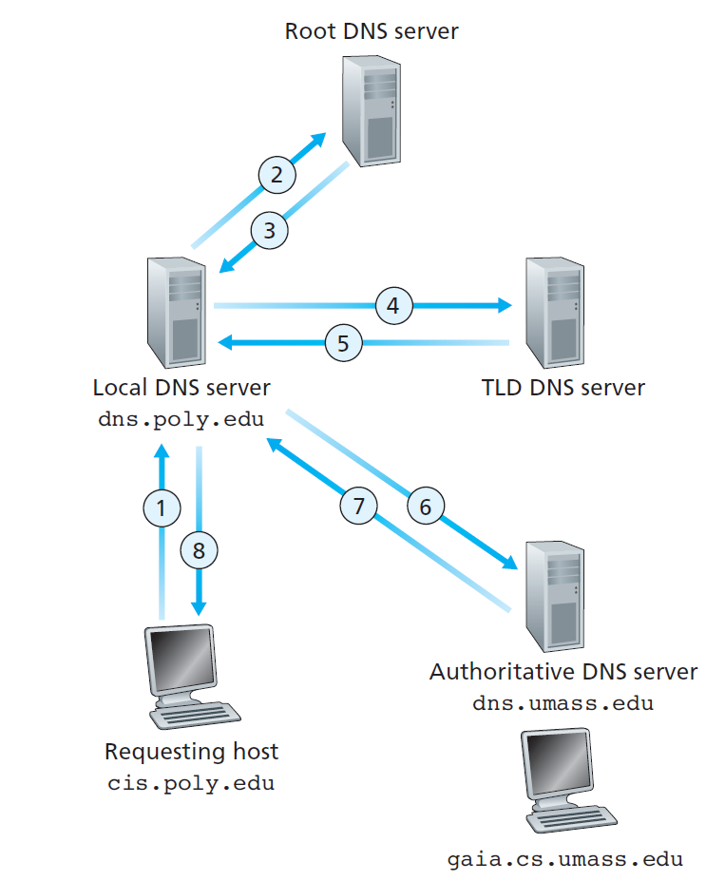
DNS Lookup Process:

Slide 41
Suppose the host cis.poly.edu desires the IP address of gaia.cs.umass.edu.
Also suppose that Polytechnic’s local DNS server is called dns.poly.edu and that an authoritative DNS server for gaia.cs.umass.edu is called dns.umass.edu.
1. The host cis.poly.edu first sends a DNS query message to its local DNS server, dns.poly.edu. The query message contains the hostname to be translated, namely, gaia.cs.umass.edu.
2. The local DNS server forwards the query message to a root DNS server.
3. The root DNS server takes note of the edu suffix and returns to the local DNS server a list of IP addresses for TLD servers responsible for edu.

Slide 42
4. The local DNS server then resends the query message to one of these TLD servers.
5. The TLD server takes note of the umass.edu suffix and responds with the IP address of the authoritative DNS server for the University of Massachusetts, namely, dns.umass.edu.
6 The local DNS server resends the query message directly to dns.umass.edu(authoritative DNS server).
7. The authoritative DNS server, dns.cs.umass.edu responds with the IP address of gaia.cs.umass.edu.
8. The local DNS server then sends the IP address of gaia.cs.umass.edu to the requesting host cis.poly.edu.

