Slide 1
1702CS704 – CLOUD COMPUTING
Prof J. Noorul Ameen M.E,(Ph.D), EMCAA, MISTE, D.Acu.,
Assistant Professor/CSE
E.G.S Pillay Engineering College, Nagapattinam
9150132532
noornilo@gmail.com
Profameencse.weebly.com

Slide 2
Course Outcomes
At the end of this course students can able to
CO1: Understand the differences between traditional
and Cloud deployment
CO2: Understand technical and business viability of
migrating existing applications to cloud
CO3: Deploy cloud applications on AWS and Azure
CO4: Design and build cloud based applications
CO5: Design scalable cloud environment for elastic demands

Slide 3
UNIT 1 – CLOUD ARCHITECTURE BASICS
Introduction to Cloud Computing
Hype cycle
Metaphorical interpretation
Cloud architecture, standards and interoperability
Cloud types: IaaS, PaaS, SaaS.
Benefits and challenges of cloud computing
Public, private clouds community cloud,
Role of virtualization in enabling the cloud.

Slide 4
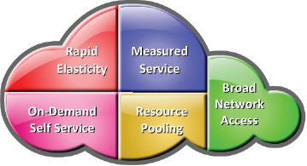
CLOUD COMPUTING
A model for enabling ubiquitous, convenient, on-demand network access to a shared pool of configurable computing resources (e.g., servers, storage, networks, applications, and services) that can be rapidly provisioned and released with minimal management effort or service provider interaction.
Characteristics of Cloud Computing:

Slide 5
On Demand Self Service:
Enables consumers to get computing resources as and when required, without any human intervention
Facilitates consumer to leverage “ready to use” services or, enables to choose required services from the service catalog
Allows provisioning of resources using self-service interface
Self-service interface should be user-friendly

Slide 6
Broad Network Access:
Cloud services are accessed via the network, usually the internet, from a broad range of client platforms such as:
Desktop computer
Laptop
Mobile phone
Thin Client
Eliminates the need for accessing a particular client platform to access the services
Enables accessing the services from anywhere across the globe

Slide 7
Resource Pooling:
IT resources (compute, storage, network) are pooled to serve multiple consumers
Based on multi-tenant model
Consumer has no knowledge about the exact location of the resources provided
Resources are dynamically assigned and reassigned based on the consumer demand

Slide 8
Rapid Elasticity:
Ability to scale IT resources rapidly, as required, to fulfill the changing needs without interruption of service
Resources can be both scaled up and scaled down dynamically
To the consumer, the Cloud appears to be infinite
Consumers can start with minimal computing power and can expand their environment to any size

Slide 9
Measured Service:
Consumers are billed based on the metered usage of Cloud resources
Cost incurred on a pay-per-use basis
Pricing/billing model is tied up with the required service levels
Resource usage is monitored and reported, which provides transparency for chargeback to both Cloud service provider and consumer about the utilized service

Slide 10
Hype Cycle:
The hype cycle is a branded graphical presentation developed and used by the American research, advisory and information technology firm Gartner to represent the maturity, adoption, and social application of specific technologies.
The hype cycle claims to provide a graphical and conceptual presentation of the maturity of emerging technologies through five phases.

Slide 11
Five Phases of Hype Cycle:
Innovation Trigger: A potential technology breakthrough kicks things off. Early proof-of-concept stories and media interest trigger significant publicity. Often no usable products exist and commercial viability is unproven. Peak of Inflated Expectations: Early publicity produces a number of success stories — often accompanied by scores of failures. Some companies take action; many do not. Trough of Disillusionment: Interest wanes as experiments and implementations fail to deliver. Producers of the technology shake out or fail. Investments continue only if the surviving providers improve their products to the satisfaction of early adopters. Slope of Enlightenment: More instances of how the technology can benefit the enterprise start to crystallize and become more widely understood. Second- and third-generation products appear from technology providers. Plateau of Productivity: Mainstream adoption starts to take off. Criteria for assessing provider viability are more clearly defined. The technology's broad market applicability and relevance are clearly paying off.

Slide 12
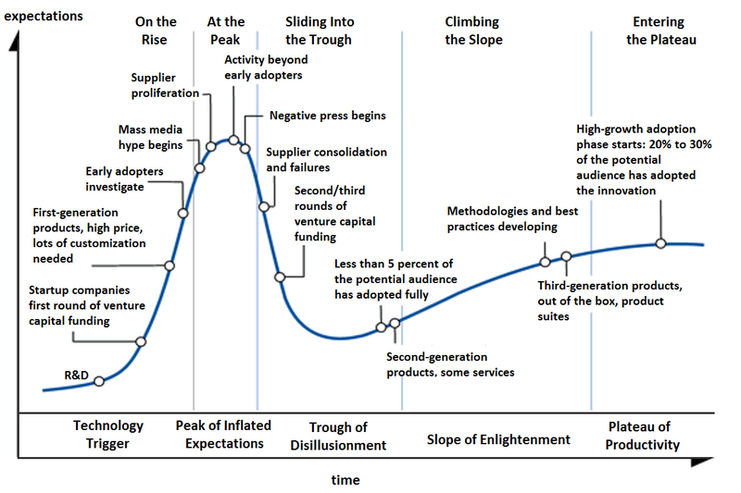
Five Phases of Hype Cycle:

Slide 13
Industry analysts use a “Hype Cycle” developed by Gartner to describe the tendency for new technologies to garner an excess of interest long before they are mature enough to be deployed in production environments.
At the Gartner Emerging Technologies conference in 2008, analysts Daryl Plummer and Thomas Bittman made a bold declaration that: “By 2012, 80 percent of Fortune 1000 companies will pay for some cloud computing service, and 30 percent of them will pay for cloud computing infrastructure”.
While it is always difficult to predict the future, the signs are appearing that cloud computing is poised for a breakthrough.

Slide 15
Metaphorical Interpretation of Cloud Computing:
There is a reason why the term cloud computing has established itself rather than other conceivable terms such as forest computing or ocean computing.
A cloud has long been used in network diagrams to represent a sort of black box where the interfaces are well known but the internal routing and processing is not visible to the network users.
A cloud, by nature, is opaque. It is also typically very large and distant.
The metaphor applies elegantly to cloud computing where not only the internal substance is opaque but also the boundaries are blurred; clouds may be overlapping; they may dynamically intersect or split.

Slide 16
Cloud Architecture:

Slide 17
The cloud computing reference model is abstract model that characterizes and standardizes the functions of a cloud computing environment by partitioning it into abstraction layers and cross-layer functions.
This reference model groups the cloud computing functions and activities into five logical layers and three cross-layer functions.
The five layers are physical layer, virtual layer, control layer, service orchestration layer, and service layer.
Each of these layers specify various types of entities that may exist in a cloud computing environment, such as compute systems, network devices, storage devices, virtualization software, security mechanisms, control software, orchestration software, management software, and so on. It also describes the relationships among these entities.
The three cross-layer function are business continuity, security, and service management.
Business continuity and security functions specify various activities, tasks, and processes that are required to offer reliable and secure cloud services to the consumers.
Service management function specify various activities, tasks, and processes that enables the administrations of the cloud infrastructure and services to meet providers business requirements and consumers expectation.

Slide 18
Physical Layer: Physical layer is the foundation layer of the cloud infrastructure.
Physical layer specifies the physical entities that operate at this layer such as compute systems, networking devices, and storage devices.
This layer also specifies the entities such as operating environment, protocols, tools, and processes that enables the physical entities of this layer to perform their functions and serves other layers of the cloud infrastructure.
A key function of this layer is to execute the request generated from the virtualization layer or control layer.
Examples of requests from the layers includes storing data on the storage devices, performing communication among compute systems, executing programs on a compute systems, creating backup copy of data, or executing security policy to block an unauthorized activity.

Slide 19
Virtual Layer: virtual layer is deployed on the physical layer. It specifies the entities that operate at this layer such as virtualization software, resource pools, and virtual resources.
A key function of this layer is to abstract physical resources, such as compute, storage, and network, and making them appear as virtual resources.
Virtualization software deployed on compute systems, network devices, and storage devices perform the abstraction of the physical resources on which they are deployed.
Abstracting the physical resources enables multitenant environment, thereby improving utilization of the physical resources.
Improved utilization of physical resources results in increased return-on-investment (ROI) on the infrastructure entities.
Virtualization software is also responsible for pooling physical resources from which virtual resources are created.
Examples of virtual resources include virtual machines, virtual volume, and virtual network.

Slide 20
The request to create resource pools and virtual resources is generated by the control layer.
After receiving the request from the control layer, the virtual layer executes the requests.
Apart from creating resource pools and virtual resources, virtualization software also support features that enables optimized resource utilization that further increases return-on-investment.
Other key functions of this layer includes executing the requests generated by control, and it also include forwarding requests to the physical layer to get them executed.
Examples of requests generated by control layers include creating pools of resources and creating virtual resources

Slide 21
Control Layer: Control layer can be deployed either on virtual layer or on physical layer. It specifies the entities that operate at this layer such as control software.
A key function of this layer includes executing the requests generated by service layer in collaboration with orchestration layer.
Another key function of this layer includes forwarding requests to the virtual and/or physical layer to get them executed.
Examples of requests generated by service layer includes creating service instance such as compute system instance for IaaS and application instance for SaaS.
The other key functions that are performed by control software are resource configuration, resource pool configuration, and resource provisioning.
The control software in collaboration with virtualization software enables resource pooling, dynamic allocation of resources, creating virtual resources, and optimizing utilization of resources.
The control software initiates all the requests such as resource configuration, resource pooling, resource provisioning, and so on. These requests are passed on to the virtual layer or physical layer.
This layer also exposes resources (physical and/or virtual) to and supports the service layer where cloud service interfaces are exposed to
consumers.

Slide 22
Service Orchestration Layer: It specifies the entities that can operate at this layer such as a orchestration software.
A key function of this layer is to provide workflows for executing automated tasks to accomplish a desired outcome.
Workflow refers to a series of interrelated tasks that perform a business operation.
The orchestration software enables this automated arrangement, coordination, and management of the tasks.
This helps to group and sequence tasks with dependencies among them into a single, automated workflow associated with each service listed in the service catalog.
When a consumer selects a service from the service catalog, an associated workflow in the orchestration layer is triggered.
Based on this workflow the orchestration software interacts with various entities (from control layer, business continuity function, security function, and service management function) to invoke provisioning tasks to be executed by the entities.

Slide 23
Service Layer: The service layer is accessible to the cloud consumers’. This layer specifies the entities that can operate at this layer such as service catalog and self-service portal.
A key function of this layer is to store and present the information about all the services offered to the cloud consumers’ in a service catalog.
A service catalog is a database of information about the cloud services offered by a service provider.
The service catalog includes a variety of information about the services, including description of the services, the types of services, cost, supported SLAs, security mechanisms, and so on.
Another key function of this layer is to enable cloud consumers to access and manage the cloud services via a self-service portal.
A self-service portal displays the service catalog to consumers. Consumers can use this web portal to request cloud services.
In addition to the service catalog it also provides interface to access and manage rented service instances.
The provisioning and management requests are passed on the orchestration layer, where the orchestration workflows to fulfill the requests.

Slide 24
CROSS LAYER FUNCTION:
1. Business Continuity: Business continuity (BC) function specifies the adoption of proactive and reactive measures that enables a business to mitigate the impact of planned and unplanned downtime.
Proactive measures include activities, tasks, processes such as business impact analysis, risk assessment, and technology solutions deployment (such as backup and replication).
Reactive measures include activities, tasks, processes such as disaster recovery and disaster restart to be invoked in the event of a service failure.
This function supports all the layers to provide uninterrupted services to the consumers.
The BC function in a cloud environment enables a business to ensure availability of services in line with the Service
Level Agreement (SLA).

Slide 25
2. Security: Security function specifies the adoption of administrative and technical mechanism that can mitigate or minimize security threats and provides a secure cloud environment.
Administrative mechanisms include security and personnel policies or standard procedures to direct the safe execution of various operations.
Technical mechanisms are usually implemented through tools or devices deployed on the IT infrastructure.
Examples of technical mechanisms include firewall, intrusion detection and prevention systems, antivirus, and so on.
This function supports all the layers to provide secure services to the consumers.

Slide 26
3. Service Management: Adoption of service management enables an organization to align the creation and delivery of cloud services to meet their business objectives and to the expectations of cloud service consumers.
Service portfolio management encompasses the set of business-related services that:
• Define the service roadmap, service features, and service levels
• Assess and prioritize where investments across the service portfolio are most needed
• Establish budgeting and pricing
• Deal with consumers in supporting activities such as taking orders, processing bills, and collecting payments
Service portfolio management also performs market research, measures service adoption, collects information about competitors, and analyzes feedback from consumers in order to quickly modify and align services according to consumer needs and market conditions.

Slide 27
Service operation management enables cloud administrators to manage cloud infrastructure and services.
Service operation management tasks includes the handling of infrastructure configuration, resource provisioning, problem resolution, capacity, availability, and compliance conformance.
All of these tasks enables ensuring that services and service levels are delivered as committed. Service operation management also includes monitoring
cloud services and their constituent elements. This enables the provider to gather
information related to resource consumption and generate bills.
This function supports all the layers to perform monitoring, management, and reporting for the entities of the infrastructure.

Slide 28
Cloud Standards and Interoperability: Cloud computing is a service based model for delivering IT infrastructure and applications like utilities such as power, water, and electricity.
To fully realize this goal, introducing standards and allowing interoperability between solutions offered by different vendors are more important.
Vendor lock-in is one of the major barriers against the seamless adoption of cloud computing at all stages.
Vendor lock-in can prevent a customer from switching to another competitor’s solution, or when this is possible, it happens at considerable conversion cost and requires significant amounts of time.
This can occur either because the customer wants to find a more suitable solution for customer needs or because the vendor is no longer able to provide the required service.
The presence of standards that are actually implemented and adopted in the cloud computing community could give room for interoperability and then lessen the risks resulting from vendor
lock-in.

Slide 29
The first steps toward a standardization process have been made, and a few organizations, such as the Cloud Computing Interoperability Forum (CCIF), the Open Cloud Consortium, and the DMTF Cloud Standards Incubator, are leading the path.
In the IaaS market, the use of a proprietary virtual machine format constitutes the major reasons for the vendor lock-in, and efforts to provide virtual machine image compatibility between IaaS vendors can possibly improve the level of interoperability among them.
The Open Virtualization Format (OVF) is an attempt to provide a common format for storing the information and metadata describing a virtual machine image.

Slide 30
TYPES OF CLOUD SERVICES: A cloud service model specifies the cloud services and the capabilities that are provided to consumers.
National Institute of Standards and Technology (NIST) classifies cloud service offerings into the three primary models listed below.
1. Infrastructure as a Service (IaaS)
2. Platform as a Service (PaaS)
3. Software as a Service (SaaS)
The different service models provide different capabilities and are suitable for different customers and business objectives.

Slide 31
1. Infrastructure as a Service (IaaS): Provides capability to the consumer to hire infrastructure components such as servers, storage, and network.
Enables consumers to deploy and run software, including OS and applications.
The consumer hires these resources as a service based on needs and pays only for the usage.
The consumer is able to deploy and run any software, which may include Operating Systems (OSs) and applications.
The consumer does not manage or control the underlying Cloud infrastructure, but has control over the Oss and deployed applications.

Slide 32
Amazon Elastic Compute Cloud (EC2) is an IaaS model that provides resizable compute capacity on a pay-per-use basis.
Allows consumers to hire virtual compute on which they run their own applications
EMC Atmos Online provides Storage as a service.
Internet accessible, on demand storage
Fig: Infrastructure as a Service(IaaS)

Slide 33
2. Platform as a Service (PaaS): Capability provided to the consumer to deploy consumer created or acquired applications on the Cloud provider’s infrastructure.
Consumer has control over
Deployed applications
Possible application hosting environment configurations
Here, the consumer does not manage or control the underlying Cloud infrastructure, such as network, servers, OSs, and storage, but controls the deployed applications and possibly the application-hosting environment configurations.
For PaaS, consumers pay only for the platform software components such as databases, OS instances, and middleware, which includes its associated infrastructure cost.

Slide 34
Google App Engine provides platform for consumers to deploy or create their own applications
Allows dynamic allocation of system resources for an application based on the actual demand
Provides Java and Python environment to create and deploy application
Microsoft Azure Platform provides diverse functionalities to build applications
Uses existing skills with Visual Studio and .Net to build applications
Builds applications also in Java and PHP using Eclipse and other tools
Fig: Platform as a Service (PaaS)

Slide 35
3. Software as a Service (SaaS): Capability provided to the consumer to use provider’s applications running in a Cloud infrastructure.
Complete stack including application is provided as a service
Application is accessible from various client devices, for example, via a thin client interface such as a Web browser
Billing is based on the application usage.
The consumers will use only the applications they really want and pay a subscription fee for the usage.
The Cloud service provider will host and manage the required infrastructure and applications to support these services.
SaaS offers the following advantages:
Reduces the need for infrastructure because storage and compute powers can be provided remotely.
Reduces the need for manual updates because SaaS providers can perform those tasks automatically.

Slide 36
EMC Mozy is a Software-as-a-Service solution for on-line backup
Consumers can leverage the Mozy console to perform automatic, secured, online backup and recovery of their data with ease
Salesforce.com is a Software-as-a-Service solution for CRM application
Consumers can access CRM applications from anywhere, any time
Fig: Software as a Service (SaaS)

Slide 37
Cloud Deployment Model: It provides a basis for how cloud infrastructure is built, managed and accessed.
NIST specifies the four primary cloud deployment models listed below
• Public cloud
• Private cloud
• Hybrid cloud
• Community cloud
The cloud deployment models may be used for any of the cloud service models – IaaS, PaaS and SaaS.

Slide 38
1. Public Cloud:
A public cloud is a cloud infrastructure deployed by a provider to offer cloud services to the general public and/or organizations over the Internet.
In the public cloud model, there may be multiple tenants (consumers) who share common cloud resources.
A provider typically has default service levels for all consumers of the public cloud.
The provider may migrate a consumer’s workload at any time and to any location.
Public cloud services may be free, subscription-based or provided on a pay-per use model.

Slide 39
Fig: Public Cloud

Slide 40
2. Private Cloud: A private cloud is a cloud infrastructure that is set up for the sole use of a particular organization.
The cloud services implemented on the private cloud are dedicated to consumers, such as the departments and business units within the organization.
With a public cloud, an organization may have concerns related to privacy, external threats, and lack of control over the computing resources and data.
When compared to a public cloud, a private cloud offers an organization a greater degree of privacy, and control over the cloud infrastructure, applications and data.
The private cloud model is typically adopted by larger-sized organizations that have the resources to deploy
and operate private clouds.

Slide 41
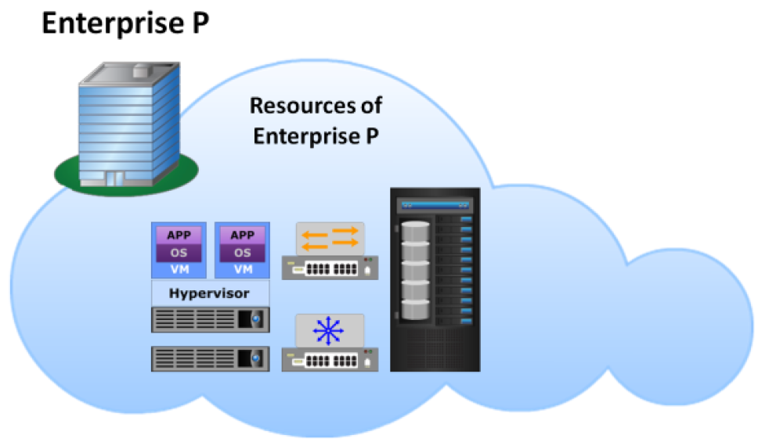
Fig: Private Cloud

Slide 42
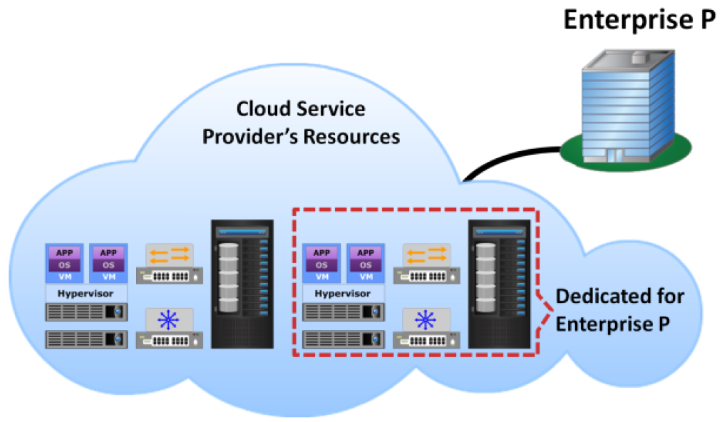
There are two variants of a private cloud
On-premise and
Externally-hosted.
Fig: On premise cloud Fig: Externally hosted
Cloud

Slide 43
3. Community Cloud: A community cloud is a cloud infrastructure that is set up for the sole use by a group of organizations with common goals or requirements.
The organizations participating in the community typically share the cost of the community cloud service.
If various organizations operate under common guidelines and have similar requirements, they could all share the same cloud infrastructure and lower their individual investments.
Community cloud may offer a higher level of control and protection against external threats than a public cloud.

Slide 44
Fig: Community Cloud

Slide 45
4. Hybrid Cloud: A hybrid cloud is composed of two or more individual clouds, each of which can be private, community, or public clouds.
Hybrid cloud has different properties in terms of parameters such as performance, cost, security, and so on.
In a hybrid cloud environment, the components of clouds are combined through the use of open or proprietary technology, such as interoperable standards, architectures, protocols, data formats, application programming interfaces (APIs), and so on.
The use of such technology enables data and application portability.

Slide 46
Fig: Hybrid Cloud

Slide 47
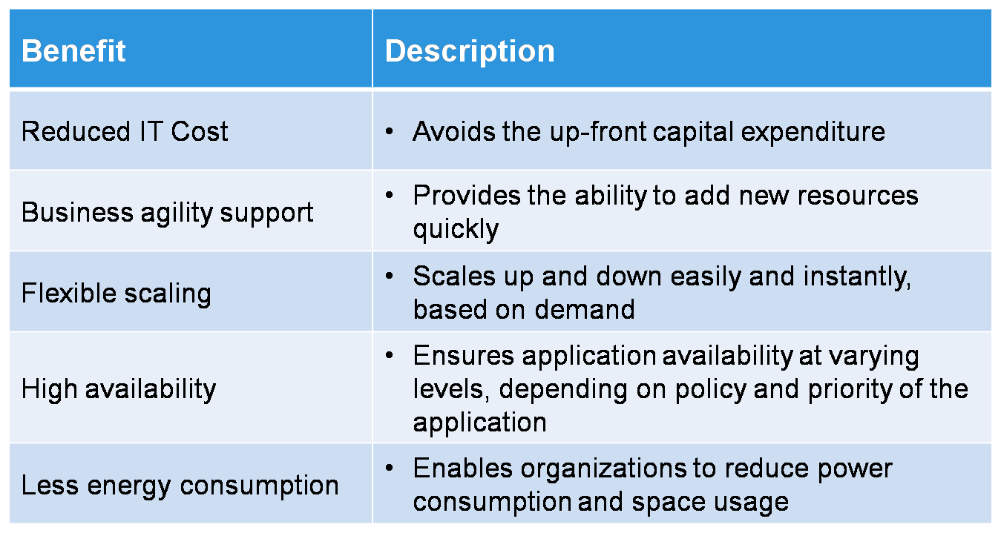
Benefits of Cloud Computing:

Slide 48
Cloud Challenges(Consumer’s Perspective):
Security and Regulation
Consumers are indecisive to transfer control of sensitive data
Regulation may prevent organizations to use Cloud services
Network latency
Real time applications may suffer due to network latency and limited bandwidth
Supportability
Legacy or Custom applications may not be compatible with Cloud platform
Interoperability
Lack of standardization across Cloud-based platforms

Slide 49
Cloud Challenges(Provider’s Perspective):
Service warranty and service cost
Resources must be kept ready to meet unpredictable demand
Hefty penalty, if SLAs are not fulfilled
Huge numbers of software to manage
Huge number of applications and platform software to purchase
ROI is unpredictable
No standard Cloud access interface
Cloud customers want open APIs
Need agreement among Cloud providers for standardization

Slide 50
Role of virtualization in enabling the cloud:
Virtualization: It refers to the logical abstraction of physical resources (such as compute, network, and storage) that enables a single hardware resource to support multiple concurrent instances of systems or multiple hardware resources to support single instance of system.
This involves making physical resources appear as a logical resources that are able to transcend their physical constraints.
For example, multiple disk drives can be concatenated and presented as a single disk drive to a compute system.
Similarly, a single disk drive can be partitioned and presented as multiple disk drives to a compute system.
With virtualization, it is also possible to make a resource appear larger than it actually is.
Further, the abstraction of physical resources due to virtualization enables multitenant environment, which improving utilization of the physical resources.

Slide 51
Benefits of Virtualization:
Optimizes utilization of IT resources
Reduces cost and management complexity
Reduces deployment time
Increases flexibility

