Slide 1
Module – 3
Virtualized Data Center – Compute
Notes:
Module – 3
Virtualized Data Center – Compute

Slide 2
Module 3: Virtualized Data Center – Compute
Upon completion of this module, you should be able to:
  Describe compute virtualization
  Discuss the compute virtualization techniques
  Explain the virtual machine (VM) components
  Describe resource management and resource optimization techniques
  Describe the process to convert physical machine to VM
Notes:
This module focuses on the compute aspect of the Virtualized Data Center (VDC). It explains the fundamental concepts of compute virtualization and describes compute virtualization techniques. This module also details virtual machine (VM) components and management of compute resources. Finally, it describes the process to convert physical machine to VM.
Note: To explain the concepts in this module VMware is used as an example.

Slide 3
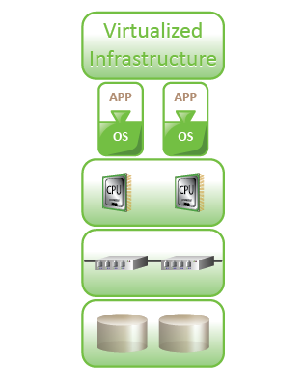
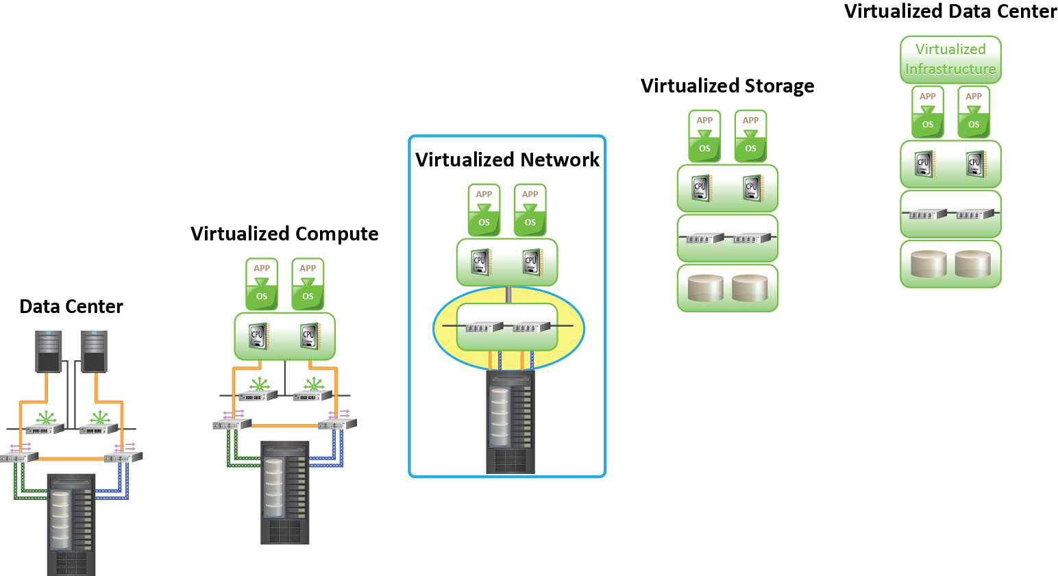
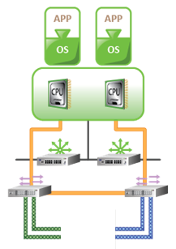
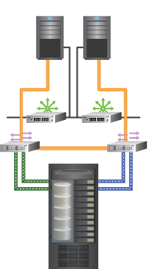
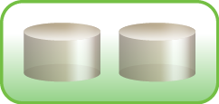
Virtualized Data Center
Transforming a Classic Data Center (CDC) into a Virtualized Data Center (VDC) requires virtualizing the core elements of the data center.
Virtualized Data Center (VDC)
Virtualize Network
Virtualize Storage
Virtualize Compute
Classic Data Center (CDC)
Using a phased approach to a virtualized infrastructure enables smoother transition to virtualize core elements.
Notes:
Virtualization is the first step towards building a cloud infrastructure. Transforming a Classic Data Center (CDC) into a Virtualized Data Center (VDC) requires virtualizing the core elements of the data center. A phased approach to virtualize an infrastructure enables a smooth transition from Classic Data Center to Virtualized Data Center .

Slide 4
Module 3: Virtualized Data Center – Compute
Lesson 1: Compute Virtualization Overview
Topics covered in this lesson:
  Drivers for compute virtualization
  Types of hypervisor
  Benefits of compute virtualization
Notes:
This lesson covers compute virtualization, the drivers and benefits of compute virtualization, hypervisor, and different types of hypervisors.

Slide 5
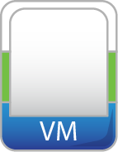





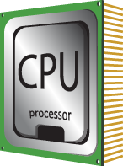
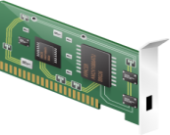
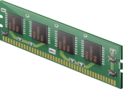
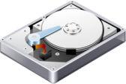
Compute Virtualization
Compute Virtualization
It is a technique of masking or abstracting the physical compute hardware and enabling multiple operating systems (OSs) to run concurrently on a single or clustered physical machine(s).
Enables creation of multiple virtual machines (VMs), each running an OS and application
  VM is a logical entity that looks and behaves like physical machine
Virtualization layer resides between hardware and VMs
  Also known as hypervisor
VMs are provided with standardized hardware resources
Virtualization Layer
x86 Architecture
CPU
NIC Card
Memory
Hard Disk
Notes:
Compute virtualization is a technique of masking or abstracting the physical hardware from the operating system and enabling multiple operating systems to run concurrently on a single or clustered physical machine(s). This technique encapsulates an operating system and an application into a portable virtual machine (VM).
A virtual machine is a logical entity that looks and behaves like a physical machine. Each operating system runs on its own virtual machines.
In compute virtualization, a virtualization layer resides between the hardware and virtual machine (on which an operating system is running). The virtualization layer is also known as hypervisor. The hypervisor provides standardized hardware resources (for example: CPU, Memory, Network, etc.) to all the virtual machines.
Note:
The terms physical machine, host machine, compute, and server are interchangeably used throughout the course. The terms virtual machine, guest machine, virtual compute, and virtual server are interchangeably used in this course.

Slide 6

Need for Compute Virtualization
Hypervisor
x86 Architecture
x86 Architecture
CPU
NIC Card
Memory
Hard Disk
CPU
NIC Card
Memory
Hard Disk
Before Virtualization | After Virtualization
Runs single operating system (OS) per machine at a time Couples s/w and h/w tightly May create conflicts when multiple applications run on the same machine Underutilizes resources Is inflexible and expensive | Runs multiple operating systems (OSs) per machine concurrently Makes OS and applications h/w independent Isolates VM from each other, hence no conflict Improves resource utilization Offers flexible infrastructure at low cost
Notes:
Traditionally, one operating system (OS) per compute system (physical machine) is deployed because the operating system and the hardware are tightly coupled and cannot be separated. Only one application is deployed per compute system to minimize the potential resource conflict. This causes organizations to purchase new physical machines for every application they deploy, resulting in expensive and inflexible infrastructure. Further, these compute systems remain underutilized - it is very common to find compute systems running at 15 – 20% utilization. This compounding over many machines within a Classic Data Center (CDC) leads to poor utilization of physical machines.
Compute virtualization enables to overcome these challenges by allowing multiple operating systems and applications to run on a single physical machine. This technique significantly reduces acquisition cost and improves utilization.

Slide 7
Hypervisor
Hypervisor
It is a software that allows multiple operating systems (OSs) to run concurrently on a physical machine and to interact directly with the physical hardware.
Has two components
  Kernel
  Virtual Machine Monitor (VMM)
VMM
VMM
VMM
Hypervisor (Kernel and VMM)
x86 Architecture
CPU
NIC Card
Memory
Hard Disk
Notes:
Hypervisor is a compute virtualization software that enables multiple operating systems (OSs) to run on a physical machine concurrently. The hypervisor interacts directly with the physical resources of the x86 based compute system. The hypervisor is a key component of data center consolidation efforts. By nature, it allows multiple operating systems and applications to reside on the same physical machine.
Hypervisor has two key components: kernel and Virtual Machine Monitor (VMM).
A hypervisor kernel provides the same functionality as other operating systems, such as process creation, file system management, and process scheduling. It is designed to specifically support multiple virtual machines and to provide core functionalities, such as resource scheduling, I/O stacks, etc.
The Virtual Machine Monitor is responsible for actually executing commands on the CPUs and performing Binary Translation (BT). A Virtual Machine Monitor abstracts hardware to appear as a physical machine with its own CPU, memory, and I/O devices. Each virtual machine is assigned a Virtual Machine Monitor that has a share of the CPU, memory, and I/O devices to successfully run the virtual machine. When a virtual machine starts running, the control is transferred to the Virtual Machine Monitor, which subsequently begins executing instructions from the virtual machine.

Slide 8


Types of Hypervisor
APP
Hypervisor
Hypervisor
Operating System
x86 Architecture
x86 Architecture
CPU
NIC Card
Memory
Hard Disk
CPU
NIC Card
Memory
Hard Disk
Type 1: Bare-Metal Hypervisor
Type 2: Hosted Hypervisor
Type 1: Bare-Metal Hypervisor
It is an operating system (OS) It installs and runs on x86 bare-metal hardware It requires certified hardware
Type 2: Hosted Hypervisor
It installs and runs as an application It relies on operating system (OS) running on physical machine for device support and physical resource management
Notes:
Hypervisors are categorized into two types: hosted hypervisor and bare-metal hypervisor.
Type 1 (Bare-metal hypervisor): In this type, the hypervisor is directly installed on the x86 based hardware. Bare-metal hypervisor has direct access to the hardware resources. Hence, it is more efficient than a hosted hypervisor.
Type 2 (Hosted hypervisor): In this type, the hypervisor is installed and run as an application on top of an operating system. Since it is running on an operating system, it supports the broadest range of hardware configurations.
A hypervisor is the primary component of virtualization that enables compute system partitioning (i.e. partitioning of CPU and memory). In this course, we will focus on type 1 hypervisors because it is most predominantly used within Virtualized Data Center (VDC).

Slide 9
Benefits of Compute Virtualization
Server consolidation
Isolation
Encapsulation
Hardware independence
Reduced cost
Notes:
Compute virtualization offers the following benefits:
Server Consolidation: Compute virtualization enables running multiple virtual machines on a physical server. This reduces the requirement for physical servers.
Isolation: While virtual machines can share the physical resources of a physical machine, they remain completely isolated from each other as if they were separate physical machines. If, for example, there are four virtual machines on a single physical machine and one of the virtual machines crashes, the other three virtual machines remain unaffected.
Encapsulation: A virtual machine is a package that contains a complete set of virtual hardware resources, an operating system, and applications. Encapsulation makes virtual machines portable and easy to manage. For example, a virtual machine can be moved and copied from one location to another just like a file.
Hardware Independence: A virtual machine is configured with virtual components such as CPU, memory, network card, and SCSI controller that are completely independent of the underlying physical hardware. This gives the freedom to move a virtual machine from one x86 machine to another without making any change to the device drivers, operating system, or applications.
Reduced Cost: Compute virtualization reduces the following direct costs:
Space (leased or owned) for physical machines, power and cooling, Hardware (including switches and Fibre Channel HBA), and annual maintenance

Slide 10
Module 3: Virtualized Data Center – Compute
Lesson 2: Compute Virtualization Techniques
Topics covered in this lesson:
  Requirements of x86 hardware virtualization
  Compute virtualization techniques
Notes:
This lesson covers the challenges of virtualizing x86 hardware and the techniques to overcome them.

Slide 11
Requirements: x86 Hardware Virtualization
An operating system (OS) is designed to run on a bare-metal hardware and to fully own the hardware
  x86 architecture offer four levels of privilege
    Ring 0, 1, 2, and 3
    User applications run in Ring 3
    OS run in Ring 0 (most privileged)
Challenges of virtualizing x86 hardware
  Requires placing the virtualization layer below the OS layer
  Is difficult to capture and translate privileged OS instructions at runtime
Techniques to virtualize compute
  Full, Para, and hardware assisted virtualization
Ring 3
User Apps
Ring 2
Ring 1
Ring 0
OS
X86 Hardware
Notes:
x86 based operating systems (OS) are designed to run directly on the bare-metal hardware. So, they naturally assume that they fully ‘own’ the compute hardware. As shown in the figure on this slide, the x86 CPU architecture offers four levels of privilege known as Ring 0, 1, 2, and 3 to operating systems and applications to manage access to the compute hardware. While the user-level applications typically run in Ring 3, the operating system needs to have direct access to the hardware and must execute its privileged instructions in Ring 0. Privileged instruction is a class of instructions that usually includes interrupt handling, timer control, and input/output instructions. These instructions can be executed only when the compute is in a special privileged mode, generally available to an operating system, but not to user programs.
Virtualizing the x86 architecture requires placing a virtualization layer below the operating system (which expects to be in the most privileged Ring 0) to create and manage the virtual machines that deliver shared resources.
Further complicating the situation, some privileged operating system instructions cannot effectively be virtualized because they have different semantics when they are not executed in Ring 0. The difficulty in capturing and translating these privileged instruction requests at runtime was the challenge that originally made x86 architecture virtualization look impossible.
The three techniques that now exist for handling privileged instructions to virtualize the CPU on x86 architecture are as follows:
Full virtualization using Binary Translation (BT)
Operating oystems-assisted virtualization or Paravirtualization
Hardware assisted virtualization

Slide 12
Full Virtualization
Virtual Machine Monitor (VMM) runs in the privileged Ring 0
VMM decouples guest operating system (OS) from the underlying physical hardware
Each VM is assigned a VMM
  Provides virtual components to each VM
  Performs Binary Translation (BT) of non-virtualizable OS instructions
Guest OS is not aware of being virtualized
Ring 3
User Apps
Ring 2
Ring 1
Guest OS
Ring 0
Hypervisor
Physical Machine
X86 Hardware
Notes:
In a full virtualization, Binary Translation (BT) of operating system (OS) instructions is essential. Binary Translation means replacing the guest operating system (an operating system running on a virtual machine) instructions that cannot be virtualized, with new instructions that have the same effect on the virtual hardware. Application requests work as they would otherwise on a physical machine. Each virtual machine is assigned a Virtual Machine Monitor (VMM), which performs Binary Translation and provides each virtual machine all the services similar to a physical compute, including a virtual BIOS and virtual devices.
Binary Translation provides ‘Full Virtualization’ because the hypervisor completely decouples the guest operating system from the underlying hardware. The guest operating system is not aware that it is being virtualized and requires no modification.
VMware ESX/ESXi and Microsoft Hyper-V are product examples that implement the full virtualization technique.

Slide 13
Paravirtualization
Guest operating system (OS) knows that it is virtualized
Guest OS runs in Ring 0
Modified guest OS kernel is used, such as Linux and OpenBSD
Unmodified guest OS is not supported, such as Microsoft Windows
Ring 3
User Apps
Ring 2
Ring 1
Ring 0
Paravirtualized
Guest OS
Hypervisor
Physical Machine
X86 Hardware
Notes:
In paravirtualization, guest operating systems (OSs) are aware of being virtualized. In this approach, the guest operating system kernel is modified to eliminate the need for Binary Translation. While it is possible to modify open source operating systems, such as Linux and OpenBSD, it is not possible to modify “closed” source operating systems such as Microsoft Windows. Paravirtualization is possible in open source operating systems. A full virtualization approach should be adopted for unmodified guest operating systems such as Microsoft Windows.
Xen and KVM are product examples of paravirtualization.

Slide 14
Hardware Assisted Virtualization
Achieved by using hypervisor-aware CPU to handle privileged instructions
  Reduces virtualization overhead caused due to full and paravirtualization
  CPU and Memory virtualization support is provided in hardware
Enabled by AMD-V and Intel VT technologies in the x86 processor architecture
Ring 3
User Apps
Ring 2
Ring 1
Ring 0
Guest OS
VMM
Physical Machine
X86 Hardware
Notes:
Hardware assisted virtualization is accomplished by making hypervisor-aware CPU to handle privileged instructions. Currently, both Intel and AMD offer x86 CPUs with extensions. Though virtualizing the x86 instruction set decreases the hypervisor overhead, it does increase the CPU overhead. Generally, this is seen as negligible, because the machine is usually bound by memory than processing power.
The hardware virtualization support enabled by AMD-V and Intel VT technologies introduces virtualization in the x86 processor architecture. Currently, hardware assisted virtualization supports both CPU and memory virtualization.

Slide 15
Module 3: Virtualized Data Center – Compute
Lesson 3: Virtual Machine
Topics covered in this lesson:
  Virtual machine (VM) files
  File systems that manage Virtual machine files
  Virtual machine hardware
  Virtual machine console
Notes:
This lesson covers the various components of virtual machine (VM), virtual machine files, and file systems used to manage these files. The lesson also describes Virtual machine hardware and virtual machine console.

Slide 16
Virtual Machine
From a user’s perspective, a logical compute system
  Runs an operating system (OS) and application like a physical machine
  Contains virtual components such as CPU, RAM, disk, and NIC
From a hypervisor’s perspective
  Virtual machine (VM) is a discrete set of files such as configuration file, virtual disk files, virtual BIOS file, VM swap file, and log file
Hypervisor
x86 Architecture
CPU
NIC Card
Memory
Hard Disk
Notes:
From a user’s perspective, a virtual machine (VM) is a logical compute system just like a physical machine that runs an operating system (OS) and application. An operating system that runs within a virtual machine is called a guest operating system. At a time, only one supported guest operating system can run on a single virtual machine. Each virtual machine is independent and can run its own application.
From a hypervisor perspective, a virtual machine is a discrete set of files. The set includes a configuration file, virtual disk files, virtual BIOS file, virtual machine swap file, and a log file.

Slide 17
Virtual Machine Files
File name | Description
Virtual BIOS File | Stores the state of the virtual machine’s (VM’s) BIOS
Virtual Swap File | Is a VM’s paging file which backs up the VM RAM contents The file exists only when VM is running
Virtual Disk File | Stores the contents of the VM’s disk drive Appears like a physical disk drive to VM VM can have multiple disk drives
Log File | Keeps a log of VM activity Is useful for troubleshooting
Virtual Configuration File | Stores the configuration information chosen during VM creation Includes information such as number of CPUs, memory, number and type of network adaptors, and disk types
Notes:
The table displayed on this slide lists the files that make up a virtual machine (VM).
Virtual BIOS file: It stores the state of virtual machine BIOS.
Virtual Machine swap file: It is the paging file of a virtual machine, which backs up the virtual machine RAM contents. This file exists only when the virtual machine is running.
Virtual disk file: It stores the contents in the disk drive of the virtual machine. A virtual disk file appears as a physical disk drive to the virtual machine. A virtual machine can have multiple virtual disk files. Each virtual disk file appears like a separate disk drive.
Log file: This file keeps a log of virtual machine activities. This file may be useful in troubleshooting if a problem is encountered.
Configuration file: It stores the configuration information chosen during creating virtual machines. This includes information such as: virtual machine name, inventory location, guest operating system, virtual disk parameters, number of CPUs and memory sizes, number of adaptors and associated MAC addresses, the networks to which the network adapters connect, SCSI controller type, and the disk type.

Slide 18
File System to Manage VM Files
The file systems supported by hypervisor are Virtual Machine File System (VMFS) and Network File System (NFS)
VMFS
  Is a cluster file system that allows multiple physical machines to perform read/write on the same storage device concurrently
  Is deployed on FC and iSCSI storage apart from local storage
NFS
  Enables storing VM files on a remote file server (NAS device)
  NFS client is built into hypervisor
Notes:
The file system supported by hypervisor are Virtual Machine File System (VMFS) and Network File System (NFS).
The Virtual Machine File System is a clustered file system optimized to store virtual machine files. Virtual Machine File System can be deployed on Fibre Channel and iSCSI storage, apart from the local storage. The virtual disks are stored as files on a VMFS.
Network File System enables storing virtual machine files on remote file servers (NAS device) accessed over an IP network. The Network File System client built into the hypervisor uses the Network File System protocol to communicate with the NAS device.

Slide 19





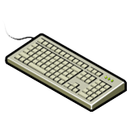

Virtual Machine Hardware
Parallel
port
Serial/Com
ports
USB controller
and USB devices
IDE controllers
Floppy controller
and floppy drives
Graphic card
Virtual Machine
Mouse
RAM
Keyboard
VM chipset with one or more CPUs
Network adapters
(NIC and HBA)
SCSI controllers
Notes:
A virtual machine uses a virtual hardware. Each guest operating system sees the hardware devices as if they were physical and owned by them. All virtual machines have standardized hardware. Standardized hardware makes virtual machine portable across physical machines.
Virtual machine can be configured with a virtual CPU, memory, and other virtual hardware devices such as virtual hard disk, virtual Ethernet cards, virtual CD/DVD drives, virtual floppy drives, USB controllers, and SCSI controllers. These components can be added while creating a new virtual machine or when required. In the current implementation of hypervisors, not all devices are available to add and configure; for example video devices cannot be added, but the available video device can be configured.

Slide 20
VM Hardware Components
Virtual Hardware | Description
vCPU | Virtual machine (VM) can be configured with one or more virtual CPUs Number of CPUs allocated to a VM can be changed
vRAM | Amount of memory presented to the guest operating system (OS) Memory size can be changed based on requirement
Virtual Disk | Stores VM's OS and application data A VM should have at least one virtual disk
vNIC | Enables a VM to connect to other physical and virtual machines
Virtual DVD/CD-ROM Drive | It maps a VM’s DVD/CD-ROM drive to either a physical drive or an .iso file
Virtual Floppy Drive | It maps a VM’s floppy drive to either a physical drive or an .flp file
Virtual SCSI Controller | VM uses virtual SCSI controller to access virtual disk
Virtual USB Controller | Maps VM’s USB controller to the physical USB controller
Notes:
A virtual machine (VM) can be configured with the following virtual components:
Virtual Central processing Unit (vCPU): A virtual machine can be configured with one or more vCPU when it is created. The number of vCPUs can be increased or decreased based on requirements.
Virtual Random Access Memory (vRAM): vRAM is the amount of memory allocated to a virtual machine. It is visible to a guest operating system. This memory size can be changed based on requirements.
Virtual Disk: A virtual disk stores the virtual machine's operating system, program files, application data, and other data associated with the virtual machine. A virtual machine should have at least one virtual disk.
Virtual Network Adaptor (vNIC): It provides connectivity between virtual machines on the same compute system, between virtual machines on different compute systems, and between virtual and physical machines. vNIC functions exactly like a physical NIC.
Virtual DVD/CD-ROM and floppy drives: These devices enable to map the virtual machines drive to either the physical drive or to the image file (such as .iso for CD/DVD and .flp for floppy) on the storage.
Virtual SCSI Controller: A virtual machine uses virtual SCSI controller to access virtual disks.
Virtual USB Controllers: Enables a virtual machine to connect to the physical USB controller and to access the USB device connected.

Slide 21
Virtual Machine Console
Provides mouse, keyboard, and screen functionality
Sends power changes (on/off) to the virtual machine (VM)
Allows access to BIOS of the VM
Typically used for virtual hardware configuration and troubleshooting issues
Notes:
A virtual machine (VM) console provides the mouse, keyboard, and screen functionalities. To install an operating system (OS), a virtual machine console is used. The virtual machine console allows access to the BIOS of the virtual machine. It offers the ability to power the virtual machine on/off and to reset it.
The virtual machine console is normally not used to connect to the virtual machine for daily tasks. It is used for tasks such as virtual hardware configuration and troubleshooting issues.

Slide 22
Module 3: Virtualized Data Center – Compute
Lesson 4: Resource Management
Topics covered in this lesson:
  Resource management and resource pool
  Share, limit, and reservation
  CPU and memory resource optimization techniques
Notes:
This lesson covers the process of pooling and managing resources, explains how the resources are controlled using share, limit, and reservation. It also describes the CPU and memory optimization techniques.

Slide 23
Resource Management
Resource management
A process of allocating resources from physical machine or clustered physical machines to virtual machines (VMs) to optimize the utilization of resources.
Goals of resource management
  Controls utilization of resources
  Prevents VMs from monopolizing resources
  Allocates resources based on relative priority of VMs
Resources must be pooled to manage them centrally
Notes:
Resource management is the allocation of resources from a physical machine or clustered physical machines to virtual machines (VMs). It helps optimize the utilization of resources because the demand for resource varies over time. It also allows to dynamically reallocate resources so that the available capacity can be used more efficiently.
In addition to controlling resource utilization, resource management helps prevent virtual machines from monopolizing resources and guarantees predictable service levels. With resource management, resources are allocated based on the relative priority of virtual machines. For example, consider two virtual machines with different priority levels, one at a high level and the other at a low level. In this case, more resources are allocated to the virtual machine with high priority.
In order to allocate resources, they must be pooled and managed centrally.
Note: Resource management includes management of CPU, memory, network, and storage. This module focuses on the management of CPU and memory resources. Network and storage resource management are covered in Module 4 and 5 of this course.

Slide 24
Resource Pool
Resource pool
It is a logical abstraction of aggregated physical resources that are managed centrally.
Created from a physical machine or cluster
Administrators may create child resource pool or virtual machine (VM) from the parent resource pool
Reservation, limit, and share are used to control the resources consumed by resource pools or VMs
Notes:
A resource pool is a logical abstraction of aggregated physical resources that are managed centrally. Each physical machine and cluster has a parent resource pool that groups the resources of that physical machine or cluster. Administrators may create child resource pools from the parent resource pool. Each child resource pool owns some of the parent’s resources. A parent resource pool can contain child resource pools, virtual machines, or both.
For each resource pool and virtual machine, reservation, limit, and share (discussed later) can be specified. Reservation, limit, and share are used to control the resources consumed by a child resource pool or virtual machines.
Let us look at an example of resource pool.

Slide 25
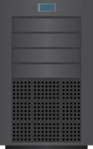
Resource Pool Example
Standalone Physical Machine – Machine 1
Parent Pool
CPU = 3000 MHz
Memory = 6GB
Engineering Pool (Child Pool)
CPU = 1000 MHz
Memory = 2GB
Finance Pool (Child Pool)
CPU = 1000 MHz
Memory = 2GB
Marketing-Production VM
CPU = 500 MHz
Memory = 1GB
Engineering-Test VM
CPU = 500 MHz
Memory = 1GB
Engineering-Production VM
CPU = 500 MHz
Memory = 1GB
Finance-Test VM
CPU = 500 MHz
Memory = 1GB
Finance-Production VM
CPU = 500 MHz
Memory = 1GB
Notes:
This slide illustrates an example where resources of a parent resource pool are distributed among child resource pools and virtual machines. The resources of the child resource pools are further distributed among virtual machines (VMs).
The parent resource pool includes the sum of all CPUs power (in megahertz) and the sum of all the capacity of installed RAM (in megabytes) available in the compute environment (physical machine or cluster).
On this slide, the parent resource is a physical machine named ‘Machine 1’. It has 3000 MHz of CPU and 6GB of RAM, available for use by child resource pools and/or virtual machines.
A child resource pool uses allocated resources from the parent resource pool for the virtual machines. The child resource pool cannot exceed the capacity of the parent resource pool. Creating a child pool reserves resources from the parent pool, irrespective of whether or not the virtual machine in the child pool is powered on.

Slide 26
Share, Limit, and Reservation
Parameters that control the resources consumed by a child resource pool or a virtual machine (VM) are as follows:
  Share
    Amount of CPU or memory resources a VM or a child resource pool can have with respect to its parent’s total resources
  Limit
    Maximum amount of CPU and memory a VM or a child resource pool can consume
  Reservation
    Amount of CPU and memory reserved for a VM or a child resource pool
Notes:
Reservation, limit, and share are mechanisms to control the resources consumed by a child resource pool or virtual machine (VM).
Share
Child Resource Pool: When resources are scarce and when resource contention occurs, the share value defines the relative priority of child resource pools in a parent pool.
Virtual machine: Similar to a child resource pool, share specifies the relative priority of a virtual machine. If a virtual machine has twice as many CPU/memory share as another Virtual Machine, it is entitled to consume twice as much CPU/memory when the virtual machines are competing for resources.
Limit
Child Resource Pool: It defines the maximum amount of CPU (MHz) and memory (MB) that a child resource pool is allowed to consume.
Virtual machine: Similar to a resource pool, limit defines the maximum amount of CPU (MHz) and memory (MB) that a virtual machine is allowed to consume. The maximum amount of memory and CPU a virtual machine may consume is configured when it is created, and can only be modified when the virtual machine is powered off.
Reservation
Child Resource Pool: It defines the amount of CPU (MHz) and memory (MB) that is reserved for a child resource pool.
Virtual machine: Similar to child resource pool, virtual machine defines the amount of CPU (MHz) and memory (MB) reserved for a virtual machine. If the virtual machine does not use the total amount of its CPU and memory reserved, the unused portion will be available for use by other virtual machines until the virtual machine needs it. A virtual machine will not power on if the amount of resources defined in reservation is not available in the pool.

Slide 27
Optimizing CPU Resources
Modern CPUs are equipped with multiple cores and hyper-threading
  Multi-core processors have multiple processing units (cores) in a single CPU
  Hyper-threading makes a physical CPU appear as two or more logical CPUs
Allocating a CPU resource efficiently and fairly is critical
Hypervisor schedules virtual CPUs on the physical CPUs
Hypervisors support multi-core, hyper-threading, and CPU load-balancing features to optimize CPU resources
Notes:
Modern CPUs are equipped with multiple cores per CPU and hyper-threading features. A multi-core CPU is an integrated circuit to which two or more processing units (cores) have been attached for enhanced performance and more efficient, simultaneous processing of multiple processes. Hyper-threading makes a physical CPU appear as two or more logical CPUs.
Today’s data centers deploy servers with multi core and hyper-threading features in their environment. The role of the hypervisor scheduler is to assign a physical CPU resource to the virtual CPU in a way that meets system objectives, such as responsiveness, throughput, and utilization. A conventional Operating System schedules a process or thread on a CPU, while a hypervisor schedules virtual CPUs of virtual machines on the physical machines.
A hypervisor supports and optimizes the CPU resources using modern CPU features such as multi-core and hyper-threading. They also support CPU load balancing, which is discussed later.

Slide 28

Multi-core Processors
VM with
one CPU
VM with
two CPUs
VM with
four CPUs
Virtual CPU
Virtual
Physical
Thread
Thread
Thread
Thread
Thread
Thread
Thread
Thread
Thread
Core
Socket
Single – core
Dual – socket system
Dual – core
Single – socket system
Quad – core
Single – socket system
Notes:
Multi-core CPUs provide many advantages to a hypervisor that performs multitasking of virtual machines. A dual-core CPU, for example, can provide almost double the performance of a single-core CPU by allowing two virtual CPUs to execute at the same time.
Intel and AMD have developed CPUs that combine two or more cores into a single integrated circuit, called a socket in this discussion.
A hypervisor running on a physical machine can have single core, dual core, or quad core CPUs. Virtual machines can be configured with one or more virtual CPUs. When a virtual machine is scheduled, its virtual CPUs are scheduled to run on a physical CPU by the hypervisor. To maximize the overall utilization and performance, a hypervisor scheduler optimizes the placement of virtual CPUs onto different sockets.

Slide 29
Hyper-threading
VM with
one CPU
VM with
two CPUs
VM with
one CPU
Makes a physical CPU appear as two Logical CPUs (LCPUs)
  Enables operating system (OS) to schedule two or more threads simultaneously
Two LCPUs share the same physical resources
  While the current thread is stalled, CPU can execute another thread
Hypervisor running on a hyper-threading-enabled CPU provides improved performance and utilization
LCPU
LCPU
LCPU
LCPU
Thread 1 and 2
Dual – core
Single – socket system
with hyperthreading
Thread 1 and 2
Notes:
Hyper-threading makes a physical CPU appear as two or more Logical CPUs (LCPUs), allowing the operating system (OS) to schedule two threads or processes simultaneously. The two threads cannot be executed at the same time because the two logical CPUs share a single set of physical resources. When physical resources are not in use by the current thread in a physical CPU, especially when the processor is stalled (due to a cache miss or data dependency), a hyper-threading-enabled CPU can use those execution resources to execute another scheduled task.
When a hypervisor runs on a hyper-threading enabled CPU, it provides improved performance and utilization.

Slide 30
CPU Load Balancing
VM with
one CPU
VM with
one CPU
VM with
one CPU
LCPU
LCPU
LCPU
LCPU
Hyperthreaded dual – core
Dual – socket system
Notes:
When a hypervisor is running on multi-processor and hyper-threading-enabled compute systems, balancing the load across CPUs is critical to the performance. In this environment, load balancing is achieved by migrating a thread from one logical CPU (over utilized) to another (under utilized) to keep the load balanced. The hypervisor intelligently manages the CPU load by spreading it smoothly across the CPU cores in the compute system. At regular intervals, the hypervisor looks to migrate the CPU of a virtual machine (virtual CPU) from one logical CPU to another to keep the load balanced.
If the logical CPU has no work assigned, it is put into a halted state. This action frees its physical resources and allows the virtual machine running on the logical CPU of the same core to use all the physical resources of that core.

Slide 31
Optimizing Memory Resource
Hypervisor manages a machine’s physical memory
  Part of this memory is used by the hypervisor
  Rest is available for virtual machines (VMs)
VMs can be configured with more memory than physically available, called ‘memory overcommitment’
  Memory optimization is done to allow overcommitment
Memory management techniques are Transparent page sharing, memory ballooning, and memory swapping
Notes:
The hypervisor manages the physical memory of compute systems. A part of memory is consumed by the hypervisor and rest of the memory is available for virtual machines (VMs).
Hypervisor allows configuring more memory to the virtual machines than what is physically available. This is known as overcommitment of memory. Memory overcommitment is allowed because, typically, some virtual machines are lightly loaded, compared to others. Their memory may be used infrequently, and much of the time, their memory remains idle. Memory overcommitment allows the hypervisor to use memory reclamation techniques to take the inactive or unused memory away from the idle virtual machines and give it to other virtual machines that will actively use it.
For example, consider a physical machine with 4GB physical memory running three virtual machines with 2GB VM memory each. Without memory overcommitment, only one virtual machine can be run because the hypervisor cannot reserve the physical memory for more than one virtual machine. This is because a hypervisor will consume some memory space and each virtual machine has a memory overhead.
In order to effectively support memory overcommitment, the hypervisor must provide efficient physical memory reclamation techniques. A hypervisor supports three techniques to reclaim memory: transparent page sharing, ballooning, and memory swapping.

Slide 32


Transparent Page Sharing
Hypervisor detects identical memory pages of virtual machines (VMs) and maps them to same physical page
  Read-only when shared
For writes, hypervisor treats the shared pages as copy-on-write
Attempts to write on shared page
  Generates minor page fault
  Creates private copy after write and remaps the memory
VM0 Memory
VM1 Memory
VM2 Memory
Private copy
Physical Memory
Memory Page
Notes:
When multiple virtual machines (VMs) are running, some of them may have identical sets of memory content. This presents opportunities to share memory across virtual machines (as well as to share within a single virtual machine). For example, several virtual machines may run the same guest operating system, have the same applications, or contain the same user data. With page sharing, the hypervisor can reclaim the redundant copies and keep only one copy, which is shared by multiple virtual machines in the physical memory. As a result, the total amount of physical memory consumed by virtual machines is reduced and memory overcommitment becomes possible.
A hypervisor identifies redundant page copies by their contents. This means that pages with identical content can be shared regardless of when, where, and how those contents are generated. The hypervisor scans the content of VM memory for sharing opportunities.
After the candidate virtual machine page content is confirmed to match the content of an existing physical page, the virtual machine memory pointer is updated to point to the shared location, and the redundant physical memory copy is reclaimed. This mapping process is invisible to the virtual machine.
When a write occurs on the shared page, the standard Copy-on-Write (CoW) technique is used to handle these writes. Any attempt to write to the shared pages will generate a minor page fault. After a page fault occurs, the hypervisor will transparently create a private copy of the page for that virtual machine. It remaps the pointer to this private copy of the virtual machines. In this way, virtual machines can safely modify the shared pages without disrupting other virtual machines sharing that memory.

Slide 33
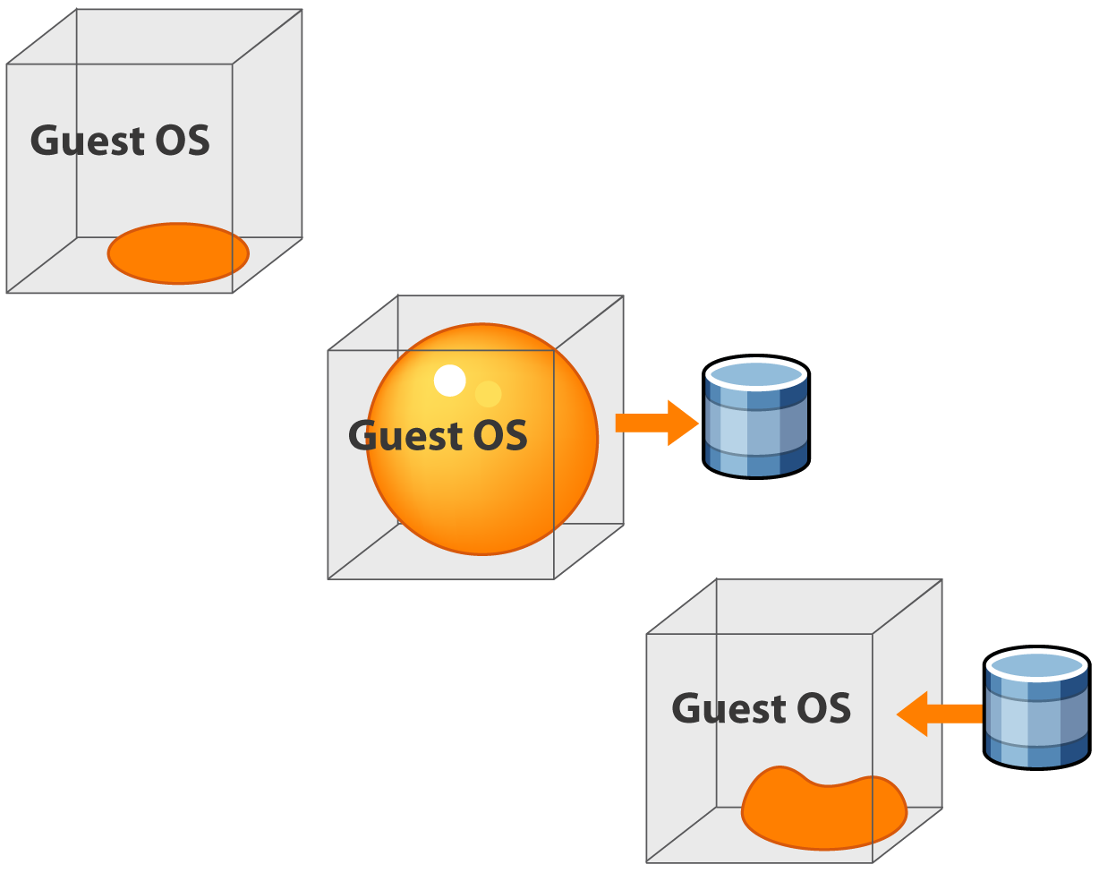

Memory Ballooning
No memory shortage, balloon remains uninflated
Virtual Machine (VM)
Memory shortage, balloon inflates
Driver demands memory from guest operating system (OS)
Guest OS forces page out
Hypervisor reclaims memory
Virtual Machine (VM)
Memory shortage resolved, deflates balloon
Driver relinquishes memory
Guest OS can use pages
Hypervisor grants memory
Virtual Machine (VM)
Notes:
Ballooning is a completely different memory reclamation technique, compared to page sharing. When a virtual machine (VM) must yield memory, the best thing is to let the guest operating system of the VM select the memory pages to give up. The virtual machine knows which pages have been least recently used and can be freed up. Ballooning technique makes the guest operating system free some of the virtual machine memory.
The balloon driver is installed in the guest operating system as a pseudo-device driver and communicates with the hypervisor. The guest operating system is aware of the fact that the balloon driver is installed but not aware of its purpose. The driver’s function is to demand memory from the guest operating system and later to relinquish it under the control of the hypervisor. The guest operating system is not aware of the communication taking place between the balloon driver and the hypervisor.
When a compute is not under memory pressure, no virtual machine’s balloon is inflated. But when memory becomes scarce, the hypervisor chooses a virtual machine and inflates its balloon. It instructs the balloon driver in the virtual machine to demand memory from the guest operating system. The guest operating system complies by yielding memory, according to its own algorithms. The hypervisor can assign the relinquished pages to other virtual machines that require more memory.
The hypervisor can safely reclaim this physical memory because neither the balloon driver nor the guest operating system relies on the contents of these pages. This means that no processes in the virtual machine will intentionally access those pages to read or write. If any of these pages are re-accessed by the virtual machine for some reason, the hypervisor will treat it as normal virtual machine memory allocation and allocate a new physical page for that virtual machine.

Slide 34
Memory Swapping
Each powered-on virtual machine (VM) needs its own swap file
  Created when the VM is powered-on
  Deleted when the VM is powered-off
Swap file size is equal to the difference between the memory limit and the VM memory reservation
Hypervisor swaps out the VM’s memory content if memory is scarce
Swapping is the last option because it causes notable performance impact
Notes:
As a last effort to manage excessively overcommitted physical memory, the hypervisor will swap the virtual machine’s (VM’s) memory content to their swap files. When virtual machines are powered on, the hypervisor creates and assigns one swap file to each virtual machine. This swap file stores the virtual machine’s memory contents. If a physical machine cannot get enough memory through page sharing and memory ballooning, the hypervisor forcibly reclaims memory from virtual machines by memory swapping. The hypervisor copies the VM page contents to their corresponding swap files before assigning the pages to the virtual machines that need memory.
The swap file size is determined by the difference between the virtual machine’s configured memory (or its memory limit) and its reservation.
Whenever a swap file is actively used, performance is severely penalized. When the virtual machine is powered off, the swap file of that virtual machine is deleted. When the virtual machine is powered back on, the swap file for that virtual machine is re-created.

Slide 35
Virtual Machine Affinity
VM to VM affinity:
  Selected VMs should run on same hypervisor
    To improve performance ,if VMs are communicating with each other heavily
  Anti-affinity ensures that selected VMs are not together on a hypervisor (ex: for availability reasons)
VM to physical server affinity:
  Specify whether selected VM can be placed only on a particular hypervisor (ex: for licensing issues)
  Anti-affinity is allowing VM to move on different hypervisors in a cluster (ex: for high availability or performance requirements)
35
Notes:
Understanding virtual machine affinity is very important, especially when considering VM migrations within a virtualized data center or to the Cloud. VM affinity can be classified as affinity between individual VMs, and affinity between a VM and a hypervisor in a clustered server environment .
Affinity between virtual machines specifies that either the selected virtual machines be placed on the same host (affinity) or on different hosts (anti-affinity). Keeping virtual machines together may be beneficial in terms of performance, if VMs are communicating heavily with one another. Conversely, anti-affinity requires selected VMs to be placed on different hypervisors, probably for availability or load balancing reasons.
VM to hypervisor (or physical server) affinity relationship specifies whether a virtual machine can be placed only on a particular physical server or it is allowed to migrate on a different server, if required.
Please note, this cluster is a collection of hypervisors and associated virtual machines with shared resources.
Copyright © 2011 EMC Corporation. Do not Copy - All Rights Reserved.

Slide 36
Resource Management Tool
Provides ability to manage physical machines running hypervisor
Enables centralized management of resources from a management server
Enables pooling of resources and allocates capacity to VMs
  Communicates with hypervisors to perform management
Provides operational automation
Management
Server
Manage Physical and Virtual Machines
Hypervisor
Hypervisor
Notes:
A Virtualized Data Center (VDC) can have several physical machines running hypervisors. The resource management tool provides the ability to manage these physical machines centrally. Resource management tools, which run on a management server, enable pooling of resources and allocating capacity to VMs. It communicates with hypervisors to perform management operations. It provides administrators better control, simplified day-to-day tasks, and reduced complexity and cost of managing an IT environment. It also provides operational automation that allows task scheduling and alerting to improve responsiveness to business needs and prioritizes actions requiring the most urgent attention.

Slide 37
Module 3: Virtualized Data Center – Compute
Lesson 5: Physical to Virtual Conversion
Topics covered in this lesson:
  Converter components
  Conversion options
  Conversion process
  Conversion considerations
Notes:
This lesson covers the conversion of a physical machine to a Virtual Machine (VM), the steps required to perform the conversion, the options and processes, and the key conversion considerations.

Slide 38
Physical to Virtual Machine (P2V) Conversion
P2V Conversion
It is a process through which physical machines are converted into virtual machines (VMs).
Clones data from physical machine’s disk to VM disk
Performs system reconfiguration of the destination VM such as:
  Change IP address and computer name
  Install required device drivers to enable the VM to boot
Conversion
Physical Machine
Virtual Machine (VM)
Notes:
Physical to virtual machine (VM) conversion is a process through which a physical machine is converted into a virtual machine. When converting a physical machine, the “Converter Application” (Converter) clones data on the hard disk of the source machine and transfers that data to the destination virtual disk. Cloning is the process of creating a cloned disk, where the cloned disk is a virtual disk that is an exact copy of the source physical disk.
After cloning is complete, system reconfiguration steps are performed to configure the destination virtual machine. System reconfiguration is the process of configuring the migrated operating system to enable it to function on a virtual hardware. This configuration is performed on the target virtual disk after cloning, and enables the target virtual disk to function as a bootable system disk in a virtual machine.
Because the migration process is non-destructive to the source, it can continue to be in use after the conversion is complete.

Slide 39
Benefits of P2V Converter
Reduces time needed to setup new virtual machine (VM)
Enables migration of legacy machine to a new hardware without reinstalling operating system (OS) or application
Performs migration across heterogeneous hardware
Notes:
This slide lists the benefits offered by P2V conversion.

Slide 40
Components of P2V Converter
There are three key components:
  Converter server
    Is responsible for controlling conversion process
    Is used for hot conversion only (when source is running its OS)
    Pushes and installs agent on the source machine
  Converter agent
    Is responsible for performing the conversion
    Is used in hot mode only
    Is installed on physical machine to convert it to virtual machine (VM)
  Converter Boot CD
    Bootable CD contains its operating system (OS) and converter application
    Converter application is used to perform cold conversion
Notes:
The P2V “converter application” consists of three components: converter server, converter agent, and converter boot CD.
A converter server is an application that is loaded on a separate physical machine. It controls the conversion process in a hot mode (when the source machine is running its operating system). While performing the conversion, the converter server pushes and installs a converter agent on the source physical machine that needs conversion.
A converter agent is responsible for performing the physical to virtual machine conversion. This agent is installed on the physical machine only for hot conversion.
A converter boot CD is a bootable CD with its operating system and converter application on it. This CD is used to perform cold conversion (when the source machine is not running its operating system).

Slide 41
Conversion Options
Hot conversion
  Occurs while physical machine is running
  Performs synchronization
    Copies blocks that were changed during the initial cloning period
  Performs power off at source and power on at target virtual machine (VM)
  Changes IP address and machine name of the selected machine, if both machines must co-exist on the same network
Cold conversion
  Occurs while physical machine is not running OS and application
  Boots the physical machine using converter boot CD
  Creates consistent copy of the physical machine
Notes:
There are two ways to migrate from physical machine to virtual machine (VM). These are hot migration and cold migration.
Hot conversion involves converting the source physical machine while it is running its operating system (OS). Because processes continue to run on the source machine during conversion, the resulting virtual machine is not an exact copy of the source physical machine. After conversion is complete, the destination virtual machine is synchronized with the source machine. During synchronization, blocks that were changed during the initial cloning period are transferred from the source to the destination. After conversion is completed, source machine may be powered off and destination virtual machine is commissioned for production. If the source physical machine and the destination virtual machine coexist on the same network, then the machine name and the IP address of the selected machine must be changed.
Cold conversion, also called offline conversion, is an option in which conversion of the source physical machine is performed when it is not running its operating system. When performing cold conversion of a physical machine, the source machine is rebooted using a converter boot CD that has its own operating system and converter application. Cold conversion creates a consistent copy of the source physical machine because no changes occur on the source machine during the conversion.

Slide 42

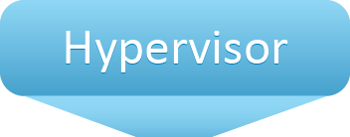
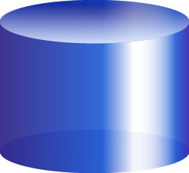

Hot Conversion Process
Converter server
running converter
software
Step 1: Converter server installs agent on source physical machine
Step 3: Creates VM on destination machine
Agent
Step 4: Clones source disk to VM disk
Powered-on
Source Physical
Machine
Source
Volume
Snapshot
Snapshot
Destination Physical
Machine running
hypervisor
Step 2: Agent takes snapshot of source volume
Notes:
Hot conversion of a physical machine to virtual machine (VM) involves following steps.
The converter server prepares the source machine for the conversion by installing the agent on the source physical machine.
The agent takes a snapshot of the source volume.
The converter server creates a virtual machine on the destination machine.
The agent clones the physical disk of source machine (using snapshot) to the virtual disk of the destination virtual machine.

Slide 43
Hot Conversion Process (contd.)
Converter server
running converter
software
Step 6: VM is ready to run
Step 5: Synchronizes and reconfigures the VM
Reconfiguration
Agent
Powered-on
Source Physical
Machine
Source
Volume
Snapshot
Snapshot
Destination Physical
Machine running
hypervisor
Notes:
The agent synchronizes the data and installs the required drivers to allow the operating system (OS) to boot from a virtual machine (VM) and personalize the virtual machine (changes the IP address and machine name, for example).
The virtual machine is ready to run on the destination server.

Slide 44

Cold Conversion Process
Step 1: Boot physical machine with converter boot CD
Step 2: Creates VM on destination machine
Converter boot CD
Powered-on
Source Physical
Machine
Source
Volume
Destination Physical
Machine (Running
Hypervisor)
Notes:
While performing cold conversion of a machine, reboot the source physical machine from a converter boot CD that has its own operating system (OS) and include the converter application.
Cold conversion of a physical machine to virtual machine (VM) involves following steps:
Boot the source machine from the converter boot CD and use the converter software to define conversion parameters and start the conversion.
The converter application creates a new virtual machine on the destination physical machine.

Slide 45
Cold Conversion Process (contd.)
Step 4: Installs required drivers to allow OS to boot on VM
Step 5: VM is ready to run
Converter boot CD
Reconfiguration
Powered-on
Source Physical
Machine
Step 3: Clones source disk to VM disk
Source
Volume
Destination Physical
Machine (Running
Hypervisor)
Notes:
The converter application copies volumes from the source machine to the destination machine.
The converter application installs the required drivers to allow the operating system to boot in a virtual machine and personalizes the virtual machine (for example, changing the IP address and machine name).
The virtual machine is ready to run on the destination server.

Slide 46
P2V Conversion: Considerations
Some hardware-dependent drivers and mapped drive letters might not be preserved
Source machine configuration remains unchanged such as:
  Operating system (OS) configuration, such as computer name, security ID, user accounts, profiles, and preferences
  Applications and data files
  Volume serial number for each disk partition
Source and target machines will have the same identities
  Running them on the same network might result in conflicts
Applications that depend on characteristics of the hardware may not work
Notes:
While performing conversion of physical to virtual machine (VM), you should consider the following key points:
A virtual machine created by the converter application contains a copy of the disk state of the source physical machine. During this conversion, some hardware-dependent drivers and sometimes the mapped drive letters may not be preserved.
The following source machine configurations remain unchanged:
Operating system configuration (computer name, security ID, user accounts, profiles, preferences, and so on)
Applications and data files
Volume serial number for each disk partition
Because the target and the source virtual machines have the same identities, running them on the same network might result in conflicts.
After conversion, most applications function correctly on the virtual machine because their configuration and data files have the same location as on the source machine. However, applications might not work if they depend on specific characteristics of the underlying hardware, such as the serial number or the device manufacturer.

Slide 47
Module 3: Virtualized Data Center – Compute
Concept in Practice
  VMware vSphere
  VMware vCenter Converter
Notes:
The Concept in Practice covers the product example of compute virtualization. It covers two products: VMware vSphere and VWware vCenter Converter.

Slide 48


Concept in Practice: VMware vSphere
VMware vSphere
An infrastructure virtualization suite that provides:
  Virtualization
  Resources management and optimization
  High availability
  Operational automation
vSphere consists of the following key components:
  VMware ESXi
  VMware vCenter Server
  VMware vCenter Client
  VMware vStorage VMFS
vSphere Client
DRS
HA
Consolidated
Backup
Plug-in
vCenter Server
Virtual Machine
ESXi Hosts
VMFS
Notes:
VMware vSphere leverages the power of virtualization and enables transformation of Classic Data Centers (CDCs) into Virtualized Data Center (VDC), which is the foundation for cloud computing infrastructures. vSphere aggregates the underlying physical x86 based hardware resources across multiple systems and provides a pool of virtual resources. The VMware vSphere consists of the components shown on this slide.
VMware vSphere also provides additional modules and plug-ins, such as VMware Distributed Resource Scheduler (DRS), VMware High Availability (HA), and VMware Data Recovery.

Slide 49




Concept in Practice: VMware vCenter Converter
Converts physical machines to virtual machines (VMs)
Supports conversion of VM created third party software to VMware VM
Source
VMware Products
VMware ESX
Hypervisor
Physical
Machine
x86 Architecture
CPU
NIC Card
Memory
Hard
Disk
VMware Converter Center
VMware ESXi
Hypervisor
Third-party
Virtual Machine
x86 Architecture
CPU
NIC Card
Memory
Hard
Disk
Notes:
VMware vCenter Converter is a highly robust and scalable enterprise-class migration tool that automates the process of creating virtual machines from physical machines and other virtual machine formats (for example virtual machines created using Microsoft Hyper-V).
VMware vCenter Converter lets users quickly, easily, and affordably convert Microsoft Windows and Linux-based physical machines to VMware virtual machines. It also converts virtual machines between VMware platforms.

Slide 50
Module 3: Summary
Key points covered in this module:
Drivers of compute virtualization
Challenges of virtualizing x86 hardware
Techniques to virtualize x86 hardware
Components of a virtual machine (VM)
Resource optimization techniques
Conversion of physical machine to VM
Notes:
This module covered the key drivers of compute virtualization and types of hypervisors that enable compute virtualization.
x86 based operating systems (OSs) need to have direct access to the hardware and must execute its privileged instructions in Ring 0. Virtualizing x86 architecture requires placing a virtualization layer below the operating system. The difficulty in capturing and translating these privileged instructions at runtime was the challenge that originally made x86 architecture virtualization look impossible.
The three techniques used for handling privileged instructions to virtualize the CPU on x86 architecture are: Full virtualization, Paravirtualization, and Hardware assisted virtualization.
From the user’s perspective, a virtual machine (VM) is a logical compute system like a physical machine that runs an operating system and applications. These virtual machines have the following virtual hardware components: vCPU, vRAM, virtual disk, vNIC, virtual DVD/CD-ROM, virtual floppy drive, virtual SCSI controller, and virtual USB controller.
Resource management helps to optimize the utilization of resources as the demand of resource varies over time. The parameters that control the resources consumed by a child resource pool or a virtual machine are share, limit, and reservation. CPU resources can be optimized by using multi-core processors, hyper-threading, and CPU load balancing. Memory resources can be optimized by using transparent page sharing, memory ballooning, and memory swapping.
Physical to virtual machine conversion is a process through which a physical machine is converted into a virtual machine. When converting a physical machine, the “Converter Application” (Converter) clones data on the hard disk of the source machine and transfers that data to the destination virtual disk.

Slide 51
Check Your Knowledge
Explain two types of hypervisor.
What are the challenges of x86 hardware virtualization?
Explain the function of each virtual machine (VM) file.
Explain the three memory optimization techniques.
What are the two options to convert physical to VM?

Slide 52
Module 3 quiz
Virtualized Data Center – Compute
52

