Slide 1
1702CS704 – CLOUD COMPUTING
Prof J. Noorul Ameen M.E,(Ph.D), EMCAA, MISTE, D.Acu.,
Assistant Professor/CSE
E.G.S Pillay Engineering College, Nagapattinam
9150132532
noornilo@gmail.com
Profameencse.weebly.com

Slide 2
Course Outcomes
At the end of this course students can able to
CO1: Understand the differences between traditional
and Cloud deployment
CO2: Understand technical and business viability of
migrating existing applications to cloud
CO3: Deploy cloud applications on AWS and Azure
CO4: Design and build cloud based applications
CO5: Design scalable cloud environment for elastic demands

Slide 3
UNIT 3 – CLOUD APPLICATION ARCHITECTURES
Development environments for service development(cloud platforms in industry):
Amazon web services
Google App Engine
Microsoft Azure

Slide 4
CLOUD PLATFORMS IN INDUSTRY
Amazon web services: Amazon Web Services (AWS) is a platform that allows the development of flexible applications by providing solutions for elastic infrastructure scalability, messaging, and data storage.

Slide 5
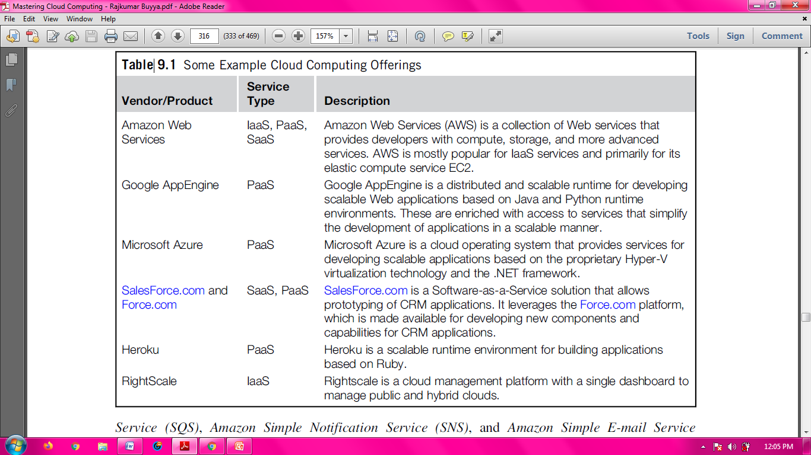

Slide 6
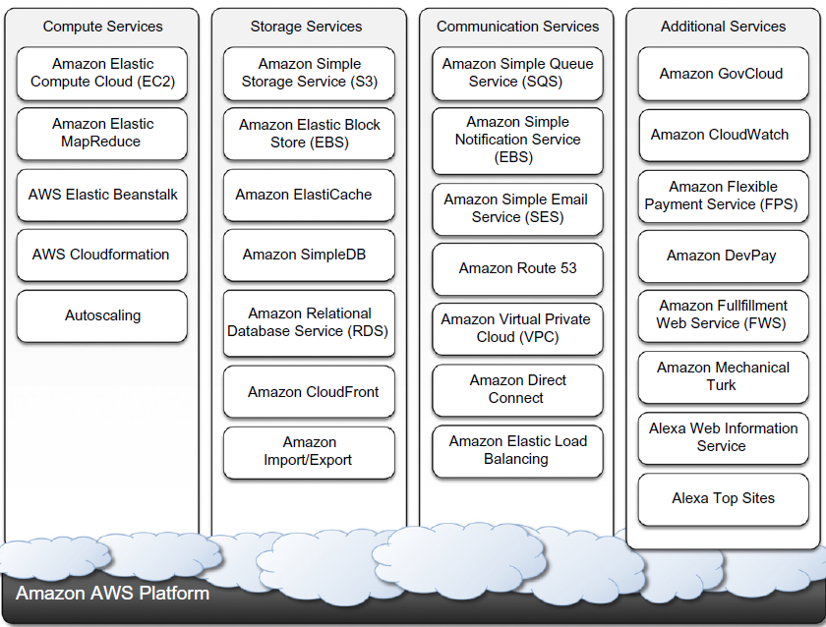
Fig: Amazon AWS Platform

Slide 7
At the base of the solution stack are services that provide raw compute and raw storage:
Amazon ElasticCompute(EC2) and Amazon Simple Storage Service(S3):These are the two most popular services, which are generally complemented with other offerings for building a complete system.
At the higher level, Elastic Map Reduce and Auto Scaling provide additional capabilities for building smarter and more elastic computing systems.
On the data side, Elastic Block Store(EBS), Amazon Simple DB, Amazon RDS, and Amazon ElastiCache provide solutions for reliable data snapshots and the management of structured and semi structured data.
Communication needs are covered at the networking level by Amazon Virtual Private Cloud(VPC), Elastic Load Balancing, Amazon Route 53, and Amazon Direct Connect.
More advanced services for connecting applications are Amazon Simple Queue Service (SQS), Amazon Simple Notification Service(SNS), and Amazon Simple E-mail Service (SES).

Slide 8
Other services include:
Amazon Cloud Front Content delivery network solution.
Amazon Cloud Watch monitoring solution for several Amazon services.
Amazon Elastic Bean Stalk and Cloud Formation flexible application packaging and deployment
Services provided by Amazon Web Service:
1. Compute Services
2. Storage Services
3. Communication Services
4. Additional Services

Slide 9
1. Compute Services: It constitute the fundamental element of cloud computing systems.
The fundamental service in this space is Amazon EC2, which delivers an IaaS solution.
Amazon EC2 allows deploying servers in the form of virtual machines created as instances of a specific image.
Images come with a preinstalled operating system and a software stack, and instances can be configured for memory, number of processors, and storage.
Users are provided with credentials to remotely access the instance and further configure or install software if needed.

Slide 10
Amazon Machine Images(AMIs): These are templates from which it is possible to create a virtual machine.
They are stored in Amazon S3 and identified by a unique identifier in the form of ami-xxxxxx and a manifest XML file.
An AMI contains a physical file system layout with a predefined operating system installed.
These are specified by the Amazon Ramdisk Image (ARI, id: ari-yyyyyy) and the Amazon Kernel Image (AKI, id: aki-zzzzzz), which are part of the configuration of the template.
AMIs are either created from scratch or “bundled” from existing EC2 instances. A common practice is to prepare new AMIs to create an instance from a preexisting AMI.
We can convert the instance into a new image.
Once an AMI is created, it is stored in an S3 bucket and the user can decide whether to make it available to other users or keep it for personal use.

Slide 11
EC2 Instances: It represent virtual machines.
They are created using AMI as templates, which are specialized by selecting the number of cores, their computing power, and the installed memory.
The processing power is expressed in terms of virtual cores and EC2 Compute Units (ECUs).
The ECU is a measure of the computing power of a virtual core; it is used to express a predictable quantity of real CPU power that is allocated to an instance.

Slide 12
Currently Available Configurations for Ec2 Instances:
Standard Instances: This class offers a set of configurations that are suitable for most applications.
Micro Instances: This class is suitable for those applications that consume a limited amount of computing power and memory and occasionally need bursts in CPU cycles to process surges in the workload.
Micro instances can be used for small Web applications with limited traffic.
High-Memory Instances: This class targets applications that need to process huge workloads and require large amounts of memory.
Three-tier Web applications characterized by high traffic are the target profile.
High-CPU Instances: This class targets compute-intensive applications.

Slide 13
Cluster Compute Instances: This class is used to provide virtual cluster services. Instances in this category are characterized by high CPU compute power and large memory and an extremely high I/O and network performance, which makes it suitable for HPC applications.
Cluster GPU Instances: This class provides instances featuring graphic processing units (GPUs) and high compute power, large memory, and extremely high I/O and network performance.
This class is particularly suited for cluster applications that perform heavy graphic computations, such as rendering clusters.
Since GPU can be used for general purpose computing, users of such instances can benefit from additional computing power, which makes this class suitable for HPC applications.

Slide 14
2. Storage Services: AWS provides a collection of services for data storage and information management.
The core service in this area is represented by Amazon Simple Storage Service (S3).
Amazon Simple Storage Service (S3): This is a distributed object store that allows users to store information in different formats.
The core components of S3 are two: Buckets and objects. Buckets represent virtual containers in which to store objects.
Objects represent the content that is actually stored.
Objects can also be enriched with metadata that can be used to tag the stored content with additional information.

Slide 15
S3 key concepts:
The storage is organized in a two-level hierarchy.
S3 organizes its storage space into buckets that cannot be further partitioned.
This means that it is not possible to create directories or other kinds of physical groupings for objects stored in a bucket.
Stored objects cannot be manipulated like standard files.
S3 has been designed to essentially provide storage for objects that will not change over time.
Therefore, it does not allow renaming, modifying, or relocating an object.
Once an object has been added to a bucket, its content and position is immutable, and the only way to change it is to remove the object from the store and add it again.

Slide 16
Content is not immediately available to users.
The main design goal of S3 is to provide an eventually consistent data store.
As a result, because it is a large distributed storage facility, changes are not immediately reflected.
For instance, S3 uses replication to provide redundancy and efficiently serve objects across the globe; this practice introduces latencies when adding objects to the store especially large ones which are not available instantly across the entire globe.
Requests will occasionally fail.
Due to the large distributed infrastructure being managed, requests for object may occasionally fail.
Under certain conditions, S3 can decide to drop a request by returning an internal server error.
Therefore, it is expected to have a small failure rate during day-to-day operations, which is generally not identified as a persistent failure.

Slide 17
Resource Naming : Buckets, objects, and attached metadata are made accessible through a REST interface.
Therefore, they are represented by uniform resource identifiers (URIs) under the s3.amazonaws.com domain.
All the operations are then performed by expressing the entity they are directed to in the form of a request for a URI.
Amazon offers three different ways of addressing a bucket:
1. Canonical form: http://s3.amazonaws.com/bukect_name/object_name
2. Subdomain form:
http://bucket-name/s3.amzonaws.com/object_name
3. Virtual hosting form:
http://bucket-name.com/object_name

Slide 18
1. Canonical form:
http://s3.amazonaws.com/bukect_name/
The bucket name is expressed as a path component of the domain name s3.amazonaws.com.
This is the naming convention that has less restriction in terms of allowed characters, since all the characters that are allowed for a path component can be used.

Slide 19
2. Subdomain form:
http://bucket-name/s3.amzonaws.com/object_name
To express a bucket name in this form, the name has to do all of the following:
Be between 3 and 63 characters long
Contain only letters, numbers, periods, and dashes
Start with a letter or a number
Contain at least one letter
Have no fragments between periods that start with a dash or end with a dash or that are empty strings
This form is equivalent to the previous one when it can be used, but it is the one to be preferred since it works more effectively for all the geographical locations.

Slide 20
3. Virtual hosting form:
http://bucket-name.com/object_name
Amazon also allows referencing of its resources with custom URLs.
This is accomplished by entering a CNAME record into the DNS that points to the sub domain form of the bucket URL.
Since S3 is logically organized as a flat data store, all the buckets are managed under the s3.amazonaws.com domain.

Slide 21
Buckets:
A bucket is a container of objects.
It can be thought of as a virtual drive hosted on the S3 distributed storage, which provides users with a flat store to which they can add objects.
Buckets are top level elements of the S3 storage architecture and do not support nesting. That is, it is not possible to create “sub buckets” or other kinds of physical divisions.
A bucket is located in a specific geographic location and eventually replicated for fault tolerance and better content distribution.
Users can select the location at which to create buckets, which by default are created in Amazon’s U.S. datacenters.
Users create a bucket by sending a PUT request to http://s3.amazonaws.com/ with the name of the bucket.

Slide 22
The content of a bucket can be listed by sending a GET request specifying the name of the bucket.
Once created, the bucket cannot be renamed or relocated.
If it is necessary to do so, the bucket needs to be deleted and recreated.
The deletion of a bucket is performed by a DELETE request, which can be successful if and only if the bucket is empty.

Slide 23
Objects And Metadata:
Objects constitute the content elements stored in S3.
An object is identified by a name that needs to be unique within the bucket in which the content is stored.
The name cannot be longer than 1,024 bytes when encoded in UTF-8.
Users create an object via a PUT request that specifies the name of the object together with the bucket name, its contents, and additional properties.
The maximum size of an object is 5 GB.
Once an object is created, it cannot be modified, renamed, or moved into another bucket.
It is possible to retrieve an object via a GET request.
Deleting an object is performed via a DELETE request.

Slide 24
Objects can be tagged with metadata, which are passed as properties of the PUT request.
Such properties are retrieved either with a GET request or with a HEAD request, which only returns the object’s metadata without the content.
Metadata are both system and user defined:
The first ones are used by S3 to control the interaction with the object.
The second ones are meaningful to the user, who can store up to 2 KB per metadata property represented by a key value pair of strings.

Slide 25
Access control and security: Amazon S3 allows controlling the access to buckets and objects by means of Access Control Policies (ACPs).
An ACP is a set of grant permissions that are attached to a resource expressed by means of an XML configuration file.
Currently, five different permissions can be used:
1. READ allows the grantee to retrieve an object and its metadata and to list the content of a bucket as well as getting its metadata.
2. WRITE allows the grantee to add an object to a bucket as well as modify and remove it.
3. READ_ACP allows the grantee to read the ACP of a resource.
4. WRITE_ACP allows the grantee to modify the ACP of a resource.
5. FULL_CONTROL grants all of the preceding permissions.
Grantees can be either single users or groups.

Slide 26
Amazon Elastic Block Store: The Amazon EBS allows AWS users to provide EC2 instances with persistent storage in the form of volumes that can be mounted at instance startup.
They accommodate up to 1 TB of space and are accessed through a block device interface, thus allowing users to format them according to the needs of the instance they are connected to (raw storage, file system, or other).
The content of an EBS volume survives the instance life cycle and is persisted into S3.
EBS volumes can be cloned, used as boot partitions, and constitute durable storage since they rely on S3 and it is possible to take incremental snapshots of their content.
EBS volumes normally reside within the same availability zone of the EC2 instances that will use them to maximize the I/O performance.
It is also possible to connect volumes located in different availability zones.

Slide 27
Once mounted as volumes, their content is lazily loaded in the background and according to the request made by the operating system.
This reduces the number of I/O requests that go to the network.
Volume images cannot be shared among instances, but multiple (separate) active volumes can be created from them.
In addition, it is possible to attach multiple volumes to a single instance.
The expense related to a volume comprises the cost generated by the amount of storage occupied in S3 and by the number of I/O requests performed against the volume.
Currently, Amazon charges $0.10/GB/month of allocated storage and $0.10 per 1 million requests made to the volume.

Slide 28
Amazon ElastiCache: It is an implementation of an elastic in-memory cache based on a cluster of EC2 instances.
It provides fast data access from other EC2 instances through a Memcached-compatible protocol so that existing applications based on such technology do not need to be modified and can transparently migrate to ElastiCache.
ElastiCache is based on a cluster of EC2 instances running the caching software, which is made available through Web services.
An ElastiCache cluster can be dynamically resized according to the demand of the client applications.

Slide 29
Structured Storage Solutions:
Traditionally, RDBMS have been the common data back-end for a wide range of applications.
Amazon provides applications with structured storage services in three different forms:
1. Preconfigured EC2 AMIs,
2. Amazon Relational Data Storage (RDS), and
3. Amazon SimpleDB.
1. Preconfigured EC2 AMIs are predefined templates featuring an installation of a given database management system.
Available AMIs include installations of IBM DB2, Microsoft SQL Server, MySQL, Oracle, PostgreSQL, Sybase, and Vertica.
Instances are priced hourly according to the EC2 cost model. This solution poses most of the administrative burden on the EC2 user, who has to configure, maintain, and manage the relational database, but offers the greatest variety of products to choose from.

Slide 30
2. Amazon RDS is relational database service that relies on the EC2 infrastructure and is managed by Amazon.
Developers do not have to worry about configuring the storage for high availability, designing failover strategies, or keeping the servers up-to-date with patches.
Moreover, the service provides users with automatic backups, snapshots, point-in-time recoveries, and facilities for implementing replications.
These and the common database management services are available through the AWS console or a specific Web service.

Slide 31
3. Amazon SimpleDB is a lightweight, highly scalable, and flexible data storage solution for applications that do not require a fully relational model for their data.
SimpleDB provides support for semi structured data, the model for which is based on the concept of domains, items, and attributes.
Amazon Cloudfront is an implementation of a content delivery network on top of the Amazon distributed storage infrastructure.
It leverages a collection of edge servers strategically located around the globe to better serve requests for static and streaming Web content so that the transfer time is reduced as much as possible.

Slide 32
3. COMMUNICATION SERVICES Amazon provides facilities to structure and facilitate the communication among existing applications and services residing within the AWS infrastructure.
These facilities can be organized into two major categories:
Virtual Networking and
Messaging.
Virtual Networking comprises a collection of services that allow AWS users to control the connectivity to and between compute and storage services. Amazon Virtual Private Cloud (VPC) and Amazon Direct Connect provide connectivity solutions in terms of infrastructure.
Route 53 facilitates connectivity in terms of naming.

Slide 33
Messaging Services constitute the next step in connecting applications by leveraging AWS capabilities.
The three different types of messaging services offered are
Amazon Simple Queue Service (SQS),
Amazon Simple Notification Service (SNS), and
Amazon Simple Email Service (SES).

Slide 34
Additional services: Besides compute, storage, and communication services, AWS provides a collection of services that allow users to utilize services in aggregation.
The two relevant services are
Amazon CloudWatch and
Amazon Flexible Payment Service (FPS).
Amazon CloudWatch is a service that provides a comprehensive set of statistics that help developers understand and optimize the behavior of their application hosted on AWS.
CloudWatch collects information from several other AWS services: EC2, S3, SimpleDB, CloudFront, and others.
Using CloudWatch, developers can see a detailed breakdown of their usage of the service they are renting on AWS and can devise more efficient and cost-saving applications.
Earlier services of CloudWatch were offered only through subscription, but now it is made available for free to all the AWS users.

Slide 35
Amazon FPS infrastructure allows AWS users to leverage Amazon’s billing infrastructure to sell goods and services to other AWS users.
Using Amazon FPS, developers do not have to set up alternative payment methods, and they can charge users via a billing service.
The payment models available through FPS include one time payments and delayed and periodic payments, required by subscriptions and usage-based services, transactions, and aggregate multiple payments.

Slide 36
Google AppEngine
Google AppEngine is a PaaS implementation that provides services for developing and hosting scalable Web applications.
AppEngine is essentially a distributed and scalable runtime environment that leverages Google’s distributed infrastructure to scale out applications facing a large number of requests by allocating more computing resources to them and balancing the load among them.
The runtime is completed by a collection of services that allow developers to design and implement applications that naturally scale on AppEngine.

Slide 37
ARCHITECTURE AND CORE CONCEPTS:
The platform is logically divided into four major components:
Infrastructure,
Runtime environment,
Underlying storage, and
Set of scalable services that can be used to develop applications.

Slide 38
Infrastructure: AppEngine hosts Web applications, and its primary function is to serve users requests efficiently.
AppEngine’s infrastructure takes advantage of many servers available within Google datacenters.
For each HTTP request, AppEngine locates the servers hosting the application that processes the request, evaluates their load, and, if necessary, allocates additional resources (i.e., servers) or redirects the request to an existing server.
The infrastructure is also responsible for monitoring application performance and collecting statistics on which the billing is calculated.

Slide 39
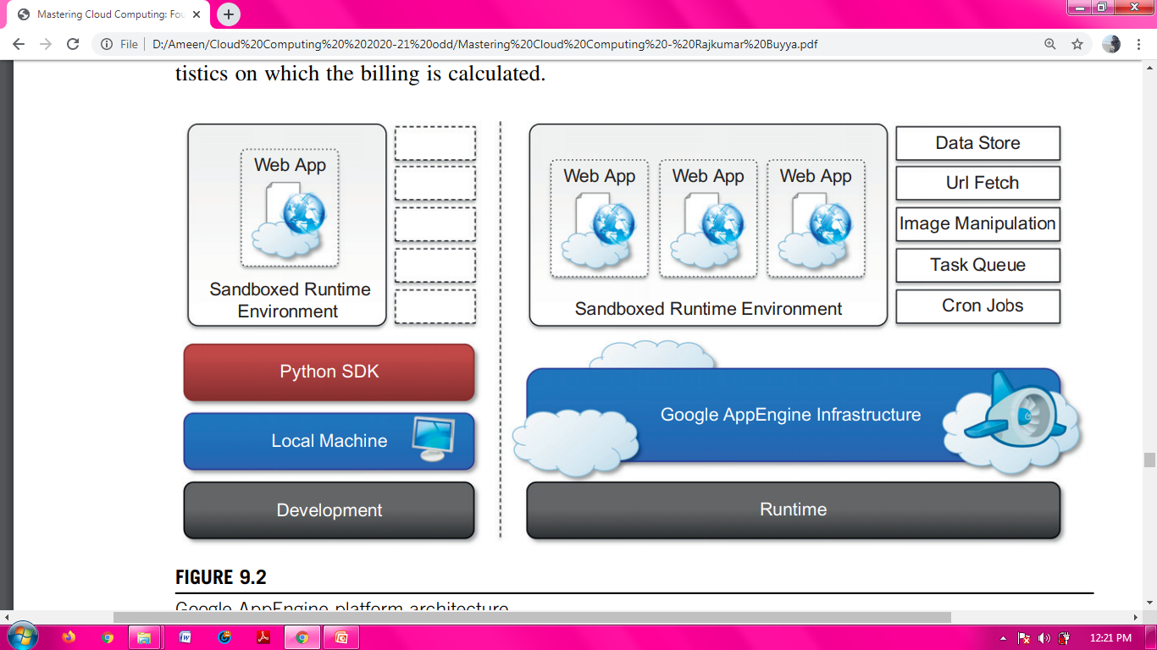
Fig: Google AppEngine Platform Architecture

Slide 40
Runtime Environment : It represents the execution context of applications hosted on AppEngine.
The runtime comes into existence when the request handler starts executing and terminates once the handler has completed.
Sandboxing: One of the major responsibilities of the runtime environment is to provide the application environment with an isolated and protected context in which it can execute without causing a threat to the server and without being influenced by other applications.
AppEngine supports applications that are developed only with managed or interpreted languages, which by design require a runtime for translating their code into executable instructions.
If an application tries to perform any operation that is considered potentially harmful, an exception is thrown and the execution is interrupted.

Slide 41
Supported runtimes Currently, it is possible to develop AppEngine applications using three different languages and related technologies: Java, Python, and Go.
Storage: AppEngine provides various types of storage, which operate differently depending on the volatility of the data.
There are three different levels of storage:
In memory-cache,
Storage for semistructured data, and
Long-term storage for static data.

Slide 42
Static File Servers: Web applications are composed of dynamic and static data.
Dynamic data are a result of the logic of the application and the interaction with the user.
Static data often are mostly constituted of the components that define the graphical layout of the application (CSS files, plain HTML files, JavaScript files, images, icons, and sound files) or data files.
These files can be hosted on static file servers, since they are not frequently modified. Such servers are optimized for serving static content, and users can specify how dynamic content should be served when uploading their applications to AppEngine.

Slide 43
The underlying infrastructure of DataStore is based on Bigtable , a redundant, distributed, and semistructured data store that organizes data in the form of tables.
Developers define their data in terms of entity and properties, and these are persisted and maintained by the service into tables in Bigtable.
DataStore also provides facilities for creating indexes on data and to update data within the context of a transaction.
Indexes are used to support and speed up queries.

Slide 44
Application Services: Applications hosted on AppEngine take the most from the services made available through the runtime environment.
These services simplify most of the common operations that are performed in Web applications:
Access to data,
Account management,
Integration of external resources,
Messaging and
Communication,
Image manipulation, and
Asynchronous computation.

Slide 45
UrlFetch: Web 2.0 has introduced the concept of composite Web applications.
Different resources are put together and organized as meshes within a single Web page.
Meshes are fragments of HTML generated in different ways.
They can be directly obtained from a remote server or rendered from an XML document retrieved from a Web service, or they can be rendered by the browser.
It provide developers with the capability of retrieving a remote resource through HTTP/HTTPS by means of the UrlFetch service.
One of the interesting features of UrlFetch is the ability to set deadlines for requests so that they can be completed (or aborted) within a given time.

Slide 46
MemCache: AppEngine provides caching services by means of MemCache.
This is a distributed in-memory cache that is optimized for fast access and provides developers with a volatile store for the objects that are frequently accessed.
The caching algorithm implemented by MemCache will automatically remove the objects that are rarely accessed.
The use of MemCache can significantly reduce the access time to data; developers can structure their applications so that each object is first looked up into MemCache and if there is a miss, it will be retrieved from DataStore and put into the cache for future lookups.

Slide 47
Mail And Instant Messaging: Communication is another important aspect of Web applications.
AppEngine provides developers with the ability to send and receive mails through Mail.
The service allows sending email on behalf of the application to specific user accounts.
It is also possible to include several types of attachments and to target multiple recipients.
AppEngine provides also another way to communicate with the external world: the Extensible Messaging and Presence Protocol (XMPP).
Any chat service that supports XMPP, such as Google Talk, can send and receive chat messages to and from the Web application.

Slide 48
Account Management: Web applications often keep various data that customize their interaction with users.
These data normally go under the user profile and are attached to an account.
AppEngine simplifies account management by allowing developers to leverage Google account management by means of Google Accounts.
The integration with the service also allows Web applications to offload the implementation of authentication capabilities to Google’s authentication system.
Using Google Accounts, Web applications can conveniently store profile settings, attach them to a given Google account, and quickly retrieve them once the user authenticates.

Slide 49
Image Manipulation: Web applications render pages with graphics.
AppEngine allows applications to perform image resizing, rotation, mirroring, and enhancement by means of Image Manipulation, a service that is also used in other Google products.
Image Manipulation is mostly designed for lightweight image processing and is optimized for speed.

Slide 50
Compute Services: Web applications are mostly designed to interface applications with users by means of a ubiquitous channel, that is, the Web.
Users navigate the Web pages and get instantaneous feedback in response to their actions.
This feedback is often the result of some computation happening on the Web application, which implements the intended logic to serve the user request.

Slide 51
Task Queues: It allow applications to submit a task for a later execution.
This service is particularly useful for long computations that cannot be completed within the maximum response time of a request handler.
The service allows users to have up to 10 queues that can execute tasks at a configurable rate.
A task is defined by a Web request to a given URL, and the queue invokes the request handler by passing the payload as part of the Web request to the handler.
It is the responsibility of the request handler to perform the “task execution,” which is seen from the queue as a simple Web request.
The queue is designed to reexecute the task in case of failure in order to avoid transient failures preventing the task from a successful completion.

Slide 52
Cron Jobs: It is possible to schedule the required operation at the desired time by using the Cron Jobs service.
This service operates similarly to Task Queues but invokes the request handler specified in the task at a given time and does not reexecute the task in case of failure.
This behavior can be useful to implement maintenance operations or send periodic notifications.

Slide 53
Application Life Cycle AppEngine provides support for almost all the phases characterizing the life cycle of an application: testing and development, deployment, and monitoring.
The SDKs released by Google provide developers with most of the functionalities required by these tasks.
Currently there are two SDKs available for development: Java SDK and Python SDK.
Application Development and Testing: Developers can start building their Web applications on a local development server.
This is a self contained environment that helps developers tune applications without uploading them to AppEngine.
The development server simulates the AppEngine runtime environment by providing a mock implementation of DataStore, MemCache, UrlFetch, and the other services leveraged by Web applications.

Slide 54
Besides hosting Web applications, the development server contains a complete set of monitoring features that are helpful to profile the behavior of applications, especially regarding access to the DataStore service and the queries performed against it.
AppEngine builds indexes for each of the queries performed by a given application in order to speed up access to the relevant data.
Java SDK: It provides developers with the facility for building applications with the Java 5 and Java 6 runtime environments.
Alternatively, it is possible to develop applications within the Eclipse development environment by using the Google AppEngine plug-in, which integrates the features of the SDK within the powerful Eclipse environment.
Using the Eclipse software installer, it is possible to download and install Java SDK, Google Web Toolkit, and Google AppEngine plug-ins into Eclipse.

Slide 55
Python SDK: It allows developing Web applications for AppEngine with Python 2.5.
It provides a standalone tool, called GoogleAppEngineLauncher, for managing Web applications locally and deploying them to AppEngine.
The tool provides a convenient user interface that lists all the available Web applications, controls their execution, and integrates them with the default code editor for editing application files.
In addition, the launcher provides access to some important services for application monitoring and analysis, such as the logs, the SDK console, and the dashboard.
The log console captures all the information that is logged by the application while it is running.

Slide 56
The console SDK provides developers with a Web interface via which they can see the application profile in terms of utilized resource.
This feature is particularly useful because it allows developers to preview the behavior of the applications once they are deployed on AppEngine, and it can be used to tune applications made available through the runtime.
The Python implementation of the SDK also comes with an integrated Web application framework called webapp that includes a set of models, components, and tools that simplify the development of Web application.

Slide 57
Application deployment and management: Once the application has been developed and tested, it can be deployed on AppEngine.
Before performing such task, it is necessary to create an application identifier, which will be used to locate the application from the Web browser by typing the address http:// , application-id..appspot.com.
An application identifier is mandatory because it allows unique identification of the application while it’s interacting with AppEngine.
Developers use an app identifier to upload and update applications.
It is possible to register an application identifier by logging into AppEngine and selecting the “Create application” option.

Slide 58
It is also possible to provide an application title that is descriptive of the application; the title can be changed over time.
Once an application identifier has been created, it is possible to deploy an application on AppEngine.
This task can be done using either the respective development environment (GoogleAppEngineLauncher and Google AppEngine plug-in) or the command-line tools.
Once the application is uploaded, nothing else needs to be done to make it available.
AppEngine will take care of everything.
Developers can then manage the application by using the administrative console.
This is the primary tool used for application monitoring and provides users with insight into resource usage (CPU, bandwidth) and services and other useful counters.
It is also possible to manage multiple versions of a single application, select the one available for the release, and manage its billing-related issues.

Slide 59
Cost Model: AppEngine provides a free service with limited quotas that get reset every 24 hours.
Once the application has been tested and tuned for AppEngine, it is possible to set up a billing account and obtain more allowance and be charged on a pay-per-use basis.
This allows developers to identify the appropriate daily budget that they want to allocate for a given application.
An application is measured against billable quotas, fixed quotas, and per-minute quotas.
Google AppEngine uses these quotas to ensure that users do not spend more than the allocated budget and that applications run without being influenced by each other from a performance point of view.
Once an application reaches the quota for a given resource, the resource is depleted and will not be available to the application until the quota is replenished.
Once a resource is depleted, subsequent requests to that resource will generate an error or an exception.

Slide 60
Microsoft Azure
Windows Azure is Microsoft’s solution for developing cloud computing applications.
Microsoft Windows Azure is a cloud operating system built on top of Microsoft datacenters’ infrastructure and provides developers with a collection of services for building applications with cloud technology.
Services range from compute, storage, and networking to application connectivity, access control, and business intelligence.
Azure services can be managed and controlled through the Windows Azure Management Portal, which acts as an administrative console for all the services offered by the Azure platform.

Slide 61
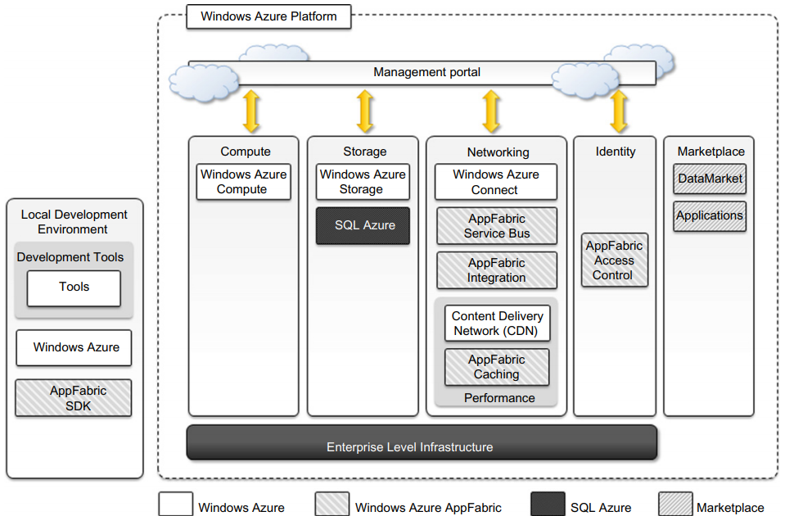
Fig: Microsoft Windows Azure Platform Architecture

Slide 62
Azure Core Concepts: The Windows Azure platform is made up of a foundation layer and a set of developer services that can be used to build scalable applications.
These services cover compute, storage, networking, and identity management, which are tied together by middleware called AppFabric.
This scalable computing environment is hosted within Microsoft datacenters and accessible through the Windows Azure Management Portal.

Slide 63
Compute Services : These are the core components of Microsoft Windows Azure, and they are delivered by means of the abstraction of roles.
A role is a runtime environment that is customized for a specific compute task.
Currently, there are three different roles: Web role, Worker role, and Virtual Machine (VM) role.
The Web Role is designed to implement scalable Web applications.
Web roles represent the units of deployment of Web applications within the Azure infrastructure.
They are hosted on the IIS 7 Web Server, which is a component of the infrastructure that supports Azure.
Since version 3.5, the .NET technology natively supports Web roles; developers can directly develop their applications in Visual Studio, test them locally, and upload to Azure.
It is possible to develop ASP.NET (ASP.NET Web Role and ASP.NET MVC 2 Web Role) and WCF (WCF Service Web Role) applications.
Since IIS 7 also supports the PHP runtime environment by means of the FastCGI module, Web roles can be used to run and scale PHP Web applications on Azure (CGI Web Role).

Slide 64
Worker Role can be used to quickly provide compute power or to host services that do not communicate with the external world through HTTP.
A common practice for Worker roles is to use them to provide background processing for Web applications developed with Web roles.
Compared to a Web role whose computation is triggered by the interaction with an HTTP client (i.e., a browser), a Worker role runs continuously from the creation of its instance until it is shut down.
The Azure SDK provides developers with convenient APIs and libraries that allow connecting the role with the service provided by the runtime and easily controlling its startup as well as being notified of changes in the hosting environment.
As with Web roles, the .NET technology provides complete support for Worker roles, but any technology that runs on a Windows Server stack can be used to implement its core logic.

Slide 65
Virtual Machine Role: The Virtual Machine role allows developers to fully control the computing stack of their compute service by defining a custom image of the Windows Server 2008 R2 operating system and all the service stack required by their applications.
The Virtual Machine role is based on the Windows Hyper-V virtualization technology, which is natively integrated in the Windows server technology at the base of Azure.
Developers can image a Windows server installation complete with all the required applications and components, save it into a Virtual Hard Disk (VHD) file, and upload it to Windows Azure to create compute instances on demand.
Compared to the Worker and Web roles, the VM role provides finer control of the compute service and resource that are deployed on the Azure Cloud.

Slide 66
Storage Services:
Blobs: Azure allows storing large amount of data in the form of binary large objects (BLOBs) by means of the blobs service.
This service is optimal to store large text or binary files.
Two types of blobs are available:
Block Blobs are composed of blocks and are optimized for sequential access; therefore they are appropriate for media streaming.
Currently, blocks are of 4 MB, and a single block blob can reach 200 GB in dimension.
Page Blobs are made of pages that are identified by an offset from the beginning of the blob.
Currently, the maximum dimension of a page blob can be 1 TB.
Blobs storage provides users with the ability to describe the data by adding metadata.
It is also possible to take snapshots of a blob for backup purposes.

Slide 67
Azure Drive : A page blob mounted as part of an NTFS tree is called an Azure Drive.
Tables: It constitute a semistructured storage solution, allowing users to store information in the form of entities with a collection of properties.
Entities are stored as rows in the table and are identified by a key, which also constitutes the unique index built for the table.
Users can insert, update, delete, and select a subset of the rows stored in the table.
Unlike SQL tables, there are no schema enforcing constraints on the properties of entities and there is no facility for representing relationships among entities.
For this reason, tables are more similar to spreadsheets rather than SQL tables.
The service is designed to handle large amounts of data and queries returning huge result sets.

Slide 68
Queues: Queue storage allows applications to communicate by exchanging messages through durable queues, thus avoiding lost or unprocessed messages.
Applications enter messages into a queue, and other applications can read them in a first-in, first-out (FIFO) style.
To ensure that messages get processed, when an application reads a message it is marked as invisible; hence it will not be available to other clients.
Once the application has completed processing the message, it needs to explicitly delete the message from the queue.
This two-phase process ensures that messages get processed before they are removed from the queue, and the client failures do not prevent messages from being processed.

Slide 69
At the same time, this is also a reason that the queue does not enforce a strict FIFO model: Messages that are read by applications that crash during processing are made available again after a timeout, during which other messages can be read by other clients.
All the services described are geo-replicated three times to ensure their availability in case of major disasters.
Geo-replication involves the copying of data into a different datacenter that is hundreds or thousands of miles away from the original datacenter.

Slide 70
Core Infrastructure: AppFabric: It is a comprehensive middleware for developing, deploying, and managing applications on the cloud or for integrating existing applications with cloud services.
AppFabric implements an optimized infrastructure supporting scaling out and high availability; sandboxing and multitenancy; state management; and dynamic address resolution and routing.
On top of this infrastructure, the middleware offers a collection of services that simplify many of the common tasks in a distributed application, such as communication, authentication and authorization, and data access.

Slide 71
Access Control: AppFabric provides the capability of encoding access control to resources in Web applications and services into a set of rules that are expressed outside the application code base.
These rules give a great degree of flexibility in terms of the ability to secure components of the application and define access control policies for users and groups.
Access control services also integrate several authentication providers into a single coherent identity management framework.

Slide 72
Service Bus: It constitutes the messaging and connectivity infrastructure provided with AppFabric for building distributed and disconnected applications in the Azure Cloud and between the private premises and the Azure Cloud.
Service Bus allows applications to interact with different protocols and patterns over a reliable communication channel that guarantees delivery.
Service Bus allows services to be available by simple URLs, which are untied from their deployment location.
A connection is the Service Bus element that is priced by Azure on a pay-as-you-go basis. Users are billed on a connections-per-month basis, and they can buy advance “connection packs,” which have a discounted price, if they can estimate their needs in advance.

Slide 73
Azure Cache: Azure Cache is a service that allows developers to quickly access data persisted on Windows Azure storage or in SQL Azure.
The service implements a distributed in-memory cache of which the size can be dynamically adjusted by applications according to their needs.
Azure Cache is delivered as a service, and it can be easily integrated with applications.
The service is priced according the size of cache allocated by applications per month, despite their effective use of the cache.
Currently, several cache sizes are available, ranging from 128 MB ($45/month) to 4 GB ($325/month).

Slide 74
Other Services: Compute, storage, and middleware services constitute the core components of the Windows Azure platform.
Besides these, other services and components simplify the development and integration of applications with the Azure Cloud.
An important area for these services is applications connectivity, including virtual networking and content delivery.
Windows Azure Virtual Network: Networking services for applications are offered under the name Windows Azure Virtual Network, which includes Windows Azure Connect and Windows Azure Traffic Manager.
Windows Azure Connect allows easy setup of IP-based network connectivity among machines hosted on the private premises and the roles deployed on the Azure Cloud.
Windows Azure Traffic Manager provides load-balancing features for services listening to the HTTP or HTTPS ports and hosted on multiple roles.

Slide 75
Windows Azure Content Delivery Network (CDN) is the content delivery network solution that improves the content delivery capabilities of Windows Azure Storage and several other Microsoft services, such as Microsoft Windows Update.
The service allows serving of Web objects (images, static HTML, CSS, and scripts) as well as streaming content by using a network of 24 locations distributed across the world.

Slide 76
SQL Azure: It is a relational database service hosted on Windows Azure and built on the SQL Server technologies.
The service extends the capabilities of SQL Server to the cloud and provides developers with a scalable, highly available, and fault-tolerant relational database.
SQL Azure is accessible from either the Windows Azure Cloud or any other location that has access to the Azure Cloud.
It is fully compatible with the interface exposed by SQL Server, so applications built for SQL Server can transparently migrate to SQL Azure.

Slide 77
Fig: SQL Azure Architecture

Slide 78
Access to SQL Azure is based on the Tabular Data Stream (TDS) protocol, which is the communication protocol underlying all the different interfaces used by applications to connect to a SQL Server-based installation such as ODBC and ADO.NET.
On the SQL Azure side, access to data is mediated by the service layer, which provides provisioning, billing, and connection-routing services.
These services are logically part of server instances, which are managed by SQL Azure Fabric.
This is the distributed database middleware that constitutes the infrastructure of SQL Azure and that is deployed on Microsoft datacenters.
Developers have to sign up for a Windows Azure account in order to use SQL Azure.
Once the account is activated, they can either use the Windows Azure Management Portal or the REST APIs to create servers and logins and to configure access to servers.

Slide 79
SQL Azure servers are abstractions that closely resemble physical SQL Servers: They have a fully qualified domain name under the database.windows.net (i.e., server-name.database.windows.net) domain name.
SQL Azure ensures that multiple copies of each server are maintained within the Azure Cloud and that these copies are kept synchronized when client applications insert, update, and delete data on them.
Currently, the SQL Azure service is billed according to space usage and the type of edition.
Currently, two different editions are available: Web Edition and Business Edition.
The former is suited for small Web applications and supports databases with a maximum size of 1 GB or 5 GB.
The latter is suited for independent software vendors, line-of-business applications, and enterprise applications and supports databases with a maximum size from 10 GB to 50 GB, in increments of 10 GB.

Slide 80
Windows Azure Platform Appliance: The Windows Azure platform can also be deployed as an appliance on third-party data centers and constitutes the cloud infrastructure governing the physical servers of the datacenter.
The Windows Azure Platform Appliance includes Windows Azure, SQL Azure, and Microsoft specified configuration of network, storage, and server hardware.
The appliance is a solution that targets governments and service providers who want to have their own cloud computing infrastructure.
The Azure appliance is instead a full-featured implementation of Windows Azure.
Its goal is to replicate Azure on a third-party infrastructure and make available its services beyond the boundaries of the Microsoft Cloud.

