Slide 1
Module – 6
Virtualized data center – desktop AND Application
Notes:
Module – 6
Virtualized Data Center – Desktop and Application

Slide 2
Module 6: Virtualized Data Center – Desktop and Application
Upon completion of this module, you should be able to:
  Describe various methods for implementing desktop virtualization, their benefits, and considerations
  Describe application virtualization methods, benefits, and considerations
Notes:
This module focuses on the various aspects of desktop and application virtualization technologies.

Slide 3
Overview of Desktop and Application Virtualization
Tight dependency between the layers
Virtualization breaks dependencies between the layers
User State (data and settings)
Application
Application Virtualization
Isolate the application from OS and hardware
Operating System
Desktop Virtualization
Isolate hardware from OS, application and user state
Hardware
3
Notes:
With the traditional desktop, the OS, applications, and user data are all tied to a specific piece of hardware. With legacy desktops, business productivity is impacted greatly when an end-point device is broken or lost, because it affects the OS, applications, user data, and settings.
In a virtualized desktop, virtualization breaks the bonds between hardware and these elements, enabling the IT staff to change, update, and deploy these elements independently for greater business agility and improved response time. End users also benefit from virtualization because they get the same desktop, but with the added ability to access the computing environment from different kinds of devices and access points in the office, at home, or on the road.
Compute-based virtualization separates the OS from the hardware, but does not inherently address the broader and more important aspects of separating the user’s data, settings, and critical applications, from the OSs themselves. These are very critical for maintaining a productive business environment. By separating the user’s data, settings, and critical applications from OSs, organizations can begin to achieve a true IT–business aligned strategy. This is the fundamental concept underlying virtualized desktops. Virtualization at each layer in a virtualized desktop will be explained in the later slides.
Application virtualization breaks the dependency between the application and the underlying platform that includes the OS and hardware. Application virtualization is discussed later in this module.

Slide 4
Module 6: Virtualized Data Center – Desktop and Application
Lesson 1: Desktop Virtualization
Topics covered in this lesson:
  Desktop virtualization drivers
  Benefits of desktop virtualization
  Desktop virtualization techniques
  User state virtualization
Notes:
This lesson covers the drivers of desktop virtualization and benefits of desktop virtualization. It also includes desktop virtualization techniques.

Slide 5
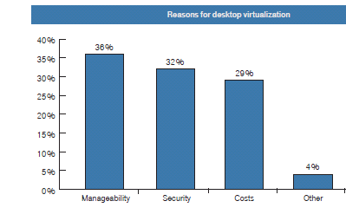
Desktop Virtualization - Drivers
Manageability concerns
  Variety of hardware models, PC refresh cycles, and hardware incompatibilities
Security concerns
  Lost or stolen laptops/desktops
Cost concerns
Source: Goldman Sachs, Independent Insight, US technology Strategy
Notes:
Manageability: One of the major concerns of an organization is management of desktop infrastructure. This is because the core component of a desktop infrastructure is the PC hardware, which continues to evolve rapidly. Organizations are forced to deal with a variety of hardware models, face complicated PC refresh cycles, and handle support problems related to PC hardware incompatibilities with applications. This makes the IT personnel spend most of their time supporting the existing environments instead of deploying new technology.
Security: Applications and data stored in traditional desktops pose severe security threats especially if the desktops/laptops are lost or stolen. Damage due to data loss can be immeasurable. Compliance regulations (e.g., Sarbanes-Oxley, HIPAA) protect privacy and corporate data by restricting the public disclosure of these data when issues arise. Failure to protect this data can lead to significant negative impact to the organization’s reputation.
Cost: The cost of deploying and managing a traditional PC is high and ranges from $160 to $350[1].
[1] IDC, Optimizing Infrastructure, 2006

Slide 6
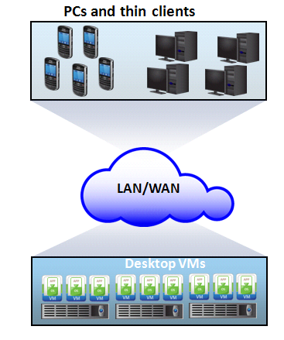
Desktop Virtualization
Enables organizations to host and centrally manage desktops
  Desktops run as virtual machines within the VDC
    They may be accessed over LAN/WAN
  Endpoint devices may be thin clients or PCs
Desktop Virtualization
Technology which enables detachment of the user state, the Operating System (OS), and the applications from endpoint devices.
6
Notes:
The objective of desktop virtualization technology is to centralize the PC Operating System (OS) at the data center. This is to make security and management of desktops significantly easy. Desktops hosted at the data center run as Virtual Machines (VMs) within the VDC, while end users remotely access these desktops from a variety of endpoint devices. Application execution and data storage do not happen at the endpoint devices; everything is done centrally at the data center.
Copyright © 2011 EMC Corporation. Do not Copy - All Rights Reserved.
6

Slide 7
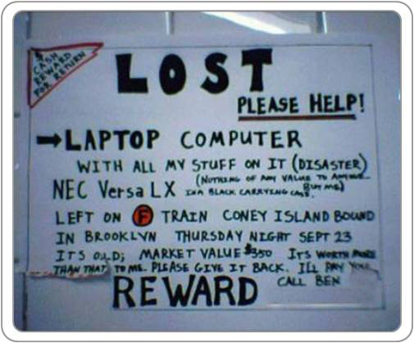
Benefits of Desktop Virtualization
Enablement of thin clients
Improved data security
Simplified data backup
Simplified PC maintenance
Flexibility of access
Notes:
The key benefits of desktop virtualization are as follows:
Enablement of thin clients: Desktop virtualization enables the use of thin clients as endpoint devices. This creates an opportunity to significantly drive down the cost of endpoint hardware by replacing aging PCs with a thin-client device, which typically operates across a life span twice that of a standard PC. Thin clients consume very less power when compared to standard PCs. Hence, they support the “Go Green” strategy of organizations and reduce OPEX.
Improved data security: Since desktops run as VMs within an organization’s data center, it mitigates the risk of data leakage and theft and simplifies compliance procedures.
Simplified data backup: Since centralized virtual desktops reside entirely within an organization’s datacenter, it is easier to ensure full compliance with backup policies.
Simplified PC maintenance: Virtual desktops are far easy to maintain than traditional PCs. Because of the unique characteristics of VMs, it is simple to patch applications, provision/remove users, and migrate to new OSs.
Flexibility of access: If corporate desktop environments are centralized using desktop virtualization techniques, access to them can be provided to users who do not have access to their corporate PCs. This is especially useful in situations where users need to work from home, away from their desks, or other remote worker scenarios.

Slide 8
Desktop Virtualization Techniques
Technique 1: Remote Desktop Services(RDS)
Technique 2: Virtual Desktop Infrastructure (VDI)
Desktop virtualization techniques provide ability to centrally host and manage desktop environments
  Deliver them remotely to the user’s endpoint devices
Notes:
There are two desktop virtualization techniques :RDS and VDI. Both of these solutions provide the ability to centrally host and manage desktop environments and deliver them remotely to the user’s endpoint devices.

Slide 9
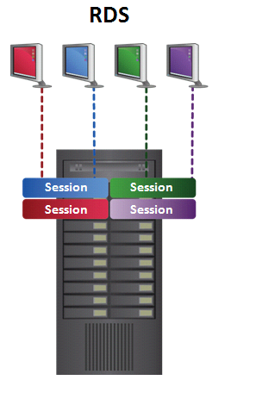
Remote Desktop Services
RDS is traditionally known as terminal services
A terminal service runs on top of a Windows installation
  Provides individual sessions to client systems
  Clients receive visuals of the desktop
  Resource consumption takes place on the server
Notes:
Remote Desktop Services (RDS) is traditionally known as Terminal Services. In RDS, a Terminal Service runs on top of a Windows installation and provides individual sessions to client systems. These sessions can provide a thorough desktop experience while remotely accessing via a terminal services client. The workstation receives the visual feedback of the session, while resource consumption takes place on the server.

Slide 10
Benefits of Remote Desktop Services
Rapid application delivery
  Applications are installed on the server and accessed from there
Improved security
  Applications and data are stored in the server
Centralized management
Low-cost technology when compared to VDI
Notes:
Application delivery is more agile and rapid because applications are installed once on the server and can be accessed by the user without having to install the application locally. Security of the user environment is improved because the user’s applications and data are stored, secured, executed, and accessed centrally instead of being located on the user’s local desktop device. Management of the user environment is easier than a distributed desktop environment because of the centralization of the OS environment, applications, and data settings and its configuration on servers in the datacenter. For example, adding a new user environment is completed without having to install an OS or applications on the local endpoint device. Software updates, patches, and upgrades are also completed on servers instead of on the user’s endpoint device. RDS is a mature technology, easy to implement, and scales well, compared to a VDI solution. An RDS solution can support more users per server than a VDI solution; for example, a typical RDS solution can support 250 or more users per server, compared to a typical VDI solution supporting 30–45 users per server. RDS is also less expensive to implement in terms of initial acquisition cost and supporting infrastructure.
The application developed for desktop operating systems may not necessarily be compatible with server operating systems; for example: Microsoft Windows XP versus Windows Server 2007. This limits the number of desktop applications that could be centralized using RDS.

Slide 11
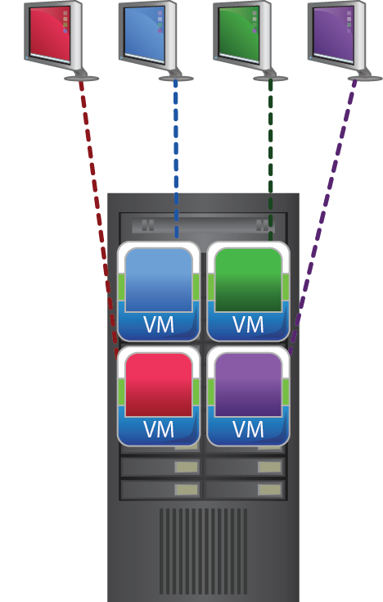
Virtual Desktop Infrastructure(VDI)
VDI involves hosting desktop which runs as VM on the server in the VDC
  Each desktop has its own OS and applications installed
User has full access to resources of virtualized desktop
Notes:
Virtual Desktop Infrastructure (VDI) refers to the hosting of a desktop OS running in a VM on a server in the VDC. A user has full access to the resources of the virtualized desktop. The server-hosted desktop virtualization solution approach is sometimes called as Virtual Desktop Environment (VDE). VDI allows a user to access a remote desktop environment from an endpoint device via a remote desktop delivery protocol. The hosted remote OS and associated applications are shown on the user’s endpoint device display and controlled via the endpoint device’s keyboard and mouse. For the user, the experience is very similar to using the RDS solution, except that the desktop OS is running in a VM hosted on a server, instead of on a remote user session on a single Server OS.
Note: Henceforth, our focus will be more on VDI because that is the most widely used desktop virtualization technology in a VDC.

Slide 12
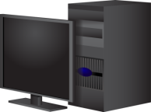
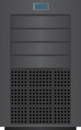


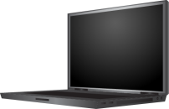
VDI: Components
Endpoint devices
VM hosting/execution servers
Connection Broker
Endpoint devices
VM execution
server
Connection broker
Shared Storage
PCs, notebooks thin clients
Notes:
The VDI architecture consists of several components that work together to provide an end-to-end solution. The main components are endpoint devices, a connection broker, and VM hosting servers. These are explained in detail, later.

Slide 13
VM Hosting Servers
VM hosting servers are responsible for hosting the desktop VMs
  Remotely delivered to the endpoint devices
Each VM may be dedicated to a specific user or allocated in a pool
  A VM pool shares VMs for concurrent use by many users
When provisioning a VM, a template or image may be used as a basis for the creation of the VM, settings, and disk
Notes:
VM hosting servers are responsible for hosting the desktop VMs that are remotely delivered to the endpoint devices. Type 1 hypervisors are most suitable for this type of solution because of their performance and scalability benefits. Additionally, they support a greater number or density of VMs than type 2 hypervisors. The number of VMs that a single server can support depends on several factors including hardware, software, configurations, and user workloads of the desktop VMs.
The desktop VMs may be running any desktop OS, supported by the hypervisor. In VDI, each VM may be dedicated to a specific user(persistent desktop) or allocated in a pool(non-persistent desktop). A VM pool shares VMs for concurrent use by many users. VM pools have the potential to save VM disk storage requirements. For example, if an organization has 100 users, but only 50 are concurrent at any one time, then they could pre-provision 50 VMs in a pool and allocate them as per request. This deployment option saves 50 percent of the VM storage required for individual OSs and applications. Each VM can be preprovisioned for later use or dynamically provisioned at the time of end-user request.
When provisioning a VM, a template or image can be used as a basis for VM creation, settings, and disk. Advanced provisioning technology allows a VM to be provisioned using a single image (Linked clone technology is explained in detail in module 7, Business Continuity in VDC). When there is a request, instead of allocating a complete disk image for every user VM, only a single image is used to provision the VM dynamically. This provisioning solution option has the potential to save a significant amount of VM disk storage. The savings result in provisioning a VM from a single image, thereby not requiring a full VM disk image for every VM.

Slide 14
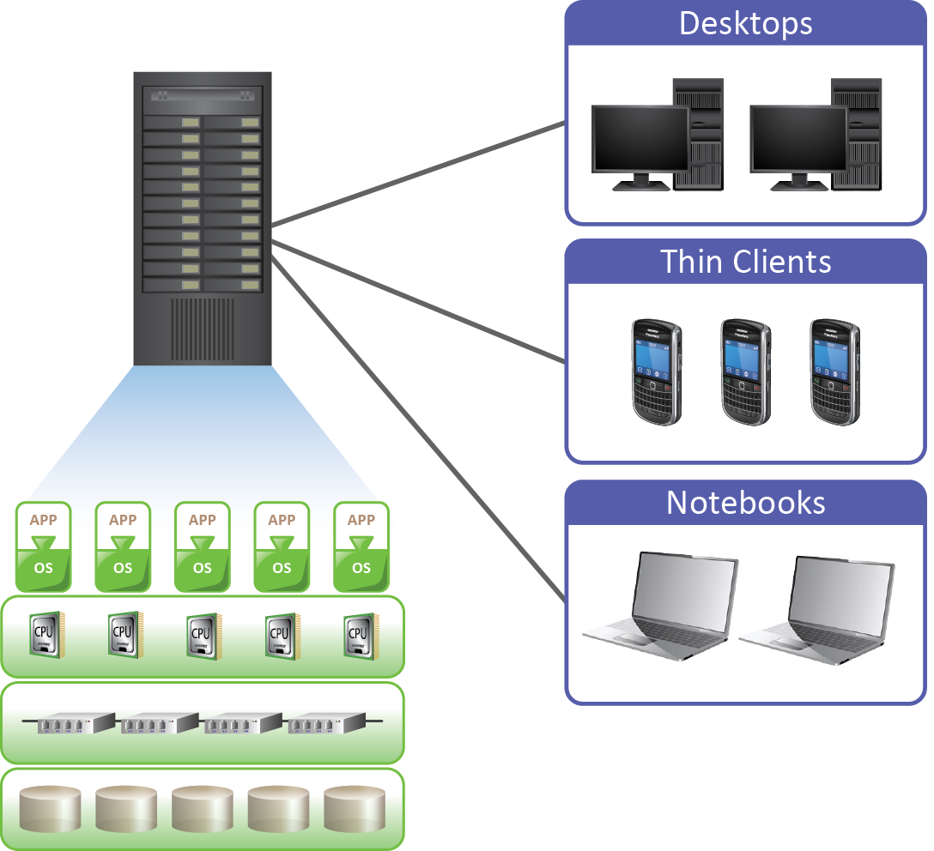
Connection Broker
It is responsible for establishing and managing the connection
  Between the endpoint device and the desktop VM
Connection Broker
Notes:
The connection broker is responsible for establishing and managing the connection between the endpoint device and the desktop VM that is running on the VM-hosting server. The connection broker provides manageability, security, reliability, and scalability benefits. A connection broker is generally needed as part of the VDI solution for a larger or more complex environment. One example where a connection broker would be needed is with VM pools. In this case, the connection broker would connect the user to an available VM in the pool. There are some cases where a connection broker may not be needed for a VDI solution. One example would be when an organization dedicates VMs to each user. In this case, the user would be configured to connect directly to the same VM by a computer name or IP address. It is important to determine whether the connection broker is compatible and supports the hypervisor that is used by the VM hosting server.

Slide 15
VDI: Benefits and Considerations
Considerations
  Reliance on network connection
  Unsuitable for high-end graphic applications
  Requires additional infrastructure
Benefit
Centralized deployment and management
Improved security
Improved Business Continuity and Disaster recovery
Notes:
Improved Deployment and Management: VDI has the potential to improve desktop OS deployment agility and management efficiency. Deployment agility improvements come from centralizing the desktop OS images on servers in the datacenter and creating virtual images of the OSs. A VDI environment can enable rapid desktop OS environment provisioning and deployment. This is enabled by virtualizing the desktop environment by decoupling the OS environment from the physical hardware of the desktop device. Desktop OS environments are provisioned from preconfigured VM templates or images. They are then deployed by distributing the VM files to the appropriate hosting server, from where they will run and be accessed by the user. A VDI environment can be more efficient to manage than a distributed, nonvirtualized desktop environment. Increased management efficiency is achieved because the desktop OS environment is centralized on hosting servers in the datacenter. By this approach, desktop environments can be more effectively managed.
Improved Security: VDI also provides security benefits for the desktop environment. The benefits come from storing and running the desktop OS environment on centralized servers located in the datacenter, instead of on distributed desktops or endpoint devices. If the desktop or laptop is lost or stolen, the user’s desktop environment is still protected. Centralization of the desktop environment on servers in the datacenter, good management practices, and software can make implementation of security software updates more efficient.

Slide 16
VDI: Benefits and Considerations
Considerations
  Reliance on network connection
  Unsuitable for high-end graphic applications
  Requires additional Infrastructure
Benefit
Centralized deployment and management
Improved security
Improved Business Continuity and Disaster recovery
Notes:
Better Business Continuity and Disaster Recovery: Desktop business continuity and disaster recovery can be improved by implementing VDI. Business continuity improvements are enabled by centralizing the desktop OS, applications, and data in the datacenter, where administrators can easily perform backup and recovery operations.
The Limitations of VDI are as follows:
Reliance on Network Connection: A VDI solution relies on the network connection to work. If the user’s endpoint device cannot connect to the hosting server, the user will be unable to access their desktop, applications, and data. In addition to reliability of connection, the network should have suitable bandwidth and low latency to provide a good user experience.
Unsuitable for High-End Graphic Applications: Typically, a VDI solution is not suitable for users who use high-end graphic applications. This is mainly due to the inability of the remote desktop delivery protocols in a VDI solution to provide the required performance levels for this type of application.
Additional Infrastructure Required: A VDI solution requires additional servers, storage, and networking infrastructure. The amount of additional infrastructure required depends on the scale, performance, and service level requirements of an organization. A VDI solution may potentially introduce a significant number of new servers and added storage into the datacenter; for example, if an organization is planning to support 5,000 dedicated users with their VDI solution, hosting 50 users per server, they would need 100 additional servers just to run the VMs. Additional shared storage would also be needed for this solution and the amount depends on the VM provisioning methods used.

Slide 17
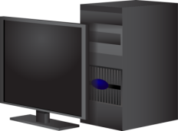
User State Virtualization
User state includes user’s data as well as application and OS configuration settings
User state virtualization is enabling technology for implementing desktop virtualization
User state virtualization stores user’s data and settings in a central location
User state virtualization benefits:
  Easier migration of user state during Operating System refresh/migration
  Makes data available to user regardless of endpoint device
User State Virtualization
User PC
Server
Central copy of
user data and settings
User State
Local Storage
User State
Central Storage
17
Notes:
User state virtualization is a key requirement for implementing desktop virtualization. The user state includes user’s data as well as application and OS configuration settings. Traditionally, user’s PCs contain the authoritative copy of user’s data and settings. There are three main challenges with managing the user state.
The first challenge is how to back up user data and settings that are scattered from PC to PC and restore the user’s productivity after a laptop is lost or stolen.
The second challenge is how to migrate the user state during OS refresh/migrations.
The final challenge is how to make the data available to the user, regardless of the PC (endpoint device) used. In any case, user state virtualization provides a solution.
In any of the above situation, ‘user state’ virtualization provides a solution. With user state virtualization, organizations store user’s data and settings in a central location. The result is that users are free to roam, and their data and settings follow them. User state virtualization can also mitigate productivity loss of PC replacement. The central copy of the data is on the network. So, it is easily restored in case of a lost or stolen PC, and the user’s settings can be re-applied automatically.
Copyright © 2011 EMC Corporation. Do not Copy - All Rights Reserved.
17

Slide 18
Module 6: Virtualized data center – Desktop and Application
Lesson 2: Application Virtualization
Topics covered in this lesson:
  Application virtualization deployment methods
  Benefits of application virtualization
Notes:
This lesson covers the application virtualization deployment methods and benefits of application virtualization.

Slide 19
Application Virtualization
Allows application to be delivered in an isolated environment
  Aggregates Operating System (OS) resources and the application into a virtualized container
  Ensures integrity of Operating System (OS) and applications
  Avoids conflicts between different applications or different versions of the same application
Application Virtualization
It is the technique of presenting an application to an end user without any installation, integration, or dependencies on the underlying computing platform
Notes:
Application virtualization software is increasingly leveraged by organizations to address challenges associated with the application life cycle, particularly those processes associated with application testing and deployment. Fundamentally, application virtualization software aggregates OS resources and isolates them within a virtualized container along with the application that accesses them. This technology provides the ability to deploy applications without modifying or making any change to the underlying OS, file system, or registry of the computing platform in which they are deployed. Because virtualized applications run in an isolated environment, the underlying OS and other applications are protected from potential corruptions which may be caused due to installation modifications. There are many scenarios where conflicts may arise if multiple applications/multiple versions of the same application are installed on the same computing platform. One such example is where Microsoft Access databases have been employed by an organization using a different version of Microsoft Access than the company standard. Because two versions of Microsoft Access cannot be installed on the same computing platform at the same time, one (or both) of them may be virtualized to overcome this problem and used simultaneously.

Slide 20
Application Virtualization: Deployment Methods
Application Encapsulation
  Application is converted into a self-contained package
    Does not rely on software installation or underlying OS
  Application packages may run from USB, CD-ROM, or local disk
  Built-in agents are present within the package
Application Streaming
  Application specific data/resources are transmitted to the client device when the application is executed
  Minimum amount of data (commonly between 10%-30% of the total application) is delivered to the client
    Before the application is launched
  Additional application features are delivered on demand
  Locally installed agents are required to run virtualized application
Notes:
The two methods which are commonly used for deploying application virtualization are application streaming and application encapsulation.
Application encapsulation packages the application in a self-contained executable package that does not rely on a software installation or an underlying OS for any dependencies. This package is accessible from the network on a USB key or via local storage. Because these applications have the capability to function like standalone executables, they do not require any agent to be installed locally in the client machine where they run (built-in agents are present within the package).
Application Streaming involves transporting application specific data/resources to the client device when the application is executed. Only a minimum amount of data (commonly between 10 to 30 percent of the total application) is delivered to a client before the application is launched. Hence, the first time launch of the application happens very quickly and the load on the network is also reduced. Additional features of the application are delivered on demand or in the background without user intervention. Application packages are stored on a (centralized) server. Application streaming is suitable in a well-networked environment (Example: VDI, RDS, and so on). Streaming involves the use of a locally installed agent on the client machine. This agent has the functionality to setup and maintain the Virtual Environment for each application. The agent takes care of management tasks (such as Shortcut creation) and is a key component in the streaming behavior.

Slide 21
Application Virtualization: Benefits
Simplified application deployment/retirement
  Applications are not installed
Simplified operating system image management
  Applications are completely separate from OS
  OS patches and upgrades do not affect the applications
Elimination of resource conflicts
  Applications have their own virtual OS resources
Notes:
Benefits of Application Virtualization are as follows:
Simplified application deployment/retirement: Applications are never installed on to an OS; hence, the deployment of the applications is greatly simplified. Furthermore, complete removal of all application bits from a PC during retirement is assured.
Simplified Operating System image management: Because applications are completely separated from the OS, managing OS images is simpler, especially during OS patches and upgrades. It helps to create a more dynamic desktop environment, in which the desktop is an aggregation of separately-managed components.
Elimination of resource conflicts: Because the each application has its own virtual OS resources, resource contention and application conflict issues are eliminated.

Slide 22
Module 6: Virtualized Data Center – Desktop
Concepts in Practice
Topics covered in this lesson:
VMware ThinApp
VMware View
22
Notes:
The Concept in Practice section covers the product examples of desktop and application virtualization technologies. The products covered are VMware View and VMware ThinApp.

Slide 23
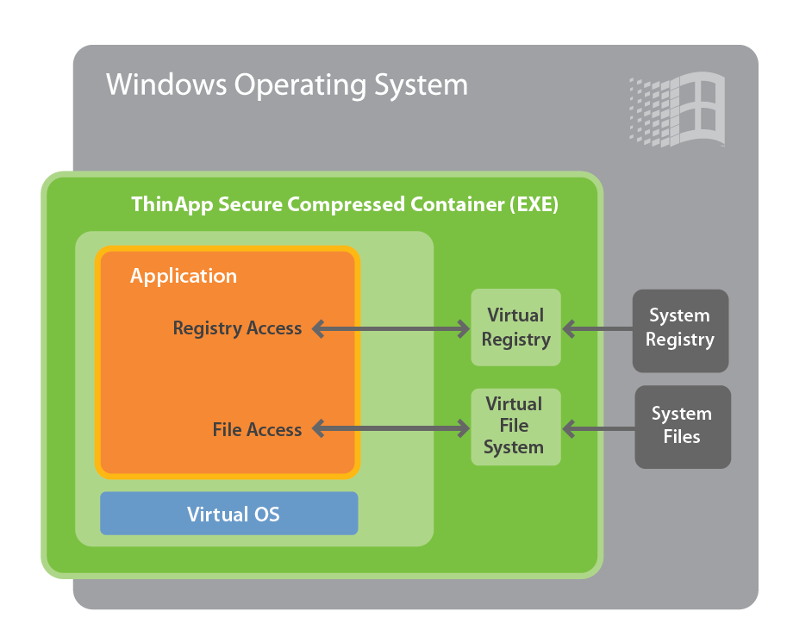
Concept in Practice: VMware ThinApp
Links the application, Virtual Operating System (VOS), file system, and registry into a single package
Enables applications to run directly from storage devices such as USB or network share
Also Supports 64-bit Operating System
  Virtualizes and runs 32-bit application on 64-bit OSs
Notes:
VMware ThinApp, an application virtualization solution, eliminates application conflicts by packaging the entire application and its settings into an executable file that is isolated from the desktop OS. ThinApp simplifies application deployment and updates. It fits into any existing infrastructure. ThinApp enables applications to run directly from storage devices such as USB flash or network shares by using block‐based streaming with transparent decompression.

Slide 24
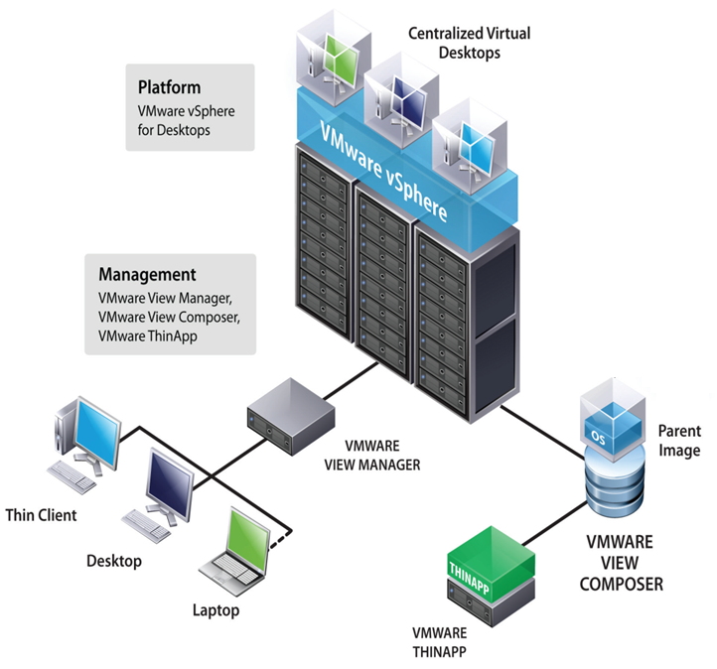
Concept in Practice: VMware View
VMware View Manager:
  Provides centralized management and brokering of connections to desktops in the data center
VMware View Composer:
  Provides storage optimization to reduce storage requirements and to simplify desktop management
24
Notes:
vSphere for Desktops
VMware View is tightly integrated with vSphere and therefore leverages and benefits from the robust set of features in that platform.
vSphere includes many features and optimizations built specifically for delivering VMware View.
vSphere provides rich application and infrastructure services. It has strong integration with compute and storage and network infrastructure through APIs.
Management software
All management components are run on VMs (vCenter, VMware View Manager, and all security VMs).
vCenter is used for the management of virtualization platform
VMware View Manager: View Manager is the core to the VMware View solution, providing centralized management of the desktop environment and brokering of connections to desktops in the data center
VMware View Composer: View Composer delivers storage optimizations to reduce storage requirements and to simplify desktop management.
VMware ThinApp: ThinApp addresses the requirement for application virtualization in both virtual and physical desktop environments
User Experience
Users can access their virtual desktops from a variety of devices including desktops, laptops, and thin clients.
These users can be on the LAN or across the WAN.
VMware View has a number of technologies to enhance user experience.

Slide 25
Module 6: Summary
Key points covered in this module:
Drivers and benefits of desktop virtualization
Desktop virtualization techniques
Remote Desktop Services
Virtual Desktop Infrastructure: Components
User profile virtualization
Application virtualization
Notes:
This module covered the concepts of desktop, application, and user state virtualization. Traditional desktops have significant management and maintenance overhead and also lack security, if they are lost or stolen. This leads to the evolution of virtualization of desktops, applications, and user states.
The two desktop virtualization techniques are RDS and VDI. In RDS, a Terminal Service runs on top of a single Windows installation, and provides individual sessions to client systems. Virtual Desktop Infrastructure (VDI) refers to hosting a desktop OS running in a VM on a server at the VDC. VDI is widely used when compared to RDS in a VDC environment.
Application virtualization enables running an application without installation or any other dependencies on the underlying computing platform. Application streaming and application encapsulation are the commonly used methods for deploying application virtualization.
User-profile virtualization involves storing user’s data and settings centrally in a server so that they can be accessed anytime, anywhere.

Slide 26
Check Your Knowledge
What are the drivers of desktop virtualization ?
What are the benefits of RDS?
What are the components of VDI?
What are the benefits and limitations of VDI?
What are the two methods for deploying application virtualization?

Slide 27
Module 6 quiz
Virtualized Data Center – Desktop and Application
27

Slide 28
This slide intentionally left bank.

