Slide 1
1702CS704 – CLOUD COMPUTING
Prof J. Noorul Ameen M.E,(Ph.D), EMCAA, MISTE, D.Acu.,
Assistant Professor/CSE
E.G.S Pillay Engineering College, Nagapattinam
9150132532
noornilo@gmail.com
Profameencse.weebly.com

Slide 2
Course Outcomes
At the end of this course students can able to
CO1: Understand the differences between traditional
and Cloud deployment
CO2: Understand technical and business viability of
migrating existing applications to cloud
CO3: Deploy cloud applications on AWS and Azure
CO4: Design and build cloud based applications
CO5: Design scalable cloud environment for elastic demands

Slide 3
UNIT 4 – HOW TO MOVE APPLICATION INTO THE CLOUD
Web Application Design
Machine Image Design
Privacy Design
Database Management

Slide 4
WEB APPLICATION DESIGN
When building a web application, there are three main principles to bear in mind.
From a customer’s point of view, the application should be simple, aesthetically pleasing, and address most of their problems.
From the business aspect, a web application should stay aligned with its product/market.
From a software engineer’s perspective, a web application should be scalable, functional, and able to withstand high traffic loads.
All these issues are addressed in the web application’s architecture.

Slide 5
Web Application Architecture:
Web application architecture is a mechanism that determines how application components communicate with each other.
In other words, the way the client and the server are connected is established by web application architecture.
Web applications of different sizes and complexity levels all follow the same architectural principle

Slide 6
How does the web request work?
To understand the components of web application architecture, we need to understand how they are used in performing the most basic action – receiving and responding to a web request.

Slide 7
Fig: Web Request – Response Cycle

Slide 8
Let’s look at Amazon.com to illustrate our explanation.
First visit amazon.com: Type in the URL and as you hit Enter, your browser prepares to recognize this URL, because it needs to know the address of the server where the page is located.
So it sends your request to the Domain Name Center (DNS), a repository of domain names and their IP addresses.
If you’ve already visited Amazon from the same browser, it will pull the address from the cache.
Then, a browser sends the request to the found IP address using the HTTPS protocol.
Second, the web server processes the request: The web server where Amazon.com is located catches the request and sends it to the storage area to locate the page and all data that follows with it.
But its route is held via Business Logic (also called Domain Logic and Application Logic).
BL manages how each piece of data is accessed and determines this work flow specifically for each application .
As BL processes the request, it sends it to storage to locate the looked-for data.

Slide 9
Third, you receive your data: Your response travels back to you and you see the content of the web page on your display.
The graphical interface you see when scrolling Amazon’s or any other website is called the front end of an application
Web application architecture components and Three-Tier Architecture:
Most web applications are developed by separating its main functions into layers, or tiers.
This allows you to easily replace and upgrade each layer independently.
This architectural pattern is called Multi- or Three-Tier Architecture.

Slide 11
THE PRESENTATION LAYER is accessible to users via a browser and consists of user interface components and UI process components that support interaction with the system.
It’s developed using three core technologies: HTML, CSS, and JavaScript.
While HTML is the code that determines what your website will contain, CSS controls how it will look.
JavaScript and its frameworks make your website interactive – responsive to a user’s actions.
BUSINESS LAYER: This layer, also called Business Logic or Domain Logic or Application Layer, accepts user requests from the browser, processes them, and determines the routes through which the data will be accessed.
The work flows by which the data and requests travel through the back end are encoded in a business layer.
For example, if your application is a hotel booking website, business logic will be responsible for the sequence of events a traveler will go through when booking a room.

Slide 12
PERSISTENCE LAYER: Also called the storage or data access layer, the persistence layer is a centralized location that receives all data calls and provides access to the persistent storage of an application.
The persistence layer is closely connected to the business layer, so the logic knows which database to talk to and the data retrieving process is more optimized.
The data storage infrastructure includes a server and a Database Management System, software to communicate with the database itself, applications, and user interfaces to obtain data and parse it.
Typically you can store your data either in owned hardware servers or in the cloud – meaning, that you purchase data center management and maintenance services while accessing your storage virtually.
Using the services of cloud technology providers such as Amazon, Google, or Microsoft, you can utilize Infrastructure- as-a-Service, Platform-as-a-Service to cloud management.

Slide 13
CROSS - CUTTING CODE: This component handles other application concerns such as communications, operational management, and security.
THIRD-PARTY INTEGRATIONS: Payment gateways, social logins, GDSs in travel websites are all integrations connected to the application’s back end via pieces of code called APIs.
They allow your software to source data from other software and widen your functionality without coding it from scratch.

Slide 14
MACHINE IMAGE DESIGN
The machine image (in Amazon, the AMI) is a raw copy of your operating system and core software for a particular environment on a specific platform.
When you start a virtual server, it copies its operating environment from the machine image and boots up.
If your machine image contains your installed application, deployment is nothing more than the process of starting up a new virtual instance.
Amazon Machine Image Data Security:
When you create an Amazon machine image, it is encrypted and stored in an Amazon S3 bundle.
One of two keys can subsequently decrypt the AMI:
• Your Amazon key
• A key that Amazon holds
Only your user credentials have access to the AMI.
Amazon needs the ability to decrypt the AMI so it can actually boot an instance from the AMI.

Slide 15
What Belongs in a Machine Image? A machine image should include all of the software necessary for the runtime operation of a virtual instance based on that image.
The starting point is obviously the operating system, but the choice of components is absolutely critical.
The full process of establishing a machine image consists of the following steps:
1. Create a component model that identifies what components and versions are required to run the service that the new machine image will support.
2. Separate out stateful data in the component model. You will need to keep it out of your machine image.
3. Identify the operating system on which you will deploy.
4. Search for an existing, trusted baseline public machine image for that operating system.
5. Harden your system using a tool such as Bastille.
6. Install all of the components in your component model.
7. Verify the functioning of a virtual instance using the machine image.
8. Build and save the machine image.

Slide 16
Sample model describing the runtime components for a MySQL database server.
In this case, the stateful data exists in the MySQL directory, which is externally mounted as a block storage device.
Consequently, you will need to make sure that your startup scripts mount your block storage device before starting MySQL.
Because the stateful data is assumed to be on a block storage device, this machine image is useful in starting any MySQL databases, not just a specific set of MySQL databases.

Slide 17
FIG: Software necessary to support a MySQL
database server

Slide 18
The services you want to run on an instance generally dictate the operating system on which you will base the machine image.
If you are deploying a .NET application, you probably will use one of the Amazon Windows images.
A PHP application, on the other hand, probably will be targeting a Linux environment.

Slide 19
Hardening an operating system is the act of minimizing attack vectors into a server.
Among other things, hardening involves the following activities:
• Removing unnecessary services.
• Removing unnecessary accounts.
• Hardening an operating system is the act of minimizing attack vectors into a server. Among
other things, hardening involves the following activities:
• Removing unnecessary services.
• Removing unnecessary accounts.

Slide 20
Different applications will definitely require different approaches based on their unique requirements.
Whatever the situation, you should structure your deployment so that the machine image has the intelligence to look for its stateful data upon startup and provide your machine image components with access to that data before they need it.

Slide 21
Once you have the deployment structured the right way, you will need to test it.
That means testing the system from launch through shutdown and recovery.
Therefore, you need to take the following steps:
1. Build a temporary image from your development instance.
2. Launch a new instance from the temporary image.
3. Verify that it functions as intended.
4. Fix any issues.
5. Repeat until the process is robust and reliable.

Slide 22
PRIVACY DESIGN:
Privacy in the Cloud:
The key to privacy in the cloud or any other environment is the strict separation of sensitive data from non sensitive data followed by the encryption of sensitive elements.
The simplest example is storing credit cards.
You may have a complex e-commerce application storing many data relationships, but you need to separate out the credit card data from the rest of it to start building a secure e-commerce infrastructure.

Slide 23
Fig: Host credit card data behind a web service that
encrypts credit card data

Slide 24
It’s a pretty simple design that is very hard to compromise as long as you take the following precautions:
The application server and credit card server sit in two different security zones with only web services traffic from the application server being allowed into the credit card processor zone.
• Credit card numbers are encrypted using a customer-specific encryption key.
• The credit card processor has no access to the encryption key, except for a short period of time (in memory) while it is processing a transaction on that card.
• The application server never has the ability to read the credit card number from the credit card server.
• No person has administrative access to both servers.
Under this architecture, a hacker has no use for the data on any individual server; he must hack both servers to gain access to credit card data.
If your web application is poorly written, no amount of structure will protect you against that failing.
You therefore need to minimize the ability of a hacker to use one server to compromise the other.

Slide 25
Managing the credit card encryption:
In order to charge a credit card, you must provide the credit card number, an expiration date, and a varying number of other data elements describing the owner of the credit card.
You may also be required to provide a security code.
This architecture separates the basic capture of data from the actual charging of the credit card.
When a person first enters her information, the system stores contact info and some basic credit card profile information with the e-commerce application and sends the credit card number over to the credit card processor for encryption and storage.
The first trick is to create a password on the e-commerce server and store it with the customer record.
It’s not a password that any user will ever see or use, so you should generate something complex using the strongest password guidelines.
You should also create a credit card record on the e-commerce server that stores everything except the credit card number.

Slide 26
Fig: The e-commerce system stores everything but the credit card number and security code
Fig: The credit card processor stores the encrypted credit card number and associates it with the e- commerce credit card ID

Slide 27
With that data stored in the e-commerce system database, the system then submits the credit card number, credit card password, and unique credit card ID from the e-commerce system to the credit card processor.
The credit card processor does not store the password.
Instead, it uses the password as salt to encrypt the credit card number, stores the encrypted credit card number, and associates it with the credit card ID.
Neither system stores a customer’s security code, because the credit card companies do not allow you to store this code.

Slide 28
Processing a credit card transaction:
When it comes time to charge the credit card, the e-commerce service submits a request to the credit card processor to charge the card for a specific amount.
The e-commerce system refers to the credit card on the credit card processor using the unique ID that was created when the credit card was first inserted.
It passes over the credit card password, the security code, and the amount to be charged.
The credit card processor then decrypts the credit card number for the specified credit card using the specified password.
The unencrypted credit card number, security code, and amount are then passed to the bank to complete the transaction.

Slide 29
If the e-commerce application is compromised:
If the e-commerce application is compromised, the attacker has access only to the non sensitive customer contact info.
There is no mechanism by which he can download that database and access credit card information or otherwise engage in identity theft.
That would require compromising the credit card processor separately.
If your e-commerce application is insecure, an attacker can still assume the identity of an existing user and place orders in their name with deliveries to their address.

Slide 30
If the credit card processor is compromised:
Compromising the credit card processor is even less useful than compromising the e-commerce application.
If an attacker gains access to the credit card database, all he has are random unique IDs and strongly encrypted credit card numbers each encrypted with a unique encryption key.
As a result, the attacker can take the database offline and attempt to brute-force decrypt the numbers, but each number will take a lot of time to crack and, ultimately, provide the hacker with a credit card number that has no individually identifying information to use in identity theft.

Slide 31
DATABASE MANAGEMENT
The trickiest part of managing a cloud infrastructure is the management of your persistent data.
Persistent data is essentially any data that needs to survive the destruction of your cloud environment.
Because you can easily reconstruct your operating system, software, and simple configuration files, they do not qualify as persistent data.
Only the data that cannot be reconstituted qualify persistent data.

Slide 32
The cloud brings a new challenge to an old problem of backing up your database, because your database server in the cloud will be much less reliable than your database server in a physical infrastructure.
The virtual server running your database will fail completely and without warning.
Whether physical or virtual, when a database server fails, there is the distinct possibility that the files that comprise the database will get corrupted.
The likelihood of that disaster depends on which database engine you are using, but it can happen with just about any engine out there.
It is much easier to recover from the failure of a server in a virtualized environment than in the physical world: simply launch a new instance from your database machine image, mount the old block storage device, and you are up and running.

Slide 33
Clustering or Replication?
The most effective mechanism for avoiding corruption is leveraging the capabilities of a database engine that supports true clustering.
In a clustered database environment, multiple database servers act together as a single logical database server.
The mechanics of this process vary from database engine to database engine, but the result is that a transaction committed to the cluster will survive the failure of any one node and maintain full data consistency.
Clients of the database will never know that a node went down and will be able to continue operating.

Slide 34
Database clustering is very complicated and generally quite expensive.
• Unless you have a skilled DBA on hand, you should not consider undertaking the deployment of a clustered database environment.
• A clustered database vendor often requires you to pay for the most expensive licenses to use the clustering capabilities in the database management system (DBMS).
Even if you are using MySQL clustering, you will have to pay for five machine instances to effectively run that cluster.
• Clustering comes with significant performance problems. If you are trying to cluster across distinct physical infrastructures, across availability zones you will pay a hefty network latency penalty.

Slide 35
Replication: A replication based database infrastructure generally has a main server, referred to as the database master.
Client applications execute write transactions against the database master.
Successful transactions are then replicated to database slaves.
Replication has two key advantages over clustering:
• It is generally much simpler to implement.
• It does not require an excessive number of servers or expensive licenses.

Slide 36
Replication is not nearly as reliable as clustering.
A database master can fail after it has committed a transaction locally, but before the database slave has received it.
In that event, you would have a database slave that is missing data.
In fact, when a database master is under a heavy load, the database slave can actually fall quite far behind the master.
If the master is somehow corrupted, it can also begin replicating corrupted data.
When your database master fails, clients using that master for write transactions cannot function until the master is recovered.
On the other hand, when a node in a cluster fails, the clients do not notice the failure because the cluster simply continues processing transactions.

Slide 37
A database can recover using a slave in one of two ways:
• Promotion of a slave to database master (you will need to launch a replacement slave)
• Building a new database master and exporting the current state from a slave to a new master.
Database Backups:
Types of database backups: Most database engines provide multiple mechanisms for executing database backups.
Typically, your database engine will offer at least these backup options:
• Database export/dump backup
• File system backup
• Transaction log backup

Slide 38
Database export/dump backup: The most solid backup you can execute is the database export/dump.
When you perform a database export, you dump the entire schema of the database and all of its data to one or more export files.
You can then store the export files as the backup.
During recovery, you can leverage the export files to restore into a pristine install of your database engine.
To execute a database export on SQL Server, for example, use the following command:
BACKUP DATABASE website to disk = 'D:\db\website.dump'
The result is an export file you can move from one SQL Server environment to another SQL Server environment.
The export of a large database takes a long time to execute.
As a result, full database exports against a production database generally are not practical.
Most databases provide the option to export parts of the database individually.

Slide 39
File System Backup: File system backups involve backing up all of the underlying files that support the database.
For some database engines, the database is stored in one big file.
For others, the tables and their schemas are stored across multiple files.
Either way, a backup simply requires copying the database files to backup media.

Slide 40
Transaction Log Backup: The least disruptive kind of backup is the transaction log backup.
As a database commits transactions, it writes those transactions to a transaction log file.
They are also smaller files and thus back up quickly.
Using this strategy, you will create a full database backup on a nightly or weekly basis and then backup the transaction logs on a more regular basis.
Restoring from transaction logs involves restoring from the most recent full database backup and then applying the transaction logs.
This approach is a more complex backup scheme than the other two because you have a number of files created at different times that must be managed together.
Furthermore, restoring from transaction logs is the longest of the three restore options.

Slide 41
Applying a backup strategy for the cloud: The best backup strategy for the cloud is a file based backup solution.
You lock the database against writes, take a snapshot, and unlock it.
It is elegant, quick, and reliable.
The key cloud feature that makes this approach possible is the cloud’s ability to take snapshots of your block storage volumes.
Without snapshot capabilities, this backup strategy would simply take too long.

Slide 42
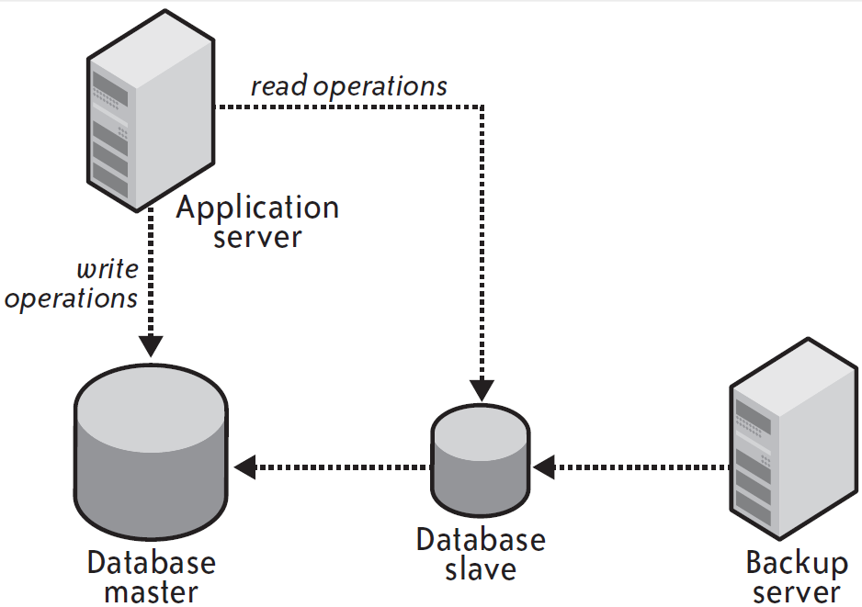
Execution of regular full database exports against a replication slave:

Slide 43
For the purposes of a backup, it does not matter if your database slave is a little bit behind the master.
What matters is that the slave represents the consistent state of the entire database at a relatively reasonable point in time.
You can therefore execute a very long backup against the slave and not worry about the impact on the performance of your production environment.
If your database backups truly take such a long time to execute that you risk having your slaves falling very far behind the master, it makes sense to configure multiple slaves and rotate backups among the slaves.
This rotation policy will give a slave sufficient time to catch up with the master after it has executed a backup and before it needs to perform its next backup.

