Slide 1
Module – 7
Business Continuity in VDC
Notes:
Module – 7
Business Continuity in VDC

Slide 2
Module 7: Business Continuity in VDC
Upon completion of this module, you should be able to:
  Discuss technology options for ensuring business continuity in a VDC
  Discuss mechanisms to protect potential points of failure in a VDC
  Describe approaches used for backup of Virtual Machines (VMs)
  Describe VM replication and migration technologies
  Discusses options for recovering from total site failure due to a disaster
Notes:
This module focuses on the concepts and techniques employed for ensuring business continuity in a Virtualized Data Center (VDC) environment. It discusses the mechanisms to protect single point of failure in a VDC. Next, it describes the various technology options for backup, replication, and migration of Virtual Machines (VM) and their data in a VDC environment. Finally, it discusses the various options for recovering from total site failure due to a disaster.
Copyright © 2011 EMC Corporation. Do not Copy - All Rights Reserved.

Slide 3
Module 7: Business Continuity in VDC
Lesson 1: Fault Tolerance Mechanisms in VDC
Topics covered in this lesson:
  An overview of BC in a VDC
  Single point of failure in a VDC environment
  Mechanisms to protect compute, storage, and networking components in a VDC
  Disaster recovery mechanisms for a VDC site failure
Notes:
This lesson covers an overview of Business Continuity (BC) in a VDC environment, identification of single point of failure, mechanisms to protect compute, storage, and networking components in a VDC, and disaster recovery mechanisms during a VDC site failure.
Copyright © 2011 EMC Corporation. Do not Copy - All Rights Reserved.

Slide 4
Business Continuity in VDC: An Overview
BC planning should include end-to-end protection of both physical and virtual resources at
  Compute, storage, and network layers
Ensuring BC mainly involves redundancy of components at each layer
BC technology for data protection includes
  Backup and replication of data (similar to CDC environment)
Besides traditional approaches, VDC environment has additional BC solutions typically implemented at the compute layer
4
Notes:
In a VDC environment, technology solutions that enable the Business Continuity (BC) process need to protect both physical and virtualized resources. This protection should include resources at all the layers including compute, storage, and network. Ensuring BC in a VDC environment involves consistent copies of data and redundant infrastructure components. BC solutions for physical network and storage are the same as those for the Classic Data Center (CDC) environment. This module focuses on the BC solutions for virtual resources built upon compute infrastructure including VMs and their data.
Copyright © 2011 EMC Corporation. Do not Copy - All Rights Reserved.

Slide 5
Advantages of Compute Virtualization in BC
Hardware independence
Cross platform compatibility
Mutual isolation
  Different BC policies may be applied to different VMs, even if they are running on the same physical server
Encapsulation of complete computing environment
Relatively robust BC processes
  Comparatively easier to maintain VM copies in diverse geographic locations
Higher data availability
Notes:
Virtualization considerably simplifies the implementation of a BC solution in a VDC environment. For example, VMs have inherent properties that facilitate the planning and implementation of a BC strategy:
VMs are compatible with standard x86 architectures and run independent of the underlying x86 hardware configurations. Therefore, BC solutions for VMs need not consider the details of the x86 hardware available at the failover site. In this module, the term compute hardware term is used to represent x86 hardware.
VMs are isolated from each other, as if physically separated, even if they run on a single physical server. This isolation prevents failure of one VM from spreading over to other VMs. Different DR policies may be applied to different VMs, even if they are running on the same physical server.
VMs encapsulate a complete computing environment. Therefore, they can be moved and restarted easily, compared to recovery of physical servers in a CDC.
It is also comparatively easier to maintain VM copies in diverse geographic locations, which makes the BC process robust. Similarly, data maintained within a VDC has higher availability. Restoring of data after an outage in a VDC is faster and more reliable, compared to CDC.
Copyright © 2011 EMC Corporation. Do not Copy - All Rights Reserved.

Slide 6
Single Point of Failure in a VDC
SPOF in Compute Infrastructure
  Physical server and hypervisor
  VM and guest OS
SPOF in Storage Infrastructure
  Storage Array and its components
  Virtual disks
SPOF in Network Infrastructure
  Network Components
  Virtual network
Site
6
Notes:
To plan for an effective BC solution in a VDC, administrators need to identify potential single point of failure (SPOF). In a VDC, the SPOF includes the following:
SPOF in Compute Infrastructure:
Physical Server: Failure of a physical server would result in the failure of complete virtualized infrastructure running on it. Similarly, failure of a hypervisor can cause all the running VMs and virtual network, which are hosted on it, to halt.
VM: Failure of a VM might result in the failure of the critical applications running on it. If there are (distributed) applications running across multiple VMs (for example an electronic banking application), failure of a VM might cause disruptions in the execution of distributed or dependent applications on other VMs. Similarly, the failure of a Guest OS might cause critical applications to stop executing, which would consequently cause disruptions in the client services.
SPOF in Storage Infrastructure: Failure of a storage array and its components might cause disruptions in the operations of hypervisor, VMs, and applications accessing data from that array. Apart from physical storage, virtual disks are also subject to potential failure. However failures in virtual disks are often due to errors in VMFS, which would be either due to incorrect operation of an hypervisor or a security attack on the file system itself. Failure in VMFS or virtual disk would impact all the applications in the associated VMs.
SPOF in Network Infrastructure: Based upon the underlying network infrastructure – SAN, NAS, or converged network type (for example, FCoE, IP SAN, etc.) – the supporting components (NICs, communication paths, interconnect device, etc.) might fail and thus disrupt communication between the devices. Apart from physical network component, virtual network is also subject to potential failures. These failures in a virtual network could be due to incorrect design, the configuration of the applications realizing these virtual components, or due to security attacks on these applications. Failure in a virtual network component results in the disruption of communication between the VMs using that component for their communication.
Site: Failure of a VDC site due to a disaster could have significant impact on business operations and thus need special consideration in terms of detailed disaster recovery planning and testing.
Copyright © 2011 EMC Corporation. Do not Copy - All Rights Reserved.

Slide 7
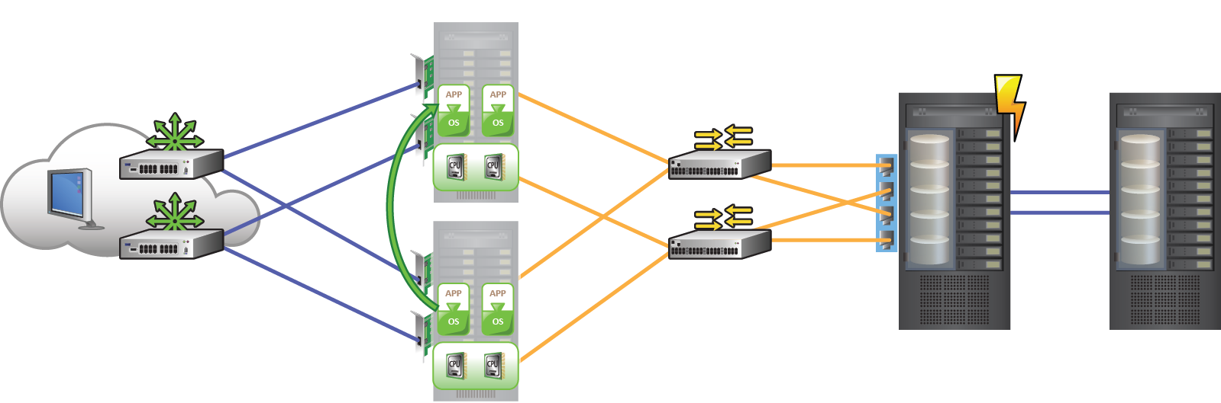
Eliminating Single Point of Failure
Clustered Servers
Redundant
Arrays
Redundant
Paths
Redundant
power
Redundant
NIC
Redundant
Ports
Redundant
Network
Redundant
FC Switches
Remote
Site
RAID
Redundant
HBA
Redundant
Array components
7
Notes:
To mitigate SPOFs identified before, VDC components are often designed with redundancy so that the system fails only if all the components, including the redundant components, fail simultaneously. Such a failure is very unlikely to happen except during catastrophic disasters. Redundancy ensures that the failure of a single component does not affect the availability of the corresponding operations.
Because of the large number of components involved in the overall operation of a VDC and their underlying complexity and interactions with each other, a careful analysis need to be performed to eliminate every SPOF. In the diagram, critical enhancements in the infrastructure of a VDC to mitigate SPOF is illustrated. Note that many of the employed mechanisms are similar to a CDC environment:
Configuration of multiple HBAs to mitigate single HBA failure.
Configuration of multiple fabrics to account for a switch failure.
Configuration of multiple storage array ports to enhance the storage array’s accessibility.
RAID configuration to ensure continuous operation in the event of disk failure.
Implementation of a storage array at a remote site to replicate data for mitigating the effect of local site failure.
Configuration of multiple copies of virtual disks and VM configuration files.
Implementation of server clustering.
A fault-tolerance mechanism whereby two VMs in a cluster access the same set of storage volumes. If one of the VMs fails, the other takes up the complete workload.
Copyright © 2011 EMC Corporation. Do not Copy - All Rights Reserved.

Slide 8
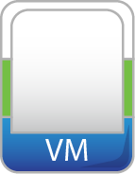


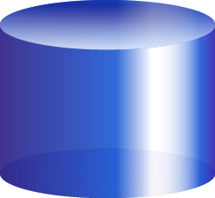

Protecting Compute: Clustering
Clustered Servers
  Groups of physical servers are combined and managed as an aggregated compute resource pool
    All servers have access to shared memory
  Provides protection from server and hypervisor failures
  Uses clustered file system, such as VMFS, to enable failover
Clustered Servers
VM Migration
Resource Pool
Hypervisor
Hypervisor
Failed Server
Operating Server
Shared Storage pool
8
Notes:
One of the important techniques to protect compute infrastructure, for providing high availability of VMs and their data in a VDC environment, is clustering.
Clustered Servers : Virtual Infrastructure provides the technology to combine groups of physical servers and manage them as an aggregated compute resource pool. These resource pools are an ideal way to abstract the underlying physical servers and present only the logical capacity to the user. Additionally, clustered servers provide an effective way to ensure compute resource availability in the event of a physical server or hypervisor failure. For example, as depicted in the diagram on this slide, if a server fails, all the VMs running on it are failed over (moved) to other servers, which are operational (active) at that time. Clustered servers use a clustered file system, such as VMFS, to enable failover.
VMFS provides multiple VMs with shared access to a consolidated pool of clustered storage. A VM sees the (virtual) disks in a VMFS as local targets, where as are actually just files on the VMFS volume. Additionally, a VMFS encapsulates the entire VM state in a single directory, making the tasks of backup, replication, and migration of VMs easy. VMFS is implemented over CS and allows each hypervisor in the cluster to store its VM files in a specific subdirectory on the VMFS. When a VM is operating, VMFS locks those files so that other hypervisors cannot update them. VMFS, thus ensures that a VM cannot be opened by more than one hypervisor at the same time. VMFS also provides each VM a separate isolated directory structure for storing its files so that files belonging to one VM cannot be accessed by other VMs.
Copyright © 2011 EMC Corporation. Do not Copy - All Rights Reserved.

Slide 9
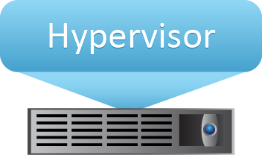
Protecting Compute: VM Fault Tolerance
Uses a secondary VM running on another physical machine as a live copy of the primary VM
The two VMs remain in synchronization
  Event logs of the primary are transmitted to the secondary
  Received event logs are replayed by the secondary
Primary VM
Secondary VM
Record Events
Logging Traffic
Replay Events
Acknowledgement
9
Notes:
The VM Fault Tolerance (VMFT) technique ensures that in the event of a VM failure, there is no disruption in business operations. The VMFT technique ensures that individual VMs are functioning well and are responding to failures without interruption in service. VMFT creates hidden duplicate copies of each VM so that when it detects that a VM has failed due to hardware failure, the duplicate VM can be used for failover.
VMFT creates a live instance of the primary VM that runs on another physical machine. The two VMs are kept in synchronization with each other. The logs of the event executions by the primary VM are transmitted over a high speed network to the secondary VM. Secondary VM replays them to bring its own state same as of the primary VM. The hypervisor running on the primary server captures the sequence of events for the primary VM, including instructions from the virtual I/O devices, virtual NICs, user inputs, etc. And transfers them to the secondary server. The hypervisor running on the secondary server receives these event sequences and sends them to the secondary VM for execution. The primary and the secondary VMs share the same virtual disk using VMFS, but all output (for example, write) operations are performed only by the primary VM. A special locking mechanism ensures that the secondary VM does not perform write operations on the shared virtual disks. Any other output instructions from the secondary VM are also not allowed. The hypervisor posts all events to the secondary VM at the same execution point as they occurred on the primary VM. This way, the two VMs play exactly the same set of events and their states are synchronized with each other.
Copyright © 2011 EMC Corporation. Do not Copy - All Rights Reserved.

Slide 10
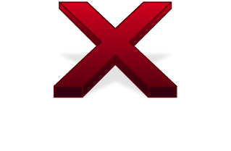

Protecting Compute: VM Fault Tolerance (contd.)
Both primary and secondary VMs access a common storage
  VMs appear as a single entity to other VMs
  Only primary VM can perform writes using special locking mechanism
VMs constantly check the status of each other using heartbeats
  If primary VM fails, the other takes over immediately
1
Primary goes down
2
Secondary becomes Primary
3
New Secondary created
10
Notes:
The two VMs essentially access a common storage and appear as a single entity with a single IP address and a single MAC address to other VMs. However, only the primary VM is allowed to perform writes. These two VMs constantly check the status of each other so that if the primary VM fails, the secondary VM immediately assumes the role of primary and starts executing writes on the shared storage. Another VM is also created to take the role of a new secondary VM, with the old secondary VM working as a new primary VM.
The process of checking the status of a VM requires an exchange of periodic signals between the primary and the secondary VMs over a reliable network. These periodic signals are known as heartbeats, and if there are specific communication channels to transfer these heartbeats, they form a heartbeat network.
Copyright © 2011 EMC Corporation. Do not Copy - All Rights Reserved.

Slide 11
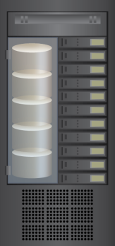
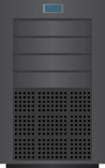
Protecting Storage
RAID
  Provides data protection against drive failures
Hot spare
  Is a standby disk drive in a RAID array
  Temporarily replaces a failed disk drive without disrupting the compute access
Redundant components
  Array controllers
  Ports in a storage array
  Storage arrays
Controllers
Ports
Server
Storage Array
11
Notes:
The key techniques for protecting storage in a VDC are similar to the ones used in CDC, including:
RAID: As explained earlier, RAID is an enabling technology that leverages multiple drives as part of a set to provide data protection against drive failures. For example, RAID uses mirroring and parity techniques to rebuild the data after a disk drive fails.
Hot spare: A hot spare refers to a spare disk drive in a RAID array that temporarily replaces a failed disk drive of a RAID set. A hot spare takes the identity of the failed disk drive in the array. When the failed disk drive is replaced with a new disk drive, either the hot spare replaces the new disk drive permanently, or the data from the hot spare is copied to it. The hot spare returns to its idle state and is used to replace the next failed drive. Multiple hot spares can be used to provide higher data availability.
In addition to RAID architecture and hot spares, high availability design for storage infrastructure is achieved by using:
Redundant array controllers to address primary array controller failures
Redundant ports in a storage array if one of the currently active port fails
Redundant storage array when the whole array goes down
Copyright © 2011 EMC Corporation. Do not Copy - All Rights Reserved.

Slide 12
Protecting Network
Protecting physical network by using redundancy
  Interconnect devices with redundant hot swappable components
  Redundant links and multipathing
  Redundant NICs and NIC teaming
Protecting virtual network
  Failure in a virtual network on a hypervisor may be result of
    Software error or security attack
    Physical server failures
  Virtual network failure is not common
12
Notes:
The following are the techniques to protect external physical network:
Interconnect devices with redundant hot swappable components: Allows the user to add or remove components while the interconnect device is operational.
Redundant links and multipathing: A technique to enable multiple paths for accessing the same storage device for I/O operations so that in case of a failure of one path, dynamic failover to an alternate path is possible.
NIC teaming: Grouping of two or more physical NICs into a single logical device.
Apart from the protection of external physical network, another important aspect is to protect the virtual network (running on a single server or hypervisor) from failure. A virtual network failure may be caused either by an incorrect operation of the software components (for example, virtual NIC, virtual Switch) or because of the failures in the compute infrastructure, for example, physical server going down, or hypervisor, or VM crashes. In general, failures due to software errors or security attacks require software patches from hypervisor vendors. The second reason is more often a cause for the failure in a virtual network. Therefore, the methods to protect compute infrastructure, as discussed earlier, equally apply for protecting such virtual network as well.
The discussion in this lesson will focus on protecting physical network infrastructure using the techniques mentioned above.
Copyright © 2011 EMC Corporation. Do not Copy - All Rights Reserved.

Slide 13
Protecting Network: Multipathing to Storage
A technique to enable multiple paths for accessing the same storage device
  Dynamic failover to an alternate path if current active path fails
Multipathing requirement
  Either a server has two or more HBAs available
  Or, one HBA port is set up with multiple storage controllers
Execution options
  At hypervisor (in-built multipathing capability)
  Third-party software module added to the hypervisor
13
Notes:
Loss of access to a storage device can cause serious disruption in service delivery. Multipathing is the technique to address such access failures to storage devices by enabling multiple alternative paths to the same storage device so that in case of failure of one path (for example, due to failures on switch, HBA port, storage processor, or cable) another alternative path can be activated and used for data transfer.
For multipathing, a server either has two or more HBAs available to reach the storage device using one or more switches, or the setup may have one HBA and multiple storage controllers so that the HBA can use different paths to reach the storage.
Multipathing is enabled either by using the hypervisor’s built-in capability or by running a third-party software module, added to the hypervisor. In case of a path failure, I/Os are redirected to the surviving paths based upon a preconfigured path selection policy. In the case of SAN storage arrays, multipathing may also require adequate synchronization between the host software or hypervisor with the array controller. This ensures that all the paths are consistently visible across the LUNs on the storage array.
Copyright © 2011 EMC Corporation. Do not Copy - All Rights Reserved.

Slide 14



Protecting Network: NIC Teaming
Enables failover in case of physical NIC failures/link outages
  Supports the IEEE 802.1AX-2008 link aggregation standard
VMs unaware of the underlying physical NICs
  Packets sent to the logical NIC team are dispatched to one of the physical NICs
  Packets arriving at any of the physical NICs are automatically directed to the appropriate virtual NIC
Logical NIC
Team
Virtual NIC
Virtual NIC
Hypervisor
x86
Architecture
Physical NIC
Physical NIC
Physical NIC
14
Notes:
NIC teaming allows grouping of two or more physical NICs—which may be of different types—into a single logical device called the NIC team. After an NIC team is configured, the VM will not be aware of the underlying physical NICs. Packets sent to the NIC team are dispatched to one of the physical NICs in the group. Packets arriving at any of the physical NICs are automatically directed to the NIC team, which consequently redirects them to the designated virtual NIC.
Apart from load balancing, which was discussed earlier, NIC teaming enables fault tolerance such that if one of the underlying physical NICs fails or its cable is unplugged, the traffic is redirected to another physical NIC in the team. Thus, NIC teaming eliminates the SPOF associated with a single physical NIC. Such failover remains totally transparent to the VMs and applications may experience performance degradation during this process.
In a VDC environment, with the hypervisor’s support for NIC teaming, a guest OS or a VM need not install separate drivers for NICs or configure NIC teaming. NIC teaming implementations in most of the hypervisors support the IEEE 802.1AX-2008 link aggregation standard.
Copyright © 2011 EMC Corporation. Do not Copy - All Rights Reserved.

Slide 15
Protection from Site Failure
In case of a regional disaster, the whole VDC site requires recovery
Automatic site failover capability is highly desirable
  Manual steps are often error prone
  Reduces RTO
“Bare-metal” (Type 1) hypervisor running directly on the physical compute is the preferred choice of configuration
  Offers greater levels of performance, reliability, and security during site failover
Site failover depends upon
  VM migration capability, reliable network infrastructure, and data backup and replication functionality
15
Notes:
In case of a regional disaster, the whole VDC site requires recovery. To ensure error-free execution of BC solutions during a disaster, a non disruptive testing of Disaster Recovery (DR) plan is often required to be carried out beforehand.
To ensure a robust and consistent failover in case of a site failure or during testing, automatic site failover capabilities are highly desirable. This is because manual steps are often error prone. RTO with automated failover is significantly less compared to the manual process. However, the DR product that automates setup, failover, and testing of DR plans must be compatible with the guest OS.
A hypervisor provides robust, reliable, and secure virtualization platform that isolates applications and OSs from their underlying hardware. This considerably reduces the complexity of implementing and testing DR strategies. Among the different types of hypervisors for BC, the “bare-metal” (Type 1) hypervisor provides a robust DR. During the DR process, the bare-metal approach offers greater levels of performance, reliability, and security; and is better equipped to leverage the power of x86 server architectures found in the datacenters.
A VDC site failover process also depends upon other capabilities, including VM replication and migration capabilities, reliable network infrastructure between primary (production) site and the secondary (recovery or DR) site, and data backup capabilities.
Copyright © 2011 EMC Corporation. Do not Copy - All Rights Reserved.

Slide 16
Module 7: Business Continuity in VDC
Lesson 2: Backup in VDC
Topics covered in this lesson:
  Traditional approaches to VM backup
  Image based VM backup
  Challenges for VM backup in a VDC environment
  Deduplication as a mechanism for backup optimization
  Restoring a VM using backup copy
Notes:
This lesson covers the challenges and the mechanisms for VM backup in a VDC environment. The lesson includes traditional and image based methods for VM backup, deduplication as a mechanism for backup optimization, and the process of restoring a VM using a backup copy.
Copyright © 2011 EMC Corporation. Do not Copy - All Rights Reserved.

Slide 17
Backup in a VDC: An Overview
VM backup includes
  Virtual disks containing system and application data
  Configuration data including network and power state
Backup options
  File based
  Image based
Backup optimization
  Deduplication
17
Notes:
A backup operation in a VDC environment often requires backing up the VM state. The VM state includes the state of its virtual disks, memory (i.e. RAM), network configuration, as well as the power state (on, off, or suspended). A virtual disk includes all the information typically backed up (OS, applications, and data.) As with physical machines, a VM backup needs to be periodically updated with respect to its source, in order to recover from human or technical errors.
A VM backup may be performed either as a “set of files” retaining the directory structure or as a complete image. File-level backup provides a way to access individual files, whereas image level backup does not. Another important difference between file based and image based backup is that an image based backup is independent of the guest OS running on the VM, whereas file based backup may have guest OS dependency, owing to file system structure. In the case of an image based backup, recovery of individual files requires additional operations to be performed.
Owing to the increased capacity requirements in a VDC environment, backup optimization methods are necessary. Deduplication, which aims to reduce duplication of backup data, is one of the important techniques towards achieving optimum backup.
Copyright © 2011 EMC Corporation. Do not Copy - All Rights Reserved.

Slide 18

Backup in a VDC: Traditional Approaches
Compute based
  Backup VM as a physical server
    Requires installing a backup agent on a VM
    Can only backup virtual disk data
  Backup VM files
    Requires installing backup agent on hypervisor
    Cannot backup LUNs directly attached to a VM
Array based
  Uses snapshot and cloning techniques
Backup VM as a Physical Server
= Backup Agent
Backup VM as a Flat File
18
Notes:
Traditional approaches for backup in a VDC environment use the same technologies as are used in a CDC, with minor modifications. These approaches often treat a VM as a set of files while creating its backup. The approaches are as following:
First approach: A VM is treated as if it were a physical server. A backup agent is installed on the VM that streams the VM data to the backup server. Management of the backup operation is similar to that of CDC, and hence, creating application consistent backups is easy. It is also possible to restore specific files to the guest OS. However, this solution requires the management of agents on all VMs. Note that the solution does not capture the VM files (i.e., Virtual BIOS file, VM swap file, Virtual disk file, Log file, and Configuration file). So, in the event of a restore, a user should manually recreate the VM and then restore data into it.
Second approach: Since a VM’s virtual disks are nothing but a collection of files, it is possible to simply back them up by performing a file system backup from a hypervisor. This is a relatively simple method because it requires only an agent on the hypervisor, and that backs up all the VM files. However, LUNs assigned directly to a VM (using RDM) cannot be backed up using this approach.
Third approach: It uses array based technologies to backup a VM and utilizes the storage subsystem for backup operations. These technologies often use snapshot and cloning techniques to capture and backup a VM. Snapshot and cloning of a VM will be discussed in the next lesson.
Copyright © 2011 EMC Corporation. Do not Copy - All Rights Reserved.

Slide 19
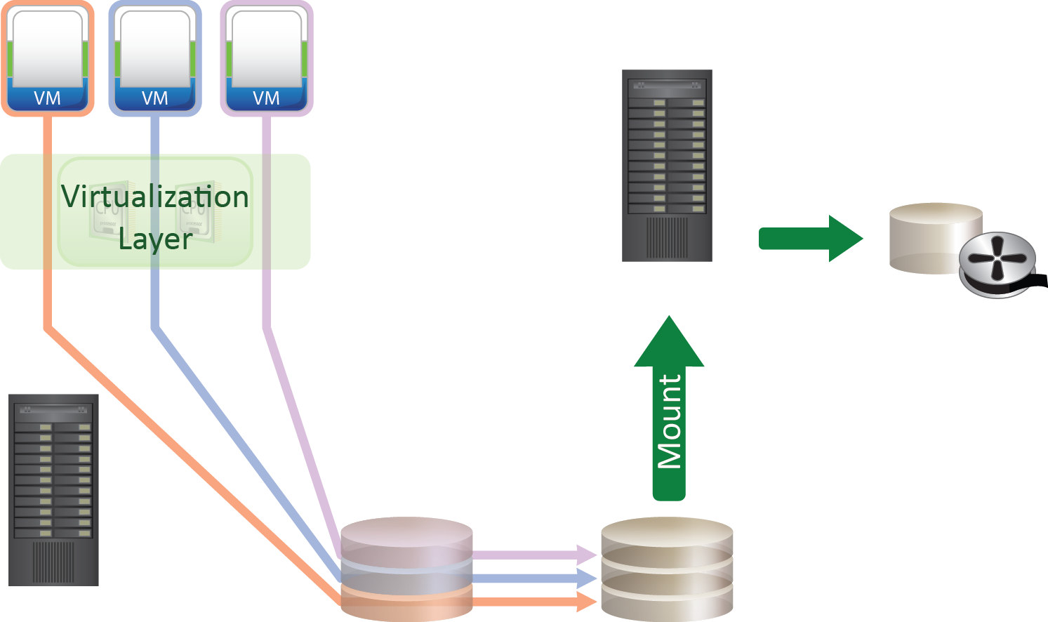
Image based Backup
Creates a copy of the guest OS, its data, VM state, and configurations
  The backup is saved
  as a single file – “image”
  Backup server creates
  the backup copies and
  offloads backup
  processing from the
  hypervisor
Restores directly at
VM level only
Operates at hypervisor
level
Mounts image on backup server
Backup Server
Backup Disk/
Tape
Physical Server
SAN Storage
19
Notes:
Image based backup creates a copy of the guest OS and all the data associated with it, including the VM state (snapshot of VM disk files) and application configurations. The backup is saved as a single file called an “image”. Image based backup operates at the hypervisor level and essentially takes a snapshot of a VM and then mounts the files on the backup server. The backup server consequently creates the backup copies to disks or tapes. This effectively offloads the backup processing from the hypervisor and transfers the load on the backup server, thereby reducing the impact to VMs and applications running on the hypervisor.
The advantage of an image based backup is that all information can be collected in a single pass, providing a Bare Metal Recovery (BMR) capability. Image based backup can even be done online. It can also be restored to dissimilar hardware resources and can recover servers remotely. Image based backup allows for fast and complete restoration of a VM. However, if the user has to recover few corrupted files, then the full VM image needs to be restored first, followed by restoration of individual files using O/S features.
Copyright © 2011 EMC Corporation. Do not Copy - All Rights Reserved.

Slide 20
Backup Considerations in a VDC
Reduced computing resources
  Existence of multiple VMs running on the same physical machine leaves fewer resources available for backup process
Complex VM configurations
  A backup agent running on VM has no access to VM configuration files
  Not possible for a backup agent running on hypervisor level to access storage directly attached to a VM using RDM
20
Notes:
In a VDC environment, a single physical machine can run multiple VMs, that increases server utilization. This results into reduced compute resources available for backup and recovery tasks.
Apart from the increased capacity requirements and reduced computing resources, backing up a VM is more complex than backing up a physical machine. With a physical machine, the OS manages all the files on the machine. In a virtual environment, the guest OS is encapsulated in a VM that is managed by the hypervisor. Because of this architecture, there are files related to a VM; however, the VM does not have any direct access to these files; for example, the VM configuration files. In the case of RDM, where storage is directly attached to a VM, an application running on the hypervisor level will have difficulty while accessing that LUN.
These factors render backup processing more challenging in a VDC as compared to CDC.
Copyright © 2011 EMC Corporation. Do not Copy - All Rights Reserved.

Slide 21
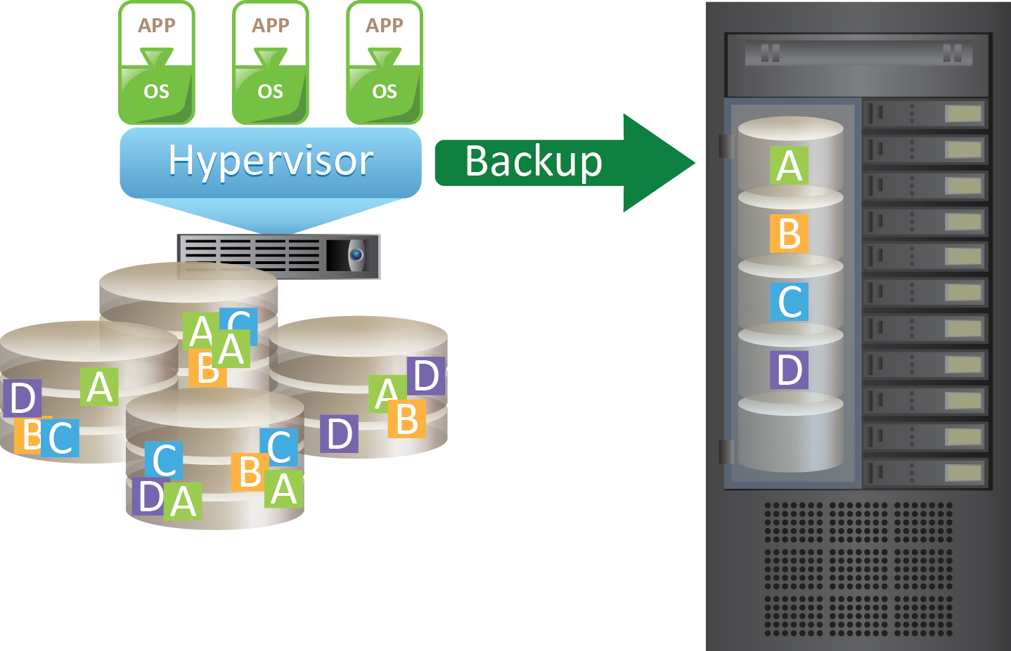
Backup Optimization: Deduplication
Backup images of VM disk files are candidates for deduplication in a VDC environment
Deduplication types and methods are same as those employed in CDC
Data to be backed up
Deduplicated Backup Storage
21
Notes:
Virtualization benefits in a data center, for example, server consolidation ,often come at the cost of additional requirements for storage and backup resources. Therefore, to fully realize benefits of virtualization, storage and network-optimized backup methods are necessary. Data deduplication, which aims to reduce duplication of backup data is one of the important techniques towards achieving the optimized backup.
Deduplication significantly reduces the amount of data to be backed up in a VDC environment. The potential sources for duplication are present when there are many similar VMs deployed in a data center. They include similar images of VM disk files, including configuration files and application data.
Deduplication types and methods to be applied in a VDC environment remain same as in CDC practice (which are discussed in module 2, Classic Data Center).
Copyright © 2011 EMC Corporation. Do not Copy - All Rights Reserved.

Slide 22
Restoring a VM
Restore VM to a required state using the backup
  Selection of the restore point depends upon RPO
Steps for restore process
  Selection of VM and virtual disks to restore from backup
  Selection of the destination
  Configuration settings
Restoring a VM may take significantly fewer steps, compared to recovering a physical machine
Restoring Physical Machine
Configure
Hardware
Install OS
Configure
OS
Install
applications/data
from backup
Start
“single-step
Automated
recovery”
Restoring Virtual Machine
Restore VM
Power on VM
22
Notes:
A restore process returns a VM to a selected previous state using the backup copies. Selection of the restore point actually depends upon the choice of the RPO.
The key steps involved in the restore process include:
Selection of the VM and virtual disks to be restored from the backup.
Selection of the destination location for the restoration: In case of an actual VM failure, the original physical machine itself is selected as a destination, whereas for restore rehearsal purposes, some alternate physical machine is selected.
Configuration settings: This includes deciding VM configuration settings either by using the existing backup or by applying new settings.
Restoring a VM may take significantly fewer steps, compared to the recovery of physical machines. Therefore, recovery time requirements for a VM and consequently for the whole VDC are relatively shorter, compared to the CDC environment.
Copyright © 2011 EMC Corporation. Do not Copy - All Rights Reserved.

Slide 23
Module 7: Business Continuity in VDC
Lesson 3: Replication and Migration in VDC
Topics covered in this lesson:
  VM replication methods – compute based and storage array based
  VM snapshot, clone, and template
  VM migration – server-to-server and array-to-array
  Service failover during an outage at the primary VDC site
Notes:
This lesson covers challenges and techniques for VM replication and migration in a VDC environment. It includes compute based and storage array based VM replication methods and discusses VM snapshot, clone, and template. It further describes migration of a VM across servers and across storage arrays. Finally, it covers service failover during an outage at the primary VDC site.
Copyright © 2011 EMC Corporation. Do not Copy - All Rights Reserved.

Slide 24
VM Replication in VDC
VM replication is a critical requirement for successful BC
VM replication is performed at the hypervisor level
  Relies upon replication software to propagate changes made to a VM’s virtual disk
To ensure data integrity, quiescing of VM is necessary before replication process starts
  Quiescing pauses currently running applications within a VM and forcibly flushes all data in the memory to the disk
  To achieve application-level consistency, is performed at the application level
    Applications complete any pending transactions and write the pending data to the disk
24
Notes:
VM replication is a critical requirement for successful BC and DR processes in a VDC. This is because, in a VDC environment, to restart operations, a user needs to primarily restart VMs on the secondary (backup) site. VM replication makes this possible by making the copies of these VMs available at the backup site. VM replication is performed at the hypervisor level and relies on replication software that can copy all the changes made to a VM disk to another server. VM replication requires a secondary site which is up and a network connectivity linking these sites.
A virtual disk snapshot taken at the hypervisor level temporarily redirects incoming writes to a separate delta file. The delta file maintains these I/Os to be written to the virtual disk after the snapshot is taken. The virtual disk is then mounted by the replication software and any updates since the last replication cycle are copied to another identical virtual disk on a VM at the secondary site.
To ensure data integrity, quiescing of VM is necessary before the replication process starts. Quiescing pauses currently running applications within a VM and forcibly flushes all data in the memory to the disk. To ensure application-level consistency, applications (for example, Microsoft Exchange or SQL Server) are instructed to complete any pending transactions and write the pending data to the disk.
Copyright © 2011 EMC Corporation. Do not Copy - All Rights Reserved.

Slide 25
VM Replication Methods
Compute based replication
  Enables replicating VMs between dissimilar storage; for example, from a local disk drive to a storage array in a different location
  Creates VM snapshot, VM clone, or VM template
Storage array based replication
  Is performed at the storage array level
  Is similar to traditional array based replication in CDC
  Is performed either at local (primary) site or to a remote (secondary) site
25
Notes:
Copyright © 2011 EMC Corporation. Do not Copy - All Rights Reserved.
There are two main methods to replicate VMs. The first approach uses compute based replication. In this method, replication happens between similar/dissimilar storage devices. For example, using compute based replication, a VM is replicated from a local disk drive to a storage array in a different location. Compute based replication creates either a VM snapshot, or a VM clone, or a VM template – these will be discussed next.
Another method is to use storage array to replicate the VM either to an array at the primary site itself or to a remote array (for example, iSCSI, or Fibre channel, or NAS storage array) at the secondary site. This method is similar to the traditional array based replication method used in a CDC. It works by copying LUNs of the source VM to the target array. Replication to a remote array may be either synchronous or asynchronous.

Slide 26
VM Snapshot
Preserves the state and data of a VM at a specific point-in-time
  State includes VM configuration files as well as its power state (on, off, suspended)
  Data includes all the files that makeup the VM including memory, and other devices, such as virtual NIC
  A log file captures the changes to the virtual disk after snapshot is taken
Snapshot(1) of VM
dd/mm/yyyy: 13:00
Snapshot(2) of VM
dd/mm/yyyy: 15:00
VM at 13:00
VM at 15:00
26
Notes:
A snapshot preserves both the state and data of a VM at a specific point in time. State includes VM files such as BIOS, network configuration, and its power state (powered-on, powered-off, or suspended). Data includes all the files that makeup the VM, including virtual disks, memory, and other devices. In this method, instead of making a copy of the entire virtual disk of the VM, which may be very large in size, a snapshot is created. A snapshot includes a separate log file which captures the changes to the virtual disk of the VM since the snapshot was taken.
Referring to the diagram on this slide, the first snapshot of the VM is taken at time-point 13:00 (on date dd/mm/yyyy) and the second snapshot is taken after two hours at time-point 15:00. These snapshots are saved with unique names and details of the points-in-time, when they are created.
Copyright © 2011 EMC Corporation. Do not Copy - All Rights Reserved.

Slide 27
VM Snapshot (contd.)
Is useful when a VM needs to be reverted to the same state again; for example, using a VM for testing purpose, upgrading, or patching applications and servers
Reverting a VM to a snapshot causes all settings configured in the Guest OS to be reverted to an earlier point-in-time
Revert to Snapshot (1)
Snapshot(1) of VM
dd/mm/yyyy: 13:00
VM at 13:00
VM at 21:00
27
Notes:
Snapshots are useful when a VM needs to be reverted to the same state repeatedly; for example, when using a VM for testing purposes or while upgrading or patching applications and servers.
Reverting a VM to a snapshot causes all settings configured in the guest OS to be reverted to that time-point in past when that snapshot was created. The configuration which is reverted includes previous IP addresses and guest OS patch versions. The log file of the snapshot is used to revert the virtual disk to its original state.
Referring to the diagram on this slide, Snapshot(1) of the VM is created at time-point 13:00. Later, after a couple of hours, at time-point 21:00, the VM crashes and needs to be reverted. Snapshot(1) is selected for that purpose and VM is reverted to Snapshot(1) and starts running in the same way as it was running at time-point 13:00, when Snapshot(1) was created.
Copyright © 2011 EMC Corporation. Do not Copy - All Rights Reserved.

Slide 28
VM Clone
An identical copy of an existing VM
  Created when the VM is required for a different use; for example, identical VM need to be deployed for testing purpose
  The existing VM is called the parent
  Changes made to a clone VM do not affect the parent VM
  Changes made to the parent VM do not appear in a clone
  A clone may share virtual disks with the parent VM
Clone VM is assigned separate network identity
  Clone has its own separate MAC address
28
Notes:
A clone is an identical copy of an existing VM. The existing VM is called parent of the clone VM. When the cloning operation is complete, the clone becomes a separate VM with its own MAC address, although it may share virtual disks with the parent VM in case of a Linked clone (discussed next). However, changes made to a clone VM do not affect the parent VM. Changes made to the parent VM do not appear in a clone. To other VMs in the network, a clone VM appears different from the parent VM.
Installing a guest OS and applications on multiple VMs is a time consuming task. With clones, a user can make many copies of a VM from a single installation and configuration process. Clones are useful when required to deploy many identical VMs. For example, deployment of standardized operating and/or application environment across a group or an organization.
Copyright © 2011 EMC Corporation. Do not Copy - All Rights Reserved.

Slide 29
VM Clone – Types
Full Clone
  An independent copy of a VM that does not share virtual disks with the parent
    Cloning process may take relatively longer time
Linked Clone
  Shares virtual disk with the parent VM
    Conserves disk space
    Virtual disk of the parent VM is read-only for the linked clone
    Writes of the linked clone are captured in a separate delta disk of smaller size
  Is made from a snapshot of the parent VM
    Snapshot is given a separate network identity and assigned to the hypervisor to run as an independent VM
    Cloning process takes relatively less time
29
Notes:
Two types of clones can be created from a VM:
Full Clone: A full clone is an independent copy of a VM that shares nothing with the parent VM. Full clone has no access or an ongoing connection with the parent VM. Because a full clone needs to have its own independent copy of the virtual disks, cloning process may take a relatively longer time. In relation to a snapshot, full clone duplicates the state of the parent VM only at the instant of the cloning operation and does not have access to any of the snapshots of the parent VM.
Linked Clone: A linked clone is made from a snapshot of the parent VM. A snapshot is given a separate network identity and assigned to the hypervisor to run as an independent VM. However, all files available on the parent at the moment of the snapshot creation continue to remain available to the linked clone VM in a read-only mode. This conserves disk space and allows multiple VMs to use the same software installation.
Ongoing changes (writes) to the virtual disk of the parent do not affect the linked clone and changes to the virtual disk of the linked clone do not affect the parent. All the writes by the linked clone are captured in a separate file called delta disk, which is often of a much smaller size, compared to a full virtual disk.
Even though a linked clone is made by using a snapshot, it differs from a snapshot in the sense that a linked clone is a running VM that would change its state over time. However, a snapshot is only a state of the VM at a specific point-in-time, which cannot change on its own.
Linked clones can be very advantageous for collaborative network environments. For example, a support team can reproduce a bug in a VM running an application and an engineer can quickly make a linked clone of that VM to work on the bug simultaneously.
Copyright © 2011 EMC Corporation. Do not Copy - All Rights Reserved.

Slide 30
VM Template
A master copy to create and provision new VMs
A reusable image created from a VM
  Includes virtual hardware components, an installed guest OS, and software applications
Created in two ways
  Convert a powered-off VM into a template
  Clone a VM into a template
Increase efficiency, consistency, and standardization
  Repetitive installation and configuration tasks can be avoided
  Deploying VMs from VM templates helps to enforce standards
30
Notes:
A VM template is a reusable image created from a VM. The VM template works like a master copy of a VM to be used for creating and provisioning new copies of the VM. The template typically includes virtual hardware components, an installed guest OS (with any applicable patches), and software applications.
Templates can be created in two ways, either by converting a powered-off VM into a template or by cloning a VM to a template. The advantage of converting a VM to a template is that the conversion is instantaneous. However, the template will not be used immediately. Cloning a VM to a template leaves the original VM intact, but will require waiting for the entire capacity of the VM to be duplicated into the template’s files.
A template differs from a clone because new VMs are deployed from templates. From a clone, only additional cloning can be done to create new VMs. However the new VMs which are created out of a Clone will reflect the changed state of the clone as compared to a VM template which preserves the original state.
Key advantages of the VM template include the following:
VM templates increase efficiency; for example, with templates, many repetitive installation and configuration tasks can be avoided.
VM templates are also used to enforce consistency and standards. Deploying from templates helps to enforce standards such as including antivirus and management software in any machine connected to the network.
Copyright © 2011 EMC Corporation. Do not Copy - All Rights Reserved.

Slide 31

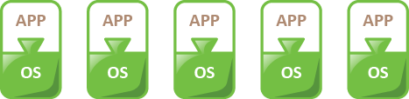
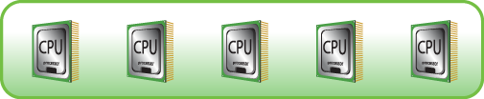
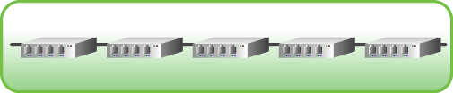
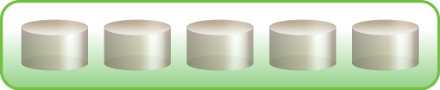
Array-Based Local Replication of VMs
Creates copies of LUNs that contain VM files on the same storage array
Replication is done using array controller within the same storage array
Local Replication within Array
Primary Site
31
Notes:
VMs typically reside on LUNs that reside on the same storage arrays. In single-site replication, these LUNs are replicated using the array controller within the same storage array.
Copyright © 2011 EMC Corporation. Do not Copy - All Rights Reserved.

Slide 32
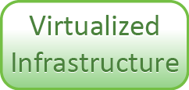
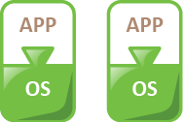
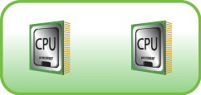
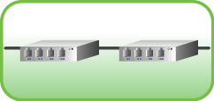
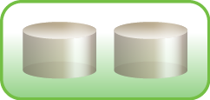

Array-Based Remote Replication of VMs
All VM files are copied to the remote site
  A LUN at the remote site is presented as a read-only copy and is kept in a synchronized state with the source LUN
LUNs are replicated between two sites using storage array replication technology
  Synchronous
  Asynchronous
Primary site
Secondary site
Array Replication over Network
32
Notes:
In a remote replication, all VM data residing on storage array (LUNs) at the primary (production) site is copied to the remote secondary (failover) site where it is kept ready to be used by the VMs, when required. This copying process remains transparent to the VMs, and they remain unaware of the underlying details. The LUNs are replicated between the two-sites using the storage array replication technology. This replication process can be either synchronous (limited distance, near zero RPO) or asynchronous (extended distance, non zero RPO). During business-as-usual periods, a LUN at the recovery site is presented as a read-only copy to any VMs connected to it at that site. The LUN is read-only at this stage as it is kept in a synchronized state with its source LUN.
Copyright © 2011 EMC Corporation. Do not Copy - All Rights Reserved.

Slide 33
VM Migration
Moving a VM from one hypervisor to another hypervisor
  For example: hypervisor failure or scheduled hypervisor or storage array maintenance
Types: Server-to-Server and Array-to-array
Migration process
  Involves movement of entire active state of a VM
  In case of server-to-server migration, virtual disks are not moved within clustered servers
    For remote migration, virtual disks are also moved
    In case of array-to-array migration, virtual disks are always moved from source array to target array
  VM in the source hypervisor needs to be deleted after migration is complete
    Virtual disks are also deleted if they were actually moved
33
Notes:
There are many situations where moving a VM from one hypervisor to another is necessary. The primary purpose is to achieve BC in case of hypervisor failure. Another situation might involve load balancing when one hypervisor is running many VMs but another hypervisor is relatively less occupied. Yet another reason might involve facilitating scheduled hypervisor or storage array maintenance.
The process of moving VMs from one (source) hypervisor to another (target) is known as VM Migration. There are primarily two different types of VM migrations:
Server-to-server migration: This type of VM migration involves moving a VM from one hypervisor to another using a client (migration agent software) running on these hypervisors. The receiving hypervisor may be remotely located in a different data center.
Array-to-array migration: This type of VM migration involves moving VMs or virtual disks across multiple physical servers using storage array based methods.
VM migration involves moving the entire active state of a VM from the source hypervisor to the target. The state information includes memory contents and all other information which identifies the VM. VM identification information includes data, which maps the VM hardware elements such as BIOS, Devices, CPU, and MAC address for Ethernet cards. When a VM is migrated to another hypervisor on a clustered server, virtual disks of the VM are not migrated because these can be accessed from another hypervisor as well. However, in situations where a VM needs to be migrated to a hypervisor on a remote server, virtual disks are also moved. In case of array-to-array migration, virtual disks are always moved from the source array to the target array. After migration, VM in the source hypervisor is deleted. Virtual disks are also deleted if they were actually moved. For example, in the case of server-to-server remote migration and array-to-array based migration, virtual disks are deleted after their copies are saved at the target.
Copyright © 2011 EMC Corporation. Do not Copy - All Rights Reserved.

Slide 34








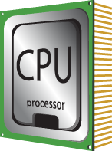


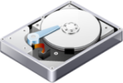


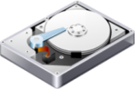


VM Migration: Server-to-Server
Hot-On – Migrate a VM that is powered on
  VM needs to be quiesced before migration
Cold – Migrate a VM that is powered off
Hot-Suspended – Migrate a VM that is suspended
Concurrent – Migrate multiple VMs simultaneously
VM Migration
Hypervisor
Hypervisor
x86 Architecture
x86 Architecture
CPU
NIC Card
Memory
Hard Disk
CPU
NIC Card
Memory
Hard Disk
34
Notes:
There are primarily four major modes of VM migration between servers:
Hot-On migration: VM remains in a powered-on state (currently running). Shared storage and CPU compatibility might be necessary between the source and destination servers. VM also needs to be quiesced during migration so that the state of the VM after migration remains consistent. After migration, client accesses are directed to the VM on the target hypervisor. Hot on migration is useful in scenarios where a server or hypervisor is overloaded or requires maintenance and/or repair soon because it might be underperforming.
Cold migration: VM is in a power off state. Cold migration is typically used when a VM needs to be moved to another remote location or VDC.
Hot-Suspended migration: VM is in a suspended state. In a suspended state, all virtual machine activities are paused until the resume command is issued. This kind of migration could be useful when a VM needs to be migrated from a failing server to another operational server.
Concurrent migration: Multiple VMs are migrated simultaneously to one or more hypervisors. The maximum number of concurrent sessions is generally dependent upon the available network bandwidth. Concurrent migration can be performed when VM is on a power on/off/suspended state. Concurrent migrations are useful for continuously optimizing VM placement across the entire IT environment.
Copyright © 2011 EMC Corporation. Do not Copy - All Rights Reserved.

Slide 35
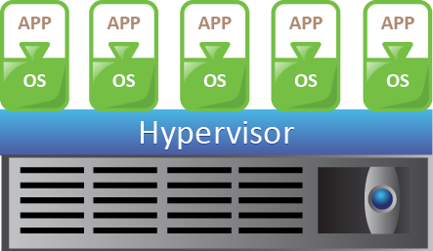

VM Migration: Array-to-Array
Uses storage array based technology to move VMs or virtual disks across storage devices
  Allows moving a live VM without any downtime
  Independent of VM and storage type
Potential application scenarios
  Moving a VM off a storage device for maintenance or reconfiguration
  Redistributing VMs or virtual disks to different storage devices in order to balance storage capacity
  Decommissioning of physical storage to be retired
Source
Destination
35
Notes:
Array-to-array based VM migration uses storage array based technology to move VMs or virtual disks across storage devices. This allows moving a VM off a storage device for maintenance or reconfiguration without VM downtime. By using this approach, it is possible for storage administrators to move VMs across dissimilar storage types. For example, VM migration can be performed across storage types such as Fibre Channel, iSCSI, and local SCSI.
Potential applications of array-to-array VM migration include:
Redistributing VMs or virtual disks to different storage devices in order to balance capacity and to improve performance.
Decommissioning physical storage that is soon to be retired, for example, storage arrays whose maintenance and release cycles are coming to an end.
Copyright © 2011 EMC Corporation. Do not Copy - All Rights Reserved.

Slide 36
Service Failover
Steps performed during an outage at the primary VDC site
  Replicated VMs are activated in the secondary (failover) site on the target servers
  The LUN at primary site is made read-only and LUN at the secondary site is made write-enabled
Secondary site can have different x86 hardware configuration than those at the primary site
Failover challenges
  Constraints on VM placement, for example, if selected VMs have to be placed on the same server/clustered servers
36
Notes:
At the simplest level, VMs run Guest OS, which consequently runs applications that provide IT services to the businesses. During an outage at the primary site, it is this service that must be protected from a BC point of view.
VMs are isolated from one another and are not dependent on the underlying x86 hardware configurations available at the failover location. The in-built properties of VMs allow mapping of resources from one virtual environment to another and at the same time, enable failover of an IT service. In addition, storage is replicated to the failover site, and then presented to the virtual infrastructure at the failover location where the VMs may be activated. When there is an outage at the production site, the source LUN is made read-only and the target is made write-enabled. Applications resume operations at the secondary site.
There exist certain challenges, which might prevent complete and/or correct failover of VMs in case of an outage at the production site. For example, there may exist VM placement rules specifying that selected VMs should be placed on the same server/clustered servers. A scenario in which such constraints might be present, is when a group of VMs are communicating with one another heavily, because of which they required to be placed on the same server or within clustered servers. These constraints might prevent a VM to failover completely and/or correctly to a different server at the failover site if all of the specifies constraints are not satisfied at the failover site.
Copyright © 2011 EMC Corporation. Do not Copy - All Rights Reserved.

Slide 37
Module 7: Business Continuity in VDC
Concepts in Practice
VMware® vCenter Site Recovery Manager
VMware® HA and VMware® FT
VMware® vMotion and Storage vMotion
EMC Avamar VE and EMC DataDomain
37
Notes:
The Concepts in Practice section covers some key products which use various technologies introduced in an earlier lesson on BC and DR purposes in a VDC environment. These include:
VMware® vCenter Site Recovery Manager, which automates and makes disaster recovery rapid, reliable, and manageable
VMware® HA and VMware® FT, which offer high availability and fault tolerance features for VMs in a VMware based virtualized environment
VMware® vMotion and Storage vMotion, which enable migration of VMs
EMC Avamar VE and EMC DataDomain, which offer highly optimized backup software and storage solutions for VDC
Copyright © 2011 EMC Corporation. Do not Copy - All Rights Reserved.

Slide 38
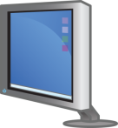



VMware® vCenter Site Recovery Manager
Makes DR in a VDC rapid, reliable, and manageable
Automates failover and recovery of VMs
Enables centralized management of recovery plans
Allows failover and recovery of multiple sites into one shared recovery site
Site Recovery
Manager
Virtual Center
Site Recovery Manager
Site Recovery Manager
Virtual Center
Virtual Machines
Virtual Machines
Protected Virtual Machines
VMware Infrastructure
VMware Infrastructure
Servers
Servers
Storage
Storage
Storage Replication
Primary Site
Secondary Site
38
Notes:
VMware vCenter™ Site Recovery Manager (SRM) is a VMware tool, which makes disaster recovery rapid, reliable, and manageable so that organizations can meet their recovery objectives. SRM is workflow product that automates setup, failover, and testing of DR plans. SRM delivers centralized management of recovery plans and automates the recovery process. It turns complex paper based traditional DR processes into an integrated element of virtual infrastructure management, allowing organizations to significantly improve testing of the recovery plan. In a VDC environment, SRM allows management and automated failover and recovery of VMs. For example, in the diagram on this slide, three VMs from production site A are configured by SRM to failover to recovery Site B. Moreover, SRM allows failover and recovery of multiple sites into one shared recovery site.
The key technical features offered by SRM in the context of DR in a VDC include:
Accelerated recovery by automating execution of failover so that organizations can meet their RTO, RPO, and compliance requirements.
Simplified creation and management of recovery plans. SRM allows organizations to create, update, and document recovery plans as an integrated part of managing their VMware virtual environment. With SRM, the steps and resources that make up the failover process are managed directly from VMware vCenter Server.
Improved reliability of recovery plans by simplifying recovery and testing. Using SRM, organizations can execute automated tests of their recovery plans without disrupting their environment. SRM enables creating an isolated environment for testing while leveraging the recovery plan that will be used in an actual failover.
Copyright © 2011 EMC Corporation. Do not Copy - All Rights Reserved.

Slide 39
VMware® High Availability
Automatically restart VMs when servers or individual VMs unexpectedly fail (unplanned downtime)
  Minimizes downtime and IT service disruption
  Uniform high availability across the entire virtualized IT environment
VMware ESXi
VMware ESXi
Failed Server
Operating Server
Shared Storage pool
39
Notes:
VMware High Availability (HA) enables automatically restarting VMs when servers (physical machines) or individual VMs unexpectedly fail (unplanned downtime). This capability dramatically reduces the costs incurred due to loss of end-user productivity because of downtime.
The key features of VMware HA include:
Minimizes downtime and IT service disruption while eliminating the need for dedicated stand-by hardware and installation of additional software.
Provides uniform high availability across the entire virtualized IT environment without the need of failover solutions tied to either OS or specific applications.
Detects OS failures within VMs. If a failure is detected, the affected VM is automatically restarted on the server.
Ensures that capacity is always available in order to restart all VMs affected by server failure. HA continuously and intelligently monitors capacity utilization and reserves spare capacity to be able to restart VMs.
Copyright © 2011 EMC Corporation. Do not Copy - All Rights Reserved.

Slide 40
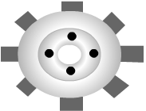
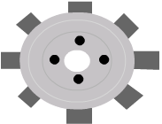


VMware® Fault Tolerance
No Reboot
Seamless Cutover
Provides zero downtime and zero data loss for any VM against failures in physical servers
  Creates a live shadow instance of the primary running on another physical server
  Keeps two instances in virtual lockstep with each other
Fault Tolerance
VMware ESXi
VMware ESX
Operating Server
Failed Server
Shared Storage pool
40
Notes:
VMware Fault Tolerance (FT) provides zero downtime and zero data loss availability for any VM against x86 hardware failures. Enabling fault tolerance for a high-value, high transaction VM enables that workload to run on two different servers simultaneously and allows the VM to run seamlessly in the event of hardware failure on either server.
Key features:
Automatically triggers seamless failover when the protected VMs fail to respond; resulting in zero downtime, zero data loss, and continuous availability
Automatically triggers the creation of a new secondary VM after failover to ensure continuous protection to the application
Compatible with all types of shared storage, for example, Fibre Channel, NAS, or iSCSI
Compatibility with all OSs supported with VMware ESX
VMware FT, when enabled for a VM, creates a live shadow instance of the primary VM, running on another physical server. The two instances are kept in virtual lockstep with each other using VMware vLockstep technology. vLockstep logs event executions by the primary VM and transmits them over a Gigabit Ethernet network to the secondary VM. The two VMs constantly heartbeat against each other. If the primary VM instance loses the heartbeat, the other takes over immediately. The heartbeats run at millisecond intervals, making the failover instantaneous and with no loss of data or state.
Copyright © 2011 EMC Corporation. Do not Copy - All Rights Reserved.

Slide 41















VMware® vMotion
Migrates VMs running any OS across any type of hardware and storage
  VMs can be migrated across different versions and generations of hardware
  Allows multiple concurrent migrations
  Allows faster and reliable recovery of VMs in the event of server failure
VMware vMotion
VMware ESX/ESXi
VMware ESX/ESXi
x86 Architecture
x86 Architecture
CPU
NIC Card
Memory
Hard Disk
CPU
NIC Card
Memory
Hard Disk
Shared Storage pool
41
Notes:
VMware vMotion enables live migration of VMs with zero downtime to the end-users. vMotion is capable of migrating VMs running any OS across any type of hardware and storage supported by VMware ESX. It supports VM migration across different versions and generations of hardware, thus helping users to migrate VMs from older servers to newer servers without disruption or downtime.
Other key features of vMotion include:
Multiple concurrent migrations to continuously optimize VM placement across the entire VDC environment.
VMware DRS underpinning, which continuously monitors the pooled resources of many servers. It also intelligently allocates available resources among VMs based on pre-defined rules that reflect business needs and changing priorities.
Faster and reliable recovery of VMs in the event of a server failure.
Copyright © 2011 EMC Corporation. Do not Copy - All Rights Reserved.

Slide 42
VMware® Storage vMotion
Enables live migration of VM disk files across storage arrays
  Relocation of VM disk files between and across shared storage locations
  Zero downtime with complete transaction integrity
  Complete OS and hardware independence
VMware ESX/ESXi
Source
Destination
Storage vMotion
42
Notes:
Storage vMotion allows the files that encapsulate a VM to be migrated from one storage location to another while the VM is powered on. This type of migration does not move the VM to another server. Storage vMotion enables live migration of VM disk files across storage arrays. It allows relocation of VM disk files between and across shared storage locations while maintaining continuous service availability and complete transaction integrity.
Key features of Storage vMotion include:
Zero downtime migrations with complete transaction integrity
Complete OS and hardware independence that allows Storage vMotion to migrate the disk files of VM running any supported OS on any supported server hardware
Broad support for live migration of VM disk files across any Fibre Channel SAN, iSCSI SAN, and NFS storage system supported by vSphere
Copyright © 2011 EMC Corporation. Do not Copy - All Rights Reserved.

Slide 43








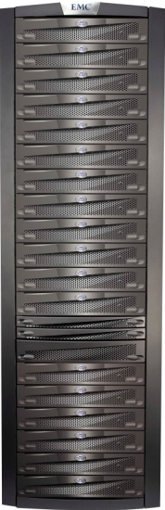
EMC Avamar
VMware ESX/ESXi Server
Is a deduplication and backup software and system
Avamar VE offers optimized solutions for protecting VMware environments
  Backups at guest OS as well as VM image-level
  Single-step recovery of individual files or complete VMDK images to the original VM or a new VM
Global source side deduplication at sub-file level
  Across sites and servers (physical as well as virtual)
  Reduces network bandwidth for backup by 99%
Employs RAIN architecture for high availability and reliability
VMware ESXi
x86 Architecture
NIC Card
CPU
Memory
Hard Disk
VMware ESX/EXSi Server
= Avamar Agent
EMC Avamar Data Store
43
Notes:
EMC Avamar is a deduplication backup software and system, designed to provide support for both CDC as well as VDC environments.
Avamar Virtual Edition offers optimized solutions for protecting VMware environments. For virtualized environments, flexible backup options include guest OS level and image level backups leveraging the latest VMware vStorage services for Data Protection. Avamar deduplicates the data stored within the Virtual Machine Disk (VMDK) image files, enabling efficient replication and DR. For image-level backup, Avamar maximizes throughput by load balancing across multiple proxy VMs. Avamar provides fast, single-step recovery of individual files or complete VMDK images to the original VM or to a new VM.
Other key features of Avamar include:
Data is deduplicated at the source before transferring across the network, thereby reducing network bandwidth for backup by 99%. Backups can be performed securely over LAN/WAN using encryption at-rest or in-flight
Employs sub-file level deduplication technology to achieve a very high degree of deduplication rate. Avamar also offers global deduplication across sites and servers (both physical and virtual), which can reduce total backup storage requirements by up to 95%
Employs RAIN architecture for high availability and reliability
Allows integration with Data Domain Systems for application-specific backups
Copyright © 2011 EMC Corporation. Do not Copy - All Rights Reserved.

Slide 44
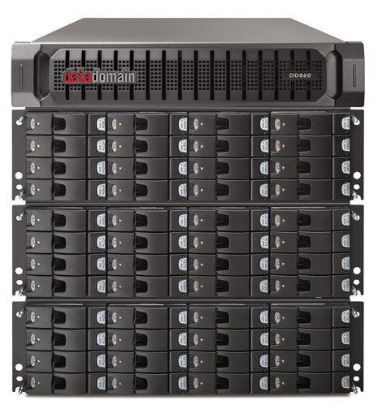
EMC Data Domain
A target based deduplication and storage solution
Addresses the challenge of extra storage and backup resources in VMware based virtualized environments
  Accelerates VMware backups by 90%
Offers consolidation of server backup and archive data to a single storage system for optimized virtualization
  Reduces redundant data across VMware data backups
Provides cost-effective bi-directional replication for DR
44
Notes:
EMC Data Domain (DD) offers deduplicated storage solution to address the challenge of reducing redundant data across backups. DD offers consolidation of server backup and archive data to a single storage system for fully-optimized virtualization. The target based deduplication feature of DD enables massive data reduction for longer retention and tape-free DR.
Other key features of EMC Data Domain for VMware based VDC environment include:
Accelerates VMware backups by 90%
Provides cost-effective replication for faster DR
Slashes VMware backup storage capacity requirements
Provides advanced VM and application-level consistent backup
Provides central management of backup and recovery for remote sites worldwide
Provides cost-effective bi-directional replication for DR using its Replicator software
Copyright © 2011 EMC Corporation. Do not Copy - All Rights Reserved.

Slide 45
Module 7: Summary
Key points covered in this module:
Elimination of single point of failures in a VDC
Backup, replication, migration, and restoration of VMs in a VDC environment
Site failover consideration and strategies for BC and DR
Virtualization benefits and considerations for business continuity
Virtualization impact on fault tolerance and RTO
45
Notes:
This module covered VDC Business Continuity (BC) solutions involving disaster recovery, high availability, and infrastructure backup. Elimination of single point of failures in various VDC infrastructure components is a key consideration for achieving BC in a VDC environment. Backup, replication, migration, and restoration of VMs are critical capabilities in order to achieve effective BC and disaster recovery. Together with VDC site failover strategies need to be designed and put in place in advance for handling disasters or serious outages. Virtualization simplifies BC operations and adds new challenges in terms of increased storage capacity requirements and reduced compute availability. Virtualization technologies enable more comprehensive fault tolerance and shorter RTOs for VM failover and recovery.
Copyright © 2011 EMC Corporation. Do not Copy - All Rights Reserved.

Slide 46
Check Your Knowledge
Which technique is used for protecting against connection loss for a VM due to a physical NIC failure?
What is the key disadvantage of an Image based backup of a VM?
What are the two methods of VM replication?
What are the different modes of VM migration across servers?
What are the key challenges in VM failover in a VDC?
List the VM characteristics that are helpful in BC planning and implementation.
46
Notes:
Copyright © 2011 EMC Corporation. Do not Copy - All Rights Reserved.

Slide 47
Exercise on BC in VDC – Scenario
An organization has more than 50 physical servers and over 100 TB of critical data to protect
Challenges
  Backup windows are difficult to meet
  Recoveries are slow and resource intensive
The organization has decided to adopt virtualization technology in their data center and redesign their infrastructure in order to
  Run around 500 virtual servers without increasing the physical server count
  Implement consistent standards and processes
  Improve disaster recovery capabilities with short RPO targets
  Improve speed and reliability of backups and restores
47
Notes:
An organization has around 50 physical servers currently running and over 100 TB of critical data to protect. There are a number of challenges impacting the effective management of backup and recovery processes. In particular, backup windows are difficult to meet and recoveries are slow and resource intensive.
As a strategic move, the organization has planned to adopt virtualization technology in their data center and redesign their infrastructure so that they are able to run around 500 virtual servers without increasing the physical server count as their operations expand and need support for increasing storage capacity requirements.
The organization has defined key goals for its new virtualized data center infrastructure including implementing consistent standards and processes; improving disaster recovery capabilities with short RPO targets; and improving speed and reliability of backups and restores.
Copyright © 2011 EMC Corporation. Do not Copy - All Rights Reserved.

Slide 48
Exercise on BC in VDC – Tasks
Suggest suitable option(s) to deal with the following requirements
  An ability to survive disasters at the primary data center with minimal RTO
  Consistent and standardized deployment of virtual machines across data center
  An ability to survive failure in a physical server while meeting reduced RPO requirements using limited storage
  Optimized network bandwidth as well as storage capacity requirements for backups
48
Notes:
Copyright © 2011 EMC Corporation. Do not Copy - All Rights Reserved.

Slide 49
Module 7 quiz
49

Slide 50
This slide intentionally left blank.

