Slide 1
1702CS704 – CLOUD COMPUTING
Prof J. Noorul Ameen M.E,(Ph.D), EMCAA, MISTE, D.Acu.,
Assistant Professor/CSE
E.G.S Pillay Engineering College, Nagapattinam
9150132532
noornilo@gmail.com
Profameencse.weebly.com

Slide 2
Course Outcomes
At the end of this course students can able to
CO1: Understand the differences between traditional
and Cloud deployment
CO2: Understand technical and business viability of
migrating existing applications to cloud
CO3: Deploy cloud applications on AWS and Azure
CO4: Design and build cloud based applications
CO5: Design scalable cloud environment for elastic demands

Slide 3
UNIT 5 – SPECIALIZED CLOUD ARCHITECTURE
Workload Distribution Architecture
Dynamic Scalability
Cloud Bursting
Hypervisor Clustering
Service Quality Metrics & SLA.

Slide 4
Workload Distribution Architecture
IT resources can be horizontally scaled via the addition of one or more identical IT resources, and a load balancer that provides runtime logic capable of evenly distributing the workload among the available IT resources .
The resulting workload distribution architecture reduces both IT resource over-utilization and under-utilization to an extent dependent upon the sophistication of the load balancing algorithms and runtime logic.

Slide 5
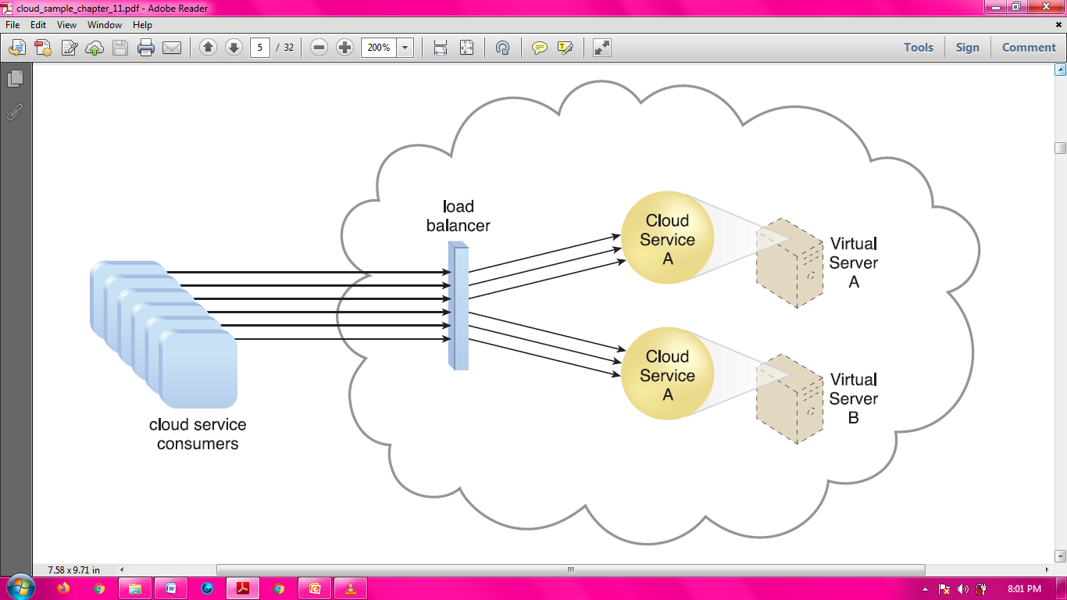
Fig: Workload
Distribution
Architecture
A redundant copy of Cloud Service A is implemented on Virtual Server B. The load balancer intercepts cloud service consumer requests and directs them to both Virtual Servers A and B to ensure even workload distribution.

Slide 6
This fundamental architectural model can be applied to any IT resource, with workload distribution commonly carried out in support of distributed virtual servers, cloud storage devices, and cloud services.
In addition to the base load balancer mechanism, and the virtual server and cloud storage device mechanisms to which load balancing can be applied, the following mechanisms can also be part of this cloud architecture:
• Audit Monitor – When distributing runtime workloads, the type and geographical location of the IT resources that process the data can determine whether monitoring is necessary to fulfill legal and regulatory requirements.
• Cloud Usage Monitor – Various monitors can be involved to carry out runtime workload tracking and data processing.

Slide 7
• Hypervisor – Workloads between hypervisors and the virtual servers that they host may require distribution.
• Logical Network Perimeter – The logical network perimeter isolates cloud consumer network boundaries in relation to how and where workloads are distributed.
• Resource Cluster – Clustered IT resources in active/active mode are commonly used to support workload balancing between different cluster nodes.
• Resource Replication – This mechanism can generate new instances of virtualized IT resources in response to runtime workload distribution demands.

Slide 8
Dynamic Scalability Architecture
The dynamic scalability architecture is an architectural model based on a system of predefined scaling conditions that trigger the dynamic allocation of IT resources from resource pools.
Dynamic allocation enables variable utilization as dictated by usage demand fluctuations, since unnecessary IT resources are efficiently reclaimed without requiring manual interaction.
The automated scaling listener is configured with workload thresholds that dictate when new IT resources need to be added to the workload processing.
This mechanism can be provided with logic that determines how many additional IT resources can be dynamically provided, based on the terms of a given cloud consumer’s provisioning contract.

Slide 9
The following types of dynamic scaling are commonly used:
• Dynamic Horizontal Scaling – IT resource instances are scaled out and in to handle fluctuating workloads.
The automatic scaling listener monitors requests and signals resource replication to initiate IT resource duplication, as per requirements and permissions.
• Dynamic Vertical Scaling – IT resource instances are scaled up and down when there is a need to adjust the processing capacity of a single IT resource.
For example, a virtual server that is being overloaded can have its memory dynamically increased or it may have a processing core added.
• Dynamic Relocation – The IT resource is relocated to a host with more capacity.
For example, a database may need to be moved from a tape-based SAN storage device with 4 GB per second I/O capacity to another disk-based SAN storage device with 8 GB per second I/O capacity.

Slide 10
Fig: Cloud service consumers are sending requests to a cloud service (1).
The automated scaling listener monitors the cloud service to determine if predefined capacity thresholds are being exceeded (2).

Slide 11
Fig: The number of requests coming from cloud service consumers increases (3).
The workload exceeds the performance thresholds. The automated scaling listener determines the next course of action based on a predefined scaling policy (4).
If the cloud service implementation is deemed eligible for additional scaling, the automated scaling listener initiates the scaling process (5).

Slide 12
Fig: The automated scaling listener sends a signal to the resource replication mechanism (6), which creates more instances of the cloud service (7).
Now that the increased workload has been accommodated, the automated scaling listener resumes monitoring and detracting and adding IT resources, as required (8).

Slide 13
The dynamic scalability architecture can be applied to a range of IT resources, including virtual servers and cloud storage devices.
Besides the core automated scaling listener and resource replication mechanisms, the following mechanisms can also be used in this form of cloud architecture:
• Cloud Usage Monitor – Specialized cloud usage monitors can track runtime usage in response to dynamic fluctuations caused by this architecture.
• Hypervisor – The hypervisor is invoked by a dynamic scalability system to create or remove virtual server instances, or to be scaled itself.
• Pay-Per-Use Monitor – The pay-per-use monitor is engaged to collect usage cost information in response to the scaling of IT resources.

Slide 14
Cloud Bursting Architecture
The cloud bursting architecture establishes a form of dynamic scaling that scales or “bursts out” on-premise IT resources into a cloud whenever predefined capacity thresholds have been reached.
The corresponding cloud-based IT resources are redundantly pre-deployed but remain inactive until cloud bursting occurs.
After they are no longer required, the cloud-based IT resources are released and the architecture “bursts in” back to the on-premise environment.
Cloud bursting is a flexible scaling architecture that provides cloud consumers with the option of using cloud based IT resources only to meet higher usage demands.
The foundation of this architectural model is based on the automated scaling listener and resource replication mechanisms.

Slide 15
Fig: An automated scaling listener monitors the usage of on-premise Service A, and redirects Service Consumer C’s request to Service A’s redundant implementation in the cloud (Cloud Service A) once Service A’s usage threshold has been exceeded (1).
A resource replication system is used to keep state management databases synchronized (2).

Slide 16
The automated scaling listener determines when to redirect requests to cloud-based IT resources, and resource replication is used to maintain synchronicity between on premise and cloud-based IT resources in relation to state information.

Slide 17
Hypervisor Clustering Architecture
The hypervisor clustering architecture establishes a high-availability cluster of hypervisors across multiple physical servers.
The hypervisor cluster is controlled via a central VIM, which sends regular heartbeat messages to the hypervisors to confirm that they are up and running.
The hypervisor cluster uses a shared cloud device to live-migrate virtual servers.

Slide 18
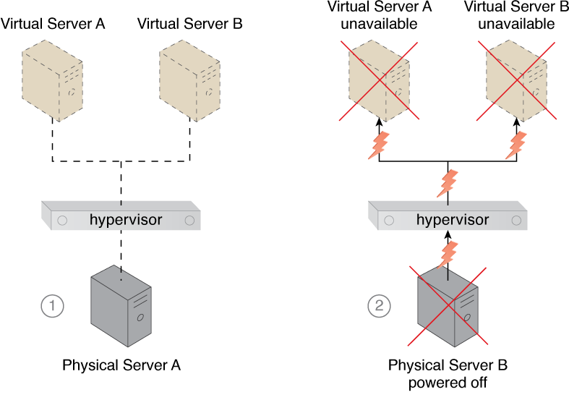
Fig: Physical Server 1 is hosting a hypervisor that hosts Virtual Servers 1 and 2 (1).
When Physical Server 1 fails, the hypervisor and two virtual servers consequently fail as well (2).

Slide 19
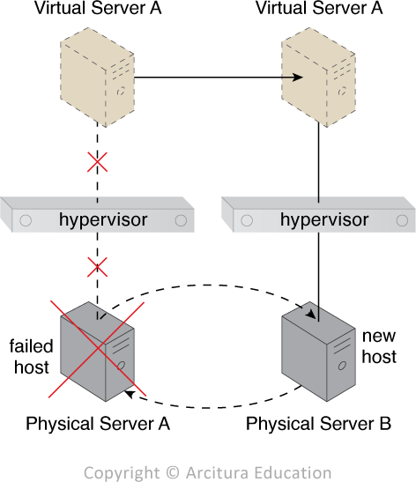
Fig: Physical Server 1 becomes unavailable and causes its hypervisor to fail.
Virtual Server 1 can be migrated to a different host named Physical Server 2, which has another hypervisor that is part of the cluster to which Physical Server 1 belongs.

Slide 20
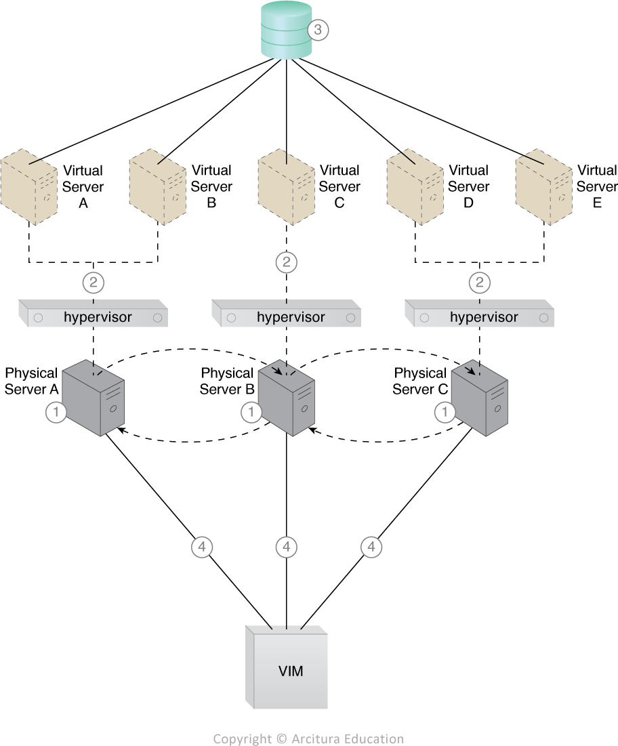
Fig: Hypervisors are installed on Physical Servers 1, 2, and 3 (1).
Virtual servers are created by the hypervisors (2).
A shared cloud storage device containing virtual server configuration files is positioned for accessibility by all hypervisors (3).
The hypervisor cluster is enabled on the three physical server hosts via a central VIM (4).

Slide 21
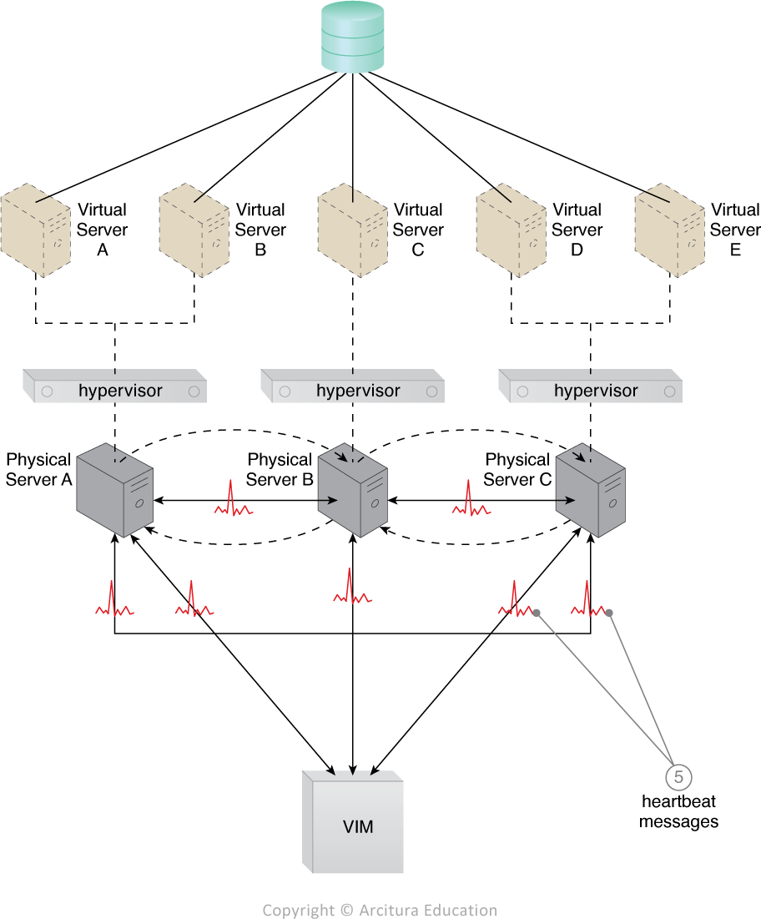
Fig: The physical servers exchange heartbeat messages with one another and the VIM according to a pre-defined schedule (5).

Slide 22
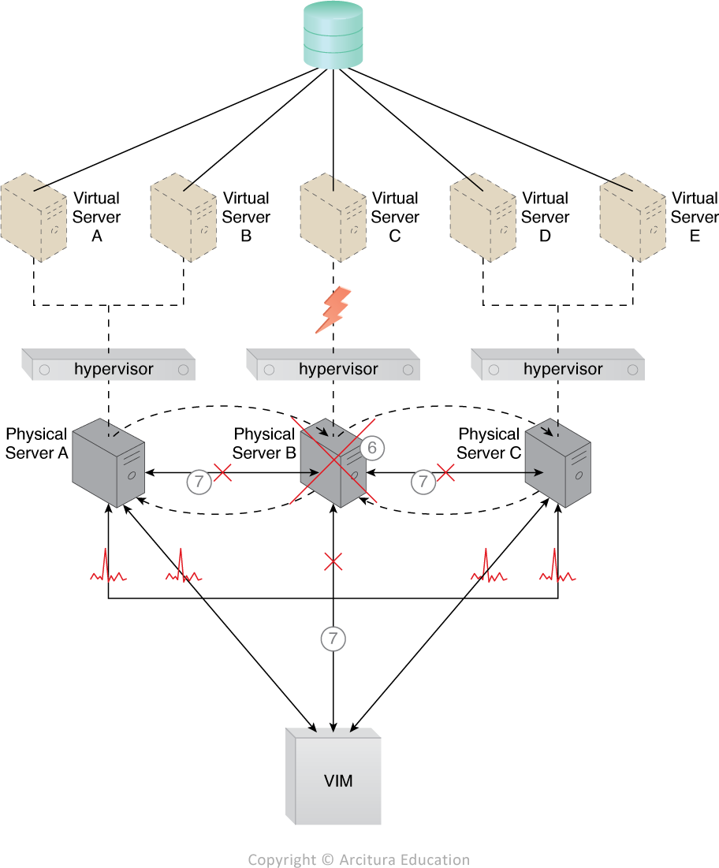
Fig :Physical Server 2 fails and becomes unavailable, jeopardizing Virtual Server C (1).
The other physical servers and the VIM stop receiving heartbeat messages from Physical Server 2 (2).

Slide 23
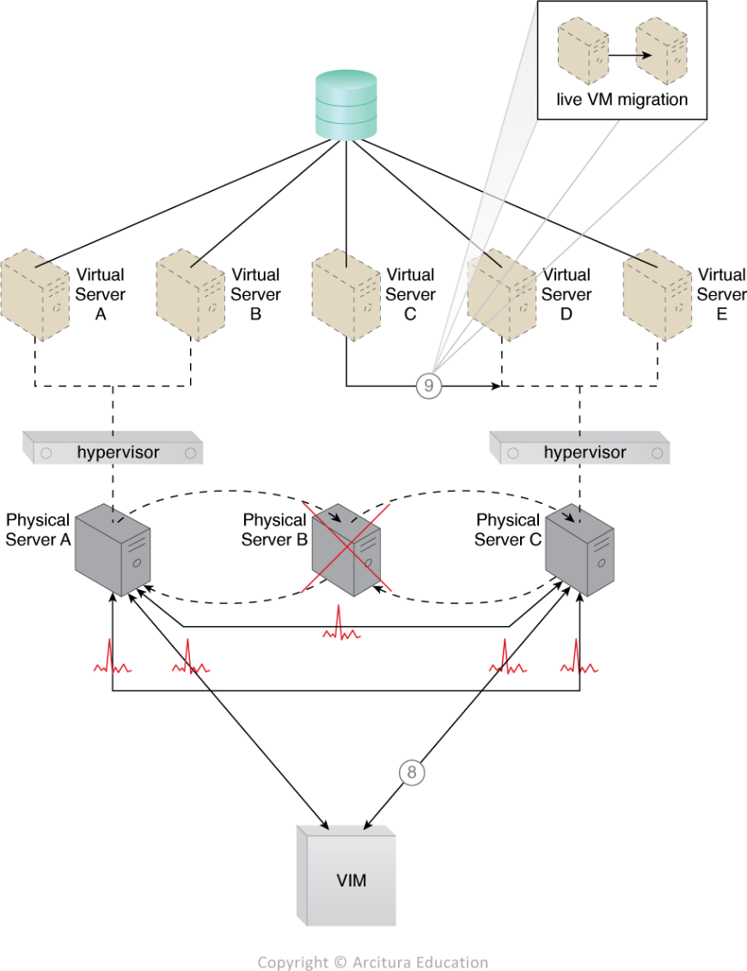
Fig: The VIM chooses Physical Server 3 as the new host to take ownership of Virtual Server C after assessing the available capacity of other hypervisors in the cluster (3).
Virtual Server C is live-migrated to the hypervisor running on Physical Server 3, where restarting may be necessary before normal operations can be resumed (4).

Slide 24
Service Quality Metrics & SLA
Service-level agreements (SLAs) are a focal point of negotiations, contract terms, legal obligations, and runtime metrics and measurements.
SLAs formalize the guarantees put forth by cloud providers, and correspondingly influence or determine the pricing models and payment terms.
SLAs set cloud consumer expectations and are integral to how organizations build business automation around the utilization of cloud-based IT resources.

Slide 25
The guarantees made by a cloud provider to a cloud consumer are often carried forward, in that the same guarantees are made by the cloud consumer organization to its clients, business partners, or whomever will be relying on the services and solutions hosted by the cloud provider.
It is therefore crucial for SLAs and related service quality metrics to be understood and aligned in support of the cloud consumer’s business requirements, while also ensuring that the guarantees can, in fact, be realistically fulfilled consistently and reliably by the cloud provider.
The latter consideration is especially relevant for cloud providers that host shared IT resources for high volumes of cloud consumers, each of which will have been issued its own SLA guarantees.

Slide 26
SERVICE QUALITY METRICS: SLAs issued by cloud providers are human-readable documents that describe quality-of-service (QoS) features, guarantees, and limitations of one or more cloud-based IT resources.
SLAs use service quality metrics to express measurable QoS characteristics.
For example:
• Availability – Up-time, outages, service duration
• Reliability – Minimum time between failures, guaranteed rate of successful responses
• Performance – Capacity, response time, and delivery time guarantees
• Scalability – Capacity fluctuation and responsiveness guarantees
• Resiliency – Mean-time to switchover and recovery SLA management systems use these metrics to perform periodic measurements that verify compliance with SLA guarantees, in addition to collecting SLA-related data for various types of statistical analysis.

Slide 27
Each service quality metric is ideally defined using some of the characteristics such as:
• Quantifiable – The unit of measure is clearly set, absolute, and appropriate so that the metric can be based on quantitative measurements.
• Repeatable – The methods of measuring the metric need to yield identical results when repeated under identical conditions.
• Comparable – The units of measure used by a metric need to be standardized and comparable.

