Slide 1
ESTABLISHING PRIVATE CLOUD USING BARE METAL HYPERVISOR VMWARE ESXI SERVER
Prof J. Noorul Ameen M.E,(Ph.D), EMCAA, MISTE, D.Acu, (M.D(Acu)).,
Assistant Professor/CSE
E.G.S Pillay Engineering College, Nagapattinam
9150132532
noornilo@gmail.com
Profameencse.weebly.com

Slide 2
VMware HOL Lab
VMware Hands-on Labs provide a quick and easy way to access VMware products and solutions, testing use cases and learning about the latest features with no installation required.
Virtualization 101:
This introductory lab demonstrates the core features and functions of vSphere and vCenter.
This is an excellent place to begin your experience with VMware vSphere.
This lab is divided into 3 modules:
Introduction to Management with vCenter Server
Introduction to vSphere Networking And Security
Introduction to vSphere Storage

Slide 3
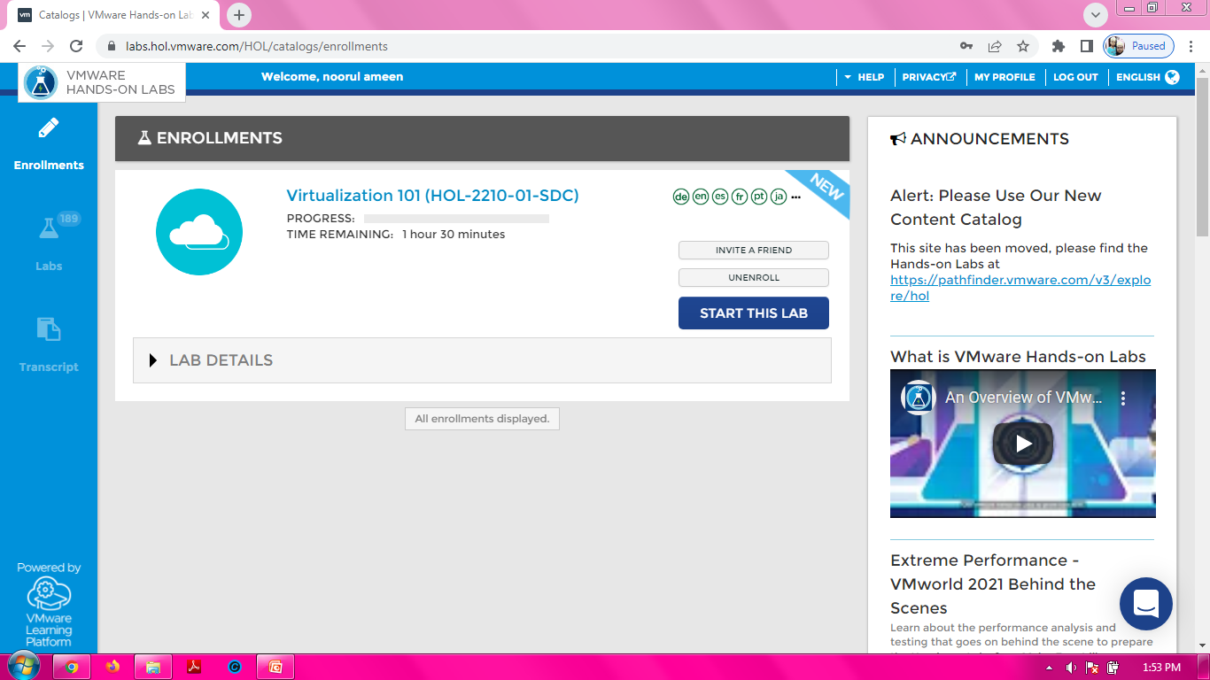

Slide 4
HANDS-ON LABS INTERACTIVE SIMULATION: ESXI INSTALLATION AND CONFIGURATION:
This will allow you to experience steps which are too time-consuming or resource intensive to do live in the lab environment.
In this simulation, you can use the software interface as if you are interacting with a live environment.

Slide 5
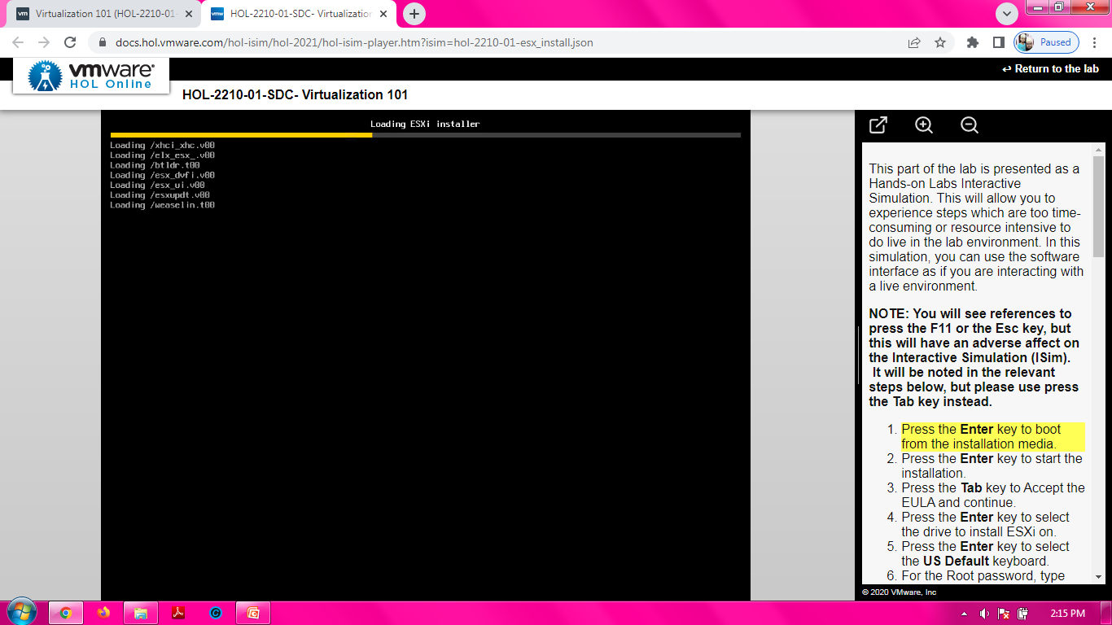

Slide 6
